Slide 1
Education of Homeless Children and Youth
PURSUANT TO: McKinney-Vento Homeless Assistance Act of 2001
Title IX, Part A of Every Student Succeeds Act (ESSA)
FUNDED BY: U.S. DEPARTMENT OF EDUCATION, OFFICE OF ELEMENTARY AND SECONDARY EDUCATION
Application Information Webinar
April 8, 2025

Slide 2

History, Legislation and Current Events – What?
McKinney-Vento Homeless Assistance Act is the primary piece of federal legislation related to the education of students experiencing homelessness
Subtitle VI Part B authorizes the Education of Homeless Children and Youth Program
Reauthorized December 2015 with Every Student Succeeds Act, Title IX, Part B.
Requires an act of congress to change

Slide 3
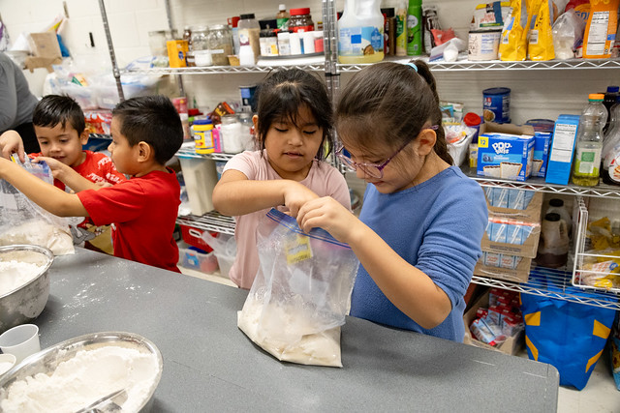
Definition of Homelessness
Under McKinney-Vento, the term “homeless” children and youth means:
Children who lack a fixed, regular, and adequate nighttime residence.
3

Slide 4

Unaccompanied Homeless Youth
Unaccompanied homeless youth are young people who lack safe, stable housing and who are not in the care of a parent or guardian
They live in a variety of temporary situations, including shelters, the homes of friends or relatives, cars, campgrounds, public parks, abandoned buildings, motels, and bus or train stations

Slide 5
Educational Rights of McKinney-Vento Students
Educational Rights of Students Experiencing Homelessness Birth – 12th Grade
Access to a McKinney-Vento Homeless Educational Liaison in their school district
Identification through outreach and coordination activities
Immediate enrollment with full and equal opportunity to succeed in school
Choice between the neighborhood school or the school of origin (school last enrolled in or attended)
Transportation to the school of origin (including preschool)
Immediate access to free school meals and educational services for which they are eligible
Automatic eligibility for Title I, Part A of the Every Student Succeeds Act of 2015
Referrals to health care, dental, mental health and substance abuse, housing, and other appropriate services
Unaccompanied youth are informed of their status as independent students on the Free Application for Federal Student Aid (FAFSA)
Notes:
Local educational agencies (LEAs) or school districts are instrumental in ensuring that the rights and services guaranteed in the McKinney-Vento Act are implemented throughout the school district. All LEAs must follow the requirements of the McKinney-Vento Act,

Slide 6

Local Liaison Responsibilities
  identifying eligible students
  expedite enrollment
  access to free school meals
  make referrals to other school and community resources
  inform families and students of their rights under the law

Slide 7
Start Here
Identification of Strengths and Gaps
Attachment A: Needs Assessment Worksheet and Summary
Attachment B: Liaison Capacity Assessment (Recommended, not required)

Slide 8
Purpose of EHCY Grant Program – Why?
Improve identification, enrollment and success in school
Review and revise regulations, practices or polices that may act as barriers to enrollment, attendance, or success of homeless children and youth including preschool
Provide school stability
Engagement of parents, family and caregivers in understanding the rights of their children
Connect to services without stigmatization
Promote graduation, completion and postsecondary options
Collaborate and coordinate with community and government agencies to serve students experiencing homelessness
Notes:
What is the why?

Slide 9
Intent of the 2025-2028 EHCY Grant Program – How?
Increase access to school and school activities, offer the opportunity for greater stability and engagement in school, and provide wraparound services to offset the barriers created by housing instability and homelessness.
Strategies, activities and performance measures will be framed around the following focus areas:
Attendance
School Stability
School Day Engagement
Academic Progress
Notes:
Successful applicants will explain how they plan to …. Using strategies related to attendance, stability, engagement and academic advancement

Slide 10
Eligible Applicants – Who?
LEAs are eligible to apply for this opportunity. An eligible LEA is:
A School District;
Consortia of school districts including but not limited to a Board of Cooperative Services (BOCES);
The Charter School Institute or consortia of Charter Schools
A Charter school authorized by the Charter School Institute or a public school district, pursuant to part 5 of article 30.5 of title 22, C.R.S;

Slide 11
Priority Considerations
New applicants that have not been funded in the last three years qualify for four (4) additional points.
The state-level team will consider the following and award up to four (4) additional points for past performance. One point for each past performance consideration.
Completion of EHCY program monitoring and findings have been resolved (1 point)
Ongoing formally communicated program or fiscal concerns were resolved (1 point)
Appropriate expenditure of grant funding on a timely basis (1 point)
Attended and participated in all mandatory in person professional development and training (1 point)

Slide 12
Priority Considerations
Up to ten (10) additional points may be awarded to applicants who describe deliberate partnership with Title I, including:
Documentation of the determination of set-asides
A clear plan for the use of Title IA set-asides in alignment with demonstrated needs and gaps
A documented history of expenditure of Title IA set-asides on services and support for homeless students.
These points will be awarded in the rubric and confirmation of set-asides and expenditure of set-asides will be confirmed at the state level.

Slide 13
Distribution of funds is based on…
Demonstrated need
Assessment of current EHCY programming at the LEA level through Attachment A: Needs Assessment Worksheet and alignment of strengths and challenges with performance measures and activities of the grant
Internal and external collaboration, partnerships and leveraging of resources as determined through:
Clarity of strategy alignment with performance measures and budget expenditures
Notes:
Number and percentages of students experiencing homelessness and those receiving services
Articulated gaps in services and opportunities for growth
Title IA set-aside amounts and drawdowns of available set-asides. Confirmed at the state level in partnership with the federal programs team.
At least a 50% match for funds used on basic need items as articulated through the budget workbook and Attachment D: Funding Chart.
Internal and external collaboration in alignment with strategies and performance measures

Slide 14
Available Funds and Duration of the Grant
Approximately $950,000 is available for the 2025-2026 school year, with funding contingent on approval of appropriations from the U.S. Department of Education. CDE anticipates awarding 12 - 15 grants each year for a three-year period
funding per year per subgrantee is $60,000 - $80,000.
Funding in subsequent years is contingent upon continued appropriations
meeting all program, fiscal, reporting and participation requirements.
For the 2025-2028 cohort, applicants will be required to demonstrate at least a 50% match for basic need items purchased with these funds.

Slide 15
Allowable Use of Funds
  McKinney-Vento Subgrant Authorized Activities
  Examples:
Expand or improve services provided through a school’s general academic program. Funds cannot replace existing programs but rather extend or augment to integrate activities and services for homeless and non-homeless students.
Include both direct academic educational services and interventions such as tutoring, as well as services to support social emotional well-being, mental and physical health, family and community partnerships and other services related to a student’s ability to engage and be successful in school.
Establish service delivery processes, procedures and implementation models that support referral and connection to services for students and families experiencing homelessness. Including but not limited to, family resource centers and hiring navigators or points of contact for McKinney-Vento students.

Slide 16
Evaluation and Reporting
1) Monitoring Requirement
Subgrantees will participate in a minimum of one on-site monitoring visit by CDE staff within the three-year grant cycle. Subgrantees may also be subject to a visit by the U.S. Department of Education.
See Appendix B: Monitoring for a copy of the monitoring tool used by the CDE. The monitoring tool can also be found on the Monitoring and Compliance CDE webpage. Please note additional interview questions may be included as part of the monitoring visit.

Slide 17
Evaluation and Reporting
2) End-of-Year Reporting
Subgrantees are required to submit an annual end-of-year report to CDE. The first report will be due in July 2026. The purpose is to evaluate annual progress on performance measures and to share program successes and challenges. Continued funding for the second and third year is assessed based upon marked progress on performance measures via the annual end-of-year report, and future budget appropriation.
The information reported to CDE in relation to grant activities is not confidential and is subject to public requests. subgrantees should ensure reported information does not contain Personally Identifiable Information (PII) or confidential information.
A template for the EHCY Subgrantee End-of-Year Report will be sent to awarded subgrantees with their Grant Award Letters.
Notes:
Participation in the required CDE Learning Cohorts will offer support in marking progress on your end-of-year reporting requirements.

Slide 18
Evaluation and Reporting
3) Financial Reporting
Subgrantees will complete an annual financial report (AFR) for each year of the grant cycle. The first AFR will be due September 30, 2026. A detailed general ledger must be submitted with the AFR to check budget to actuals.
In addition, CDE reserves the right to request a fiscal meeting with the subgrantee based on regularly monitored spenddown reports.
If the subgrantee does not meet the requirement of at least quarterly draw downs, CDE may ask for a detailed spend down plan with authorized signatures and could terminate the grant based on failure to spend funds.

Slide 19
Required Elements
Part I: Applicant Information
Application Contacts
Executive Summary
Part II: Demonstration of Support, Program Assurances and CDE Learning Cohort Assurances (Required Document Upload)
IIA: Demonstration of Support
IIB Program Assurances Form
IIC: Learning Cohort Assurances
Part III: Application Narrative
Section A: Demographics and Need
Section B: Stakeholders, Collaborations & Capacity
Section C: Performance Measures and Evaluation
Section D: Program Design and Implementation
Section E: Budget and Budget Narrative
Attachment D: Funding Chart

Slide 20
Other Uploads:
Attachment A: Needs Assessment Worksheet and Summary
Attachment B: Liaison Capacity Assessment (Recommended, not required)
Attachment C: Performance Measure Worksheet

Slide 21
Required Professional Development
To support successful implementation and marked progress towards performance measures, awarded grantees will be required to participate in one Colorado Département of Education (CDE) Learning cohorts each year of the grant.
These CDE learning cohorts will be designed specifically for grantees of the Education of Homeless Children and Youth grant and the Educational Stability Grant.

Slide 22
Required Professional Development
Selected topics of the CDE Learning Cohorts will focus on increasing student engagement and accelerated student outcomes.
Topics may include but are not limited to Chronic Absenteeism, Evidenced Based Social Emotional Learning Strategies, Credit Accrual Strategies and supporting transitions of highly mobile youth, Policy and Practices review, and additional strategies for dropout prevention and student re-engagement.
A required component of the application includes a signed assurance form articulating commitment to participation in these cohorts as a condition of funding. Completion of this assurance form will be scored as part of the rubric.

Slide 23
Why Learning Cohorts?
The purpose of a Learning Cohort is to drive systems change and shift adult behavior in order to positively impact student outcomes.
Notes:
A learning cohort is a learning community of school and district leaders (individuals and teams) that meet monthly during the school year to intentionally focus on a common educational challenge to lead systems change. For this pilot cohort for grantees, all activities will be driven by grantee-determined performance measures, feedback from grantees, and strategy implementation to meet goals.
The DISO Team facilitates group discussion and problem solving, leads site visits to highlight bright spots, and supports goal setting and progress monitoring of goals. The team partners with CDE experts to enhance participant understanding of content and the state context.

Slide 24
What can participants expect?
Learning community of school and district leaders
Meet monthly during the school year
Intentionally focus on a common educational challenge
Lead systems change
Protocols to enhance problem solving and apply solutions
Notes:
Learning community of school and district leaders → Teams, all subgrantees of EHCY and ESG
Meet monthly during the school year → mix of virtual and in-person
Intentionally focus on a common educational challenge → aligned to the performance measure from your grant application
Lead systems change
Protocols to enhance problem solving and apply solutions

Slide 25
What does DISO provide?
Facilitate group discussion and problem solving, networking within the cohort
Lead site visits to highlight bright spots
Support goal setting and progress monitoring of goals
Partner with CDE experts to enhance participant understanding of content and the state context
Notes:
**Also embedding and aligning the cohort experience to grant reporting, progress monitoring, and other grant requirements as much as possible. We want this cohort to provide you with a community working on similar challenges and know this network, as well as specified cohort meeting times with embedded work time, enhances the work.

Slide 26
Review Process and Timeline
Applications will be reviewed by CDE staff and peer reviewers to ensure they contain all required components.
Applicants will be notified of final award status no later than Friday, June 20, 2025.
Applicants must score at least 122 points out of the 184 possible points in the scored narrative to be approved for funding.
There is no guarantee that submitting an application will result in funding or funding at the requested level.
All award decisions are final.
Notes:
Applications that score below 122 points may be asked to submit revisions that would bring the application up to a fundable level.
Applicants that do not meet the qualifications may reapply for future grant opportunities.

Slide 27
Submission Process and Deadline
Completed applications must be submitted through the GAINS by Wednesday, April 23, 2025, by 4:00pm.
Application materials and resources are available on CDE’s McKinney-Vento Website

Slide 28
GAINS System Training

Slide 29

Covered in this Section…
How to Login to GAINS
How to Locate and Navigate through the Education of Homeless Children and Youth Application (EHCY) in GAINS
Live Application Walkthrough

Slide 30

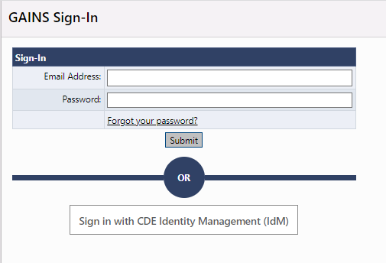
Access GAINS- IdM Users
Step 1 (IdM users): Find the login button on the top right of your screen. Login to the GAINS through the Identity Management System:
Please Note: Charter Schools WILL NOT log in through IdM

Slide 31
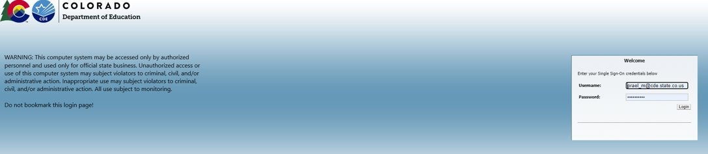
Logging In- IdM
Step 1a: The next page you will see is where you enter your Single Sign-on credentials. The username will be your full email, and the password will align to other CDE logins (i.e. Data Pipeline, the UIP System, etc.)
If your IdM login doesn't work
Contact your district Local Access Manager (LAM) to make sure you have access to the Identity Management System (IdM)
Try the CDE IdM Password Reset
Submit a GAINS Help Desk Ticket

Slide 32
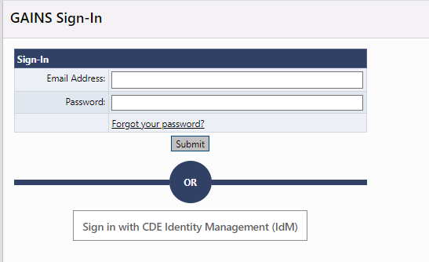
Logging In – Non-IdM Users
Step 1 (Charter Schools/Charter Consortium): Once CDE creates the user in GAINS, the applicant will be notified via email to create a password. Once the password is setup, charter school applicants will access GAINS through the native login.

Slide 33
Access – Non-IdM Users
Charter School/Charter Consortium Applicants, if you haven’t accessed GAINS before, please fill out the Charter School GAINS Application Access Request Form.
  If you have the ALL Funding Applications Director role, you will be able to access the application and complete it, but will not receive application specific notifications.
If you are unsure of your access, you can go to GAINS (without logging in) and search for your organization. Once you click on your organization’s name, the Address Book will appear in the left navigation menu. Click on the Address Book to see who in your organization has access.

Slide 34
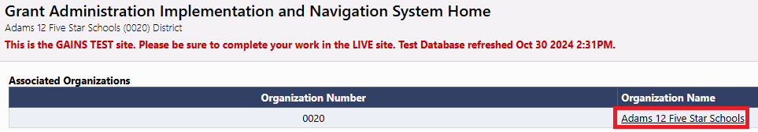
Navigate to Funding Applications
Step 2: Select your Organization's name on the Home page.

Slide 35
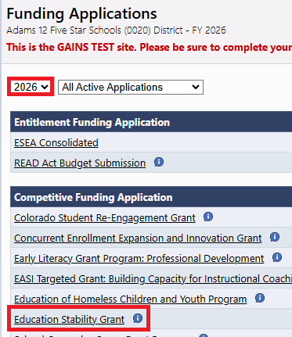
Find the Education of Homeless Children and Youth Application
Step 3a: Select 2026
Step 3b: Select "Education of Homeless Children and Youth ”

Slide 36
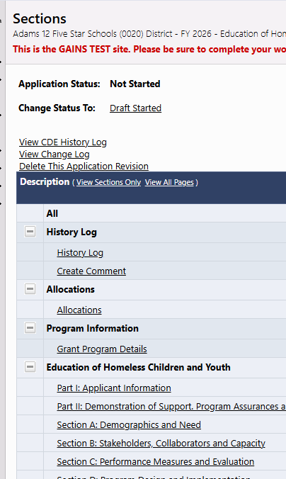
Draft Started
Step 4: Once on the Sections page of the application, be sure to change the application status to “DRAFT STARTED”
  Note: Only certain roles can change the application status. You can hover over the "Draft Started" link to see the individuals and roles in your organization with these permissions.
Please note: The pages won't be editable until the status changes to Draft Started!

Slide 37
Navigating Basics - Sections Overview
The Sections page is your EHCY home page and main navigation center.
From here you can access a number of features related to your application. The following sections are required for submission:
Part I: Applicant Information
Part II: Demonstration of Support, Program Assurances and CDE Learning Cohort Assurances
Section A: Demographics and Need
Section B: Stakeholders, Collaborations, & Capacity
Section C: Performance Measures and Evaluation
Section D: Program Design and Implementation
Section E: Budget Narrative
Budget
Attachment D: Homeless Education Funding Chart

Slide 38
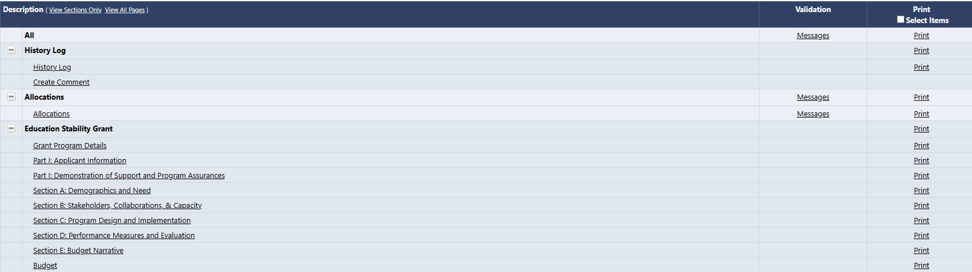
Navigating Basics – Validations
On the Sections page, you will have a Validation column which will let you know when a section has errors that would prevent you from submitting and/or warnings to check before submitting.

Slide 39
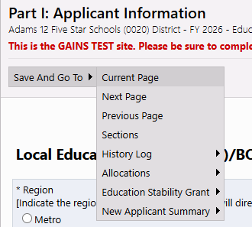
Navigating Basics – Saving your Work
DO NOT USE your browser’s back/forward buttons!
Use the "Save and Go To" feature to move throughout the application.
  "Save and Go To" will save the data entered on the current page. You can select to remain on the current page (to save your data) or you can move to the selected page. This will also result in the current page saving.
  Clicking on "Sections" here will take back to the Home Sections Page
  Be mindful of the timer in the top right-hand corner. If your time is getting low, use the Save and Go To function to save your progress. This will also reset the timer.

Slide 40
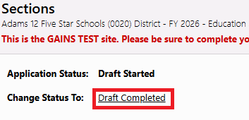
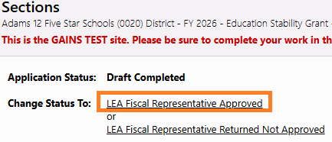
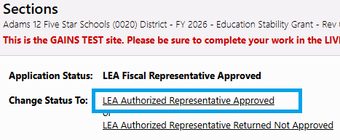
Application Submission
Application are due on April 23, 2025
  Application status must be changed to at least “Draft Completed” on April 23 to be considered for review.
  Applications are considered fully submitted to CDE, and can be considered for final funding determinations, when the status is at "LEA Authorized Representative Approved."

Slide 41
GAINS Demonstration

Slide 42
Additional Support
Office Hours for the System
  Every other Tuesday from 12:30pm to 1:00 pm, hosted by CDE's GAINS Team - Register for Office Hours!
GAINS Small Bites
  The Grants Program Administration (GPA) Office has been working on short recordings for various aspects of GAINS called GAINS Small Bites! Feel free to check out the recordings.
One on One Support
  Please fill out the Help Desk Ticket for assistance!
  In addition, you can always reach out to Jess Hollingshead at Hollingshead_J@cde.state.co.us
  Please note: These support opportunities are specific to the system itself and not the programming. The GPA team will be unable to answer programmatic questions.

Slide 43
  Paula Gumina
  State Coordinator, Education of Homeless Children & Youth
  Highly Mobile Student Programs Manager
  Gumina_p@cde.state.co.us
  303.551.3851

