Slide 1
Intro to School-wide Positive Behavior Support

Slide 2
What is PBIS?
Positive Behavioral Interventions and Support is the science of building effective environments that teach and encourage appropriate behaviors to replace the use of inappropriate behavior.
Prevent
Teach
Reinforce
Antecedent
Behavior
Consequence
Notes:
PBIS is…(read slide)
It’s about teaching desired appropriate behavior.
Behavior doesn’t occur in a vacuum. (Explain behavior chain)
Can modify behavior three ways…prevent it, teach new behavior, reinforce desired behavior

Slide 3
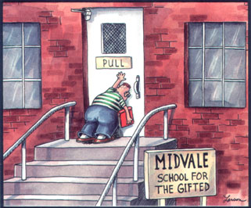
Reason we have to (re)teach…
Notes:
Question comes up why do we have to teach behavior? One is that simply, students need the social skills taught to them.

Slide 4

Reason we have to (re)teach…
Hispanic 1.23
Native American 1.52
African-American 2.84
With Disabilities 2.0
3 times more likely to drop out
More likely to be suspended again
Failure to graduate on-time
Lower academic achievement
Lower school climate ratings
Pre African-American:
18% enrollment, 42% susp.
Pre Caucasian:
43% enrollment, 26% susp.
Notes:
Two, we have used archaic practices that have had damaging results. Use of suspension and expulsion has harmed kids. Yellow box is rates of likelihood of being suspended relative to white students. Students with disabilities are twice as likely to be suspended as students without. Students that are suspended are 3 times more likely to drop out and they are more likely to be suspended again. If they drop out, 3 times more likely to be incarcerated. There’s a very real “school to prison” pipeline.
Schools that use a lot of zero tolerance have more students that fail to graduate on time, lower academic achievement, and lower school ratings.
Use of suspension starts early…preschool students that are African American make up 18% of enrollment, but make up 42% of students that have been suspended at least once. For Caucasian students? It’s 43% enrollment and only 26% suspension (Comes from National Office of Civil Rights)
Boys are two times more likely than girls to be suspended.

Slide 5
Let’s do the math…
One middle school had a reduction of 850 referrals in one year.
Savings in administrative time | Savings in Student Instructional Time
ODR = 15 mins | ODR = 45 mins
850 X 15 = | 850 X 45 =
12, 750 minutes | 38, 250 minutes
212.5 hours | 637.50 hours
26.5 eight-hour days | 106.25 six-hour days
Notes:
Why else to teach? It works.
If an ODR costs 15 minutes of admin time…have them multiple 850 x 15 and then reveal the answer (use animation). Then have them divide by 60 for hours and then divide by 8 for school days
Do same for student time, but divide by 6 for students days.

Slide 6
Positive Behavioral
Interventions and Supports
PBIS:
the science of building effective environments that teach and encourage appropriate behaviors to replace the use of inappropriate behavior.
Schoolwide PBIS:
the application of PBIS to the whole school. Thus, it is a broad range of systemic and individualized strategies for achieving important social and learning outcomes while preventing problem behavior with all students. It is a school discipline and positive school climate model.
Notes:
PBIS is on the slides. Then point out applying it to the whole school is the lower half of the slides.

Slide 7
Schoolwide PBIS is…
A framework
Data driven
Evidence-based
Preventative
Universal and Targeted
Best practice
A culture change
Staff-directed
A continuum of support
Creating effective learning environments by using the “science of behavior”

Slide 8
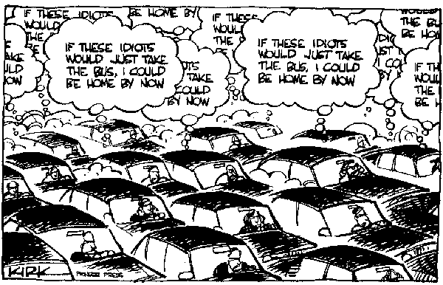
Notes:
It’s about creating a better environment. We may blame everyone who is driving, but it’s the system (bad roads, everyone gets off at the same time, etc)

Slide 9
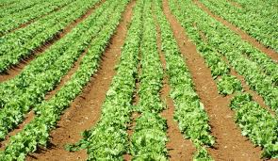
When you plant lettuce, if it does not grow well, you don’t blame the lettuce. You look for reasons it is not doing well. It may need fertilizer, or
more water, or less sun.
You never blame the lettuce.
Thich Nhat Hanh

Slide 10
Problem Behaviors…
Insubordination, noncompliance, defiance, late to class, nonattendance, truancy, fighting, aggression, inappropriate language, social withdrawal, excessive crying, stealing, vandalism, property destruction, tobacco, not ready to learn, drugs, alcohol, failure to turn in homework, bullying, unsafe on bus, minor, repeated minor, unresponsive, teasing, not following directions, disrespectful of authority, contraband, not prepared, inappropriate use of school materials, weapons, harassment, unprepared to learn, parking lot violation, inappropriate use of school property, irresponsible, trespassing, disrespectful, disrupting teaching, uncooperative, violent behavior, disruptive, verbal abuse, physical abuse, dress code, etc
These behaviors exist in all schools.
They vary only by frequency, duration and intensity.
Notes:
PBIS won’t fix all your problems, but it will help reduce them. All schools can benefit

Slide 11


Slide 12


Intensive individualized support provided to 3-5% of students.
Targeted group support provided to 10-15%
of students.
Universal instruction and support is provided to all students. At least 80% of students’ needs are met through this level of support.
Notes:
Walk through each piece of the triangle. It’s about layering on supports. The slide animates to show you layer on, not supplant

Slide 13
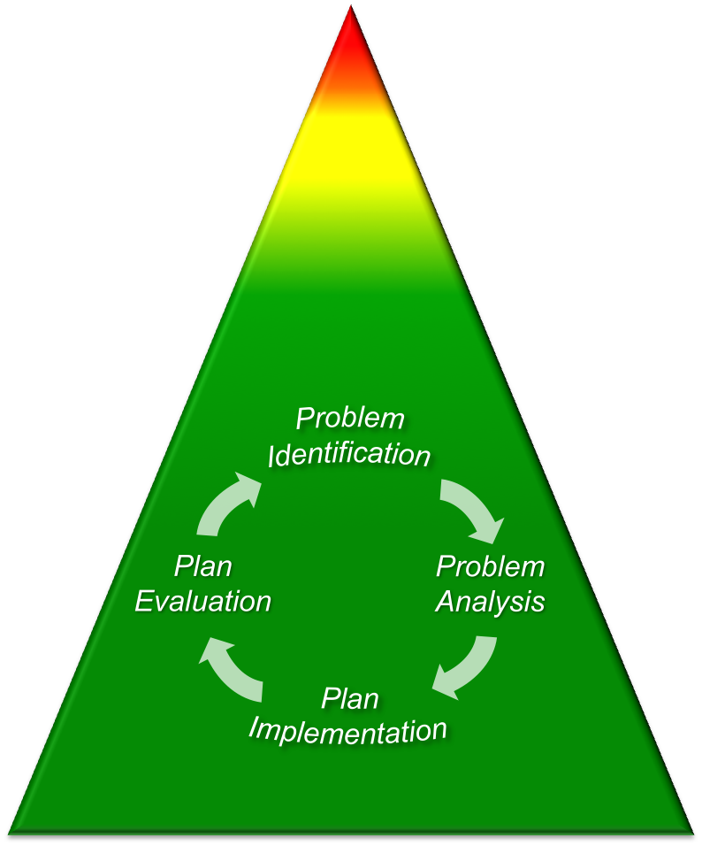
Intensive individualized support provided to 3-5% of students.
Targeted group support provided to 10-15%
of students.
Universal instruction and support is provided to all students. At least 80% of students’ needs are met through this level of support.
Use of the Problem Solving Model
Intensity of Services
Comprehensive Behavioral Services
Notes:
Discuss how it’s about

Slide 14
Tier 3 – (Intensive) Processes and procedures reflect school-wide expectations coupled with team-based strategies to address problematic behaviors of individual student
Tier 3: Intensive Behavior Intervention Plans offered following FBA.
Tier 2: Homework Club or Study Skills Intervention offered to students with escape-maintained behaviors. Check In/Check Out used for students who have attention-motivated behaviors and have trouble with disruption.
Tier 2 – (Supplemental) Processes and procedures designed reflect school-wide expectations and address behavioral issues of groups of students with behaviors that seem to occur for the same reasons (function of behavior).
Tier 1 – (Universal) Procedures and processes intended for all students and staff. School-wide expectations for student behavior and pre-planned strategies.
Tier 1: “Be Safe, Respectful, Responsible”. Active supervision during lunch.
Notes:
Provides a concrete example of what it looks like

Slide 15
PBIS Implementation
Can be thought of as 5 major steps:
Create a team to lead PBIS implementation.
Identify and teach 3-5 schoolwide expectations
Develop a system to acknowledge or encourage appropriate behavior
Develop a system to discourage misbehavior (discipline system)
Develop a system to evaluate implementation and impact of PBIS

Slide 16
Questions
What questions do you have about PBIS?
Please Note: Credit Jason Harlacher, Colorado Dept of Education for this content. You are free to modify, but please credit appropriately. (Delete this box before presenting this PPT)

