Slide 1
Evidence, ESSA, and Contextual Fit:
Exploring Proven Solutions For Your Local Context
Federal Programs Unit | 2020

Slide 2
The Big Picture

Slide 3
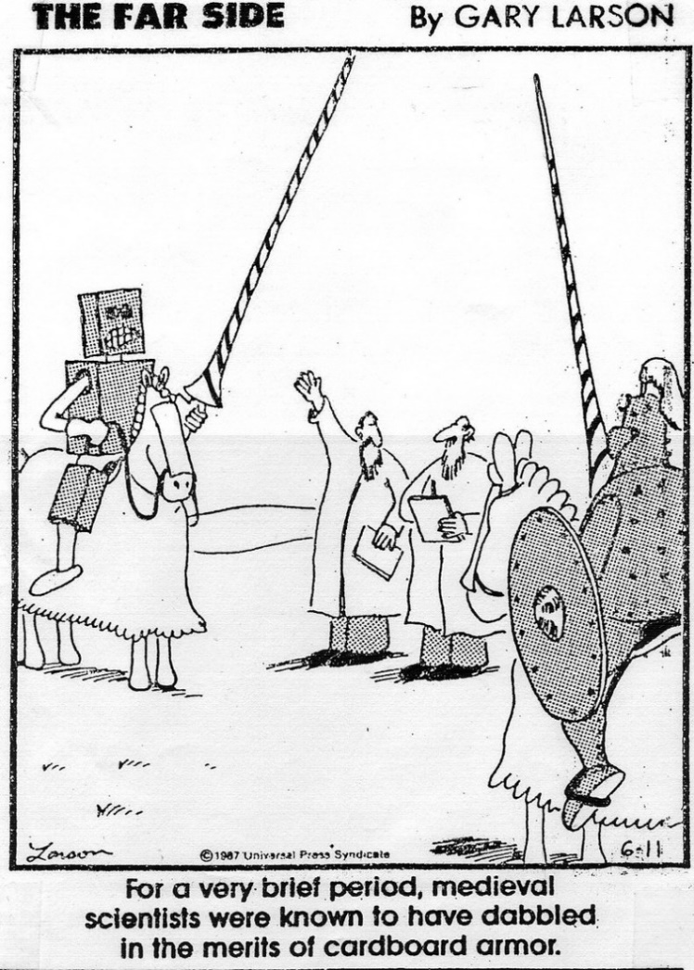
Why is evidence important?
There is a rich history of efforts in education to see what works – and what doesn’t.
While continuous research is needed, there’s a strong foundation of literature about what positively and reliably improves student learning.
Notes:
Why not cardboard armor? Over time, we have learned what works and what doesn’t.
Why is this important?
ESSA: Requirement that Level I – III evidence be incorporated into improvement plans (i.e., 1003 school improvement funds and CS identified school plans). ESSA also requires that activities funded under title programs demonstrate a record of success.
Equity: Leverage solutions that have been shown to reliably improve students’ outcomes-- particularly for historically underserved students.
“Ready solution”: Using existing solutions and interventions reduces the need to “reinvent the wheel”. EBIs have predesigned components, that together comprise a strategy or practice that is high impact.

Slide 4
Consider what research has identified as effective:
Positive Behavioral Intervention & Supports (PBIS)
Response to Intervention (RTI)
Tiered Systems of Student Support
Clear, structured lessons that build off prior knowledge
Cycle of overt instruction, student engagement, feedback, and application of knowledge
Instruction
Use of student data to inform instructional shifts
Regular observation & feedback on instructional techniques
Teacher Effectiveness
Notes:
Each of these strategies and/or interventions have a demonstrated, reliable positive impact on student learning.
Some of these are broad, high-level interventions. Often, educators ask “how” to do these things, e.g., “Will this specific intervention or strategy help me address the formative student assessment results on this math division and multiplication lesson?”

Slide 5
The Big Picture: EBI exploration and selection is starting point
Identify
Assess needs
Plan
Assure resources
Get Started
Initiate EBIs
Get Better
Explore options
Develop ongoing supports
Examine fit and feasibility
Create teaming structures
Implement fidelity measures
Focus on consistency
Drive toward positive outcomes
Systematize behavior
Use data to improve supports
Examine strength of evidence
Select EBI
EBI exploration and selection is the starting point for improving student learning

Slide 6
Defining EBI

Slide 7
Evidence Based Interventions
Strength of Evidence
The term ‘evidence-based intervention’ means an activity, strategy, or intervention that—
demonstrates a statistically significant effect on improving student outcomes or other relevant outcomes based on
strong, moderate, or promising evidence OR
demonstrates a rationale based on high-quality research findings*
Strong
Moderate
Promising
Based on a rationale
* This definition is largely informed by ESSA.

Slide 8
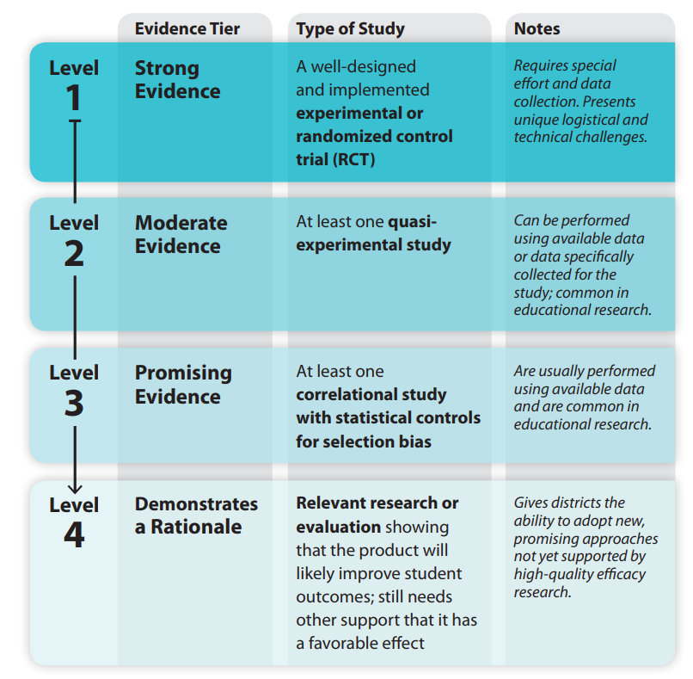
ESSA and Evidence
What Statute Says
What Statute Means
Every Student Succeeds Act (8101(21)(A))
“…the term ‘evidence-based,’ when used with respect to a State, local educational agency, or school activity, means an activity, strategy, or intervention that –
(i) demonstrates a statistically significant effect on improving student outcomes or other relevant outcomes based on –
  (I) strong evidence from at least one well-designed and well-implemented experimental study;
  (II) moderate evidence from at least one well-designed and well-implemented quasi-experimental study; or
  (III) promising evidence from at least one well-designed and well-implemented correlational study with statistical controls for selection bias; or
(ii)
  (I) demonstrates a rationale based on high-quality research findings or positive evaluation that such activity, strategy, or intervention is likely to improve student outcomes or other relevant outcomes; and
  (II) includes ongoing efforts to examine the effects of such activity, strategy, or intervention.”
Source: USDOE, Using Evidence to Strengthen Education Investments (2016)

Slide 9
Examples of EBIs
Example | Level of Evidence | Reason
Professional Learning Communities | Levels 1-3 (Strong to Promising) | Research shows that when PLCs are informed by student data and teacher performance data, take place in small groups, and focus on interventions which involve reflection and active experimentation, there are positive effects on teacher outcomes. These include greater teacher confidence; enhanced beliefs in power to make a difference in their pupils’ learning; enthusiasm for collaborative working; greater commitment to changing practice; and enhanced knowledge and practice.
Data-driven instruction | Levels 1 (Strong) | Research shows that when several components of a data driven instruction are in place, including, but not limited to: robust suite of assessments, educator collaboration, and observations driven by data, improved student outcomes result.
Capturing Kids Hearts | Level 1 (Strong) | The CKH program includes process and content to support student social-emotional health and academic engagement. It is informed by several rigorous studies, including ESSA Levels I-III. Flippen Group, the purveyor of Capturing Kids Hearts, conducted an experimental study in 2008-09, which found statistically significant and positive increase of student pro-social skills and decrease of discipline referrals.
Notes:
Here’s a few examples of EBIs: PLCs, Data Driven Instruction, and Capturing Kids Hearts have all shown Strong Evidence – meaning that they consistently have a positive impact on the population and behaviors they are seeking to affect. Notice that core components are provided in the “Reason” column. Core components of an EBI are things that must be done to achieve the desired effect. In the case of PLCs, core components include a focus on student data, small group settings, and discussion about interventions in an evolving cycle of reflection, experimentation, and adjustment.

Slide 10
Before You Explore:
Consider Contextual Fit

Slide 11
Key Selection Considerations
Strength
Is the strategy clearly defined and supported by high-quality research?
Does the strategy address needs and align to staff skills and competencies?
Fit
Is there leadership support, resources, and necessary time for implementation?
Capacity

Slide 12
3 Step Process to Answer Selection Questions
Strength
Fit
Capacity
Consideration
Explore research
Compare to Local Context
Determine readiness
Step

Slide 13
1. Explore Research
Strength
Is the strategy clearly defined and supported by high-quality research?
Clarity
Are key components of the intervention clearly defined?
Quality
Was there a comparison group?
Findings
Was there a positive impact?
Was the impact significant?
Which students benefited most?
Were experiment and control groups randomly selected?
Is the study a summary of other findings, i.e., a metastudy?

Slide 14
2. Compare to Local Context
Fit
Does the strategy address needs and align to staff skills and competencies?
Target Population
Does the research population reflect your local student population?
Current Initiatives
Does the initiative complement the strategic goals of your school or district?
Consider demographics, identified student needs, grade band, urban/rural location.
Does the intervention resonate with stakeholders, e.g., school leaders, teachers, parents?

Slide 15
3. Determine Readiness
Capacity
Is there leadership support, resources, and necessary time for implementation?
Capacity
Do staff have the necessary skills and knowledge to do this work?
Supports
Does the school/district need to seek expert assistance to implement the intervention? Consider training, coaching, and supervision.
Does the district/school have adequate funding to support the intervention sustainably?
Does the district/school need data system enhancements to thoughtfully implement the intervention?

Slide 16
Recap – Why are EBIs Important?
ESSA requires that Level 1-3 evidence be incorporated into improvement plans (i.e., 1003 school improvement funds (via EASI) and CS school plans).
It is a matter of equity to seek out and leverage solutions that have been shown to reliably improve students’ outcomes-- particularly for historically underserved students.
Using available solutions and interventions decreases the effort needed to “reinvent the wheel” and increases chances of success.

Slide 17
Thank You!
Jeremy Meredith
ESEA Programs Senior Consultant
Title II Specialist
Meredith_J@cde.state.co.us
(303) 866-3905
Mary Shen
Data, Reporting, Accountability, and Evaluation Consultant
Shen_M@cde.state.co.us
(303) 866-4571

