Slide 1
Staff Approval Matrix (SAM)
December Count
School Year 2023-2024

Slide 2
December Count Contact Information
Lindsey Heitman
Special Education December Count Collection Lead
Data Services Unit
SpedDecCount@cde.state.co.us
(303) 866 - 5759

Slide 3
Staff Records that should be Included in the December Count Snapshot
Included:
  All Special Education staff employed as of December 1st
  Full or Part-time including including direct service providers, teachers, paraprofessionals, administrators, support staff, and contract staff
Excluded:
  Staff that do not support the education of students with disabilities, such as regular education teachers (they pull into the Human Resources snapshot)
  Substitutes unless they are permanent (90 days or more in the same classroom consecutively)
  Temporary workers, such as after school coaches
  Staff not employed December 1st of the current reporting period

Slide 4
Regulations: IDEA/ECEA
Federal Law IDEA (The Individuals with Disabilities Education Act)
Requires staff who serve students with disabilities to be appropriately licensed and endorsed.
State Rules ECEA (Exceptional Children’s Educational Act-section 3.04 Personnel Qualifications)
All personnel providing special education services to children with disabilities shall be qualified.
Each special education teacher will serve, at a minimum, a majority of special education students with the same identified area of need as that teacher’s special education license endorsement. The endorsement level must be appropriate for the age being taught. (this is the 50% staff to student caseload match)

Slide 5
Purpose of Staff Data
Staff data in the December Count:
provides CDE the ability to verify licensing qualifications ensuring special education staff are qualified for the assignment and student caseload
populates mandatory Federal reporting to the US Department of Education, aggregated by:
    job classification
    age level of assignment/students served (age groups 3-5 and 6-21)
    qualified and non-qualified status

Slide 6
Staff Approval Matrix
(SAM)
The Staff Approval Matrix (SAM):
is an automated process in the December Count
triggers when a Snapshot is created
pulls in data from the Staff Assignment and IEP Interchange files
connects staff data with Educator Licensing and EDIS records via the reported SSN
determines qualified/non-qualified status for positions requiring a CDE license
Triggers DEC Staff snapshot warnings DC208, DC209, DC210, and DC211

Slide 7
Staff to Student
Caseload Match
Every IEP Student Participation File record must have a Primary Provider EDID of a 202 or a 238
All staff reported with Job Code 202 or 238 must be associated with at least one student record (either as a primary or secondary provider) in the Sped Participation file or an error will trigger
Two caseload match checks exist for Special Education Teachers (202) and Speech-Language Pathologists (238):
Grade Caseload Match in the Data Pipeline (staff grades to student grades)
  grades marked “Yes” in the staff assignment record must exactly match the grades of students in the IEP Participation file
Disability/50% Caseload Match in SAM (staff endorsement to student disability)
  Primary provider staff must hold an appropriate special education endorsement for the majority of student disabilities in the IEP Participation file
    based on the staff EDID reported in the Primary Provider field in the IEP Participation file
    Staff EDID reported in any one of the four Secondary Provider fields do not generate a student disability caseload
    SAM warnings DC209/DC210

Slide 8
Qualified Status
Qualified staff:
Hold a valid and appropriate CDE license for the assignment.
Hold an age level endorsement appropriate for the age range of students served.
Job codes 202 and 238 serve a majority of special education students (50% disability caseload match-special education teachers and speech-language pathologists) with the same identified area of need (primary disability) as the staff’s special education endorsement.
Note: SAM validations (job code, license type, endorsement, and caseload) determine if staff are qualified.

Slide 9
Non-Qualified Status
Non-qualified staff:
Do not hold a CDE license as of December 1st.
Do not hold a valid and appropriate CDE license for the assignment.
Do not hold an age level endorsement appropriate for the age range of students served.
Do not serve a majority of special education students (50% caseload match-special education teachers and speech-language pathologists) with the same identified area of need (primary disability) as the staff’s special education endorsement.
Note: SAM validations (job code, license type, endorsement, and caseload) determine if staff are non-qualified.

Slide 10
SAM Warnings
DC208, DC209, DC210, DC211
SAM Warnings are found in your Special Education December Staff Error/Warning Reports (view in either Pipeline error reports or Cognos error reports)
SAM Warning DC208 – Staff did not hold a valid license on December 1st (high severity issue)
SAM Warning DC209 – Staff does not hold an appropriate endorsement for the assignment
SAM Warning DC210 – Staff does not hold an appropriate endorsement for the caseload
SAM Warning DC211 – Staff does not hold a valid license (high severity issue)
Note: Snapshot errors should be resolved before you review SAM Warnings DC209/DC210 (caseload).
Typically, both DC209/DC210 generate for special education teachers (202) and speech-language pathologists (238) who do not satisfy SAM approval criteria.
SAM Warnings should be investigated - some may be resolved by correction of data, i.e., incorrect SSN, job code miscoding, student disability caseload discrepancy.

Slide 11
December 1st License Requirement
Special Education staff must hold a valid and appropriate CDE license on the official count date of December 1^{st.}
Licenses issued with an effective date of December 1st or prior are validated when a snapshot is created in the Data Pipeline. The snapshot generates the Staff Approval Matrix (SAM) process.
Staff who do not hold a valid or appropriate license on December 1st:
will generate SAM Warning DC208
are determined to be non-qualified
display in the SAM: 1.5 Non-Qualified Personnel Status report

Slide 12
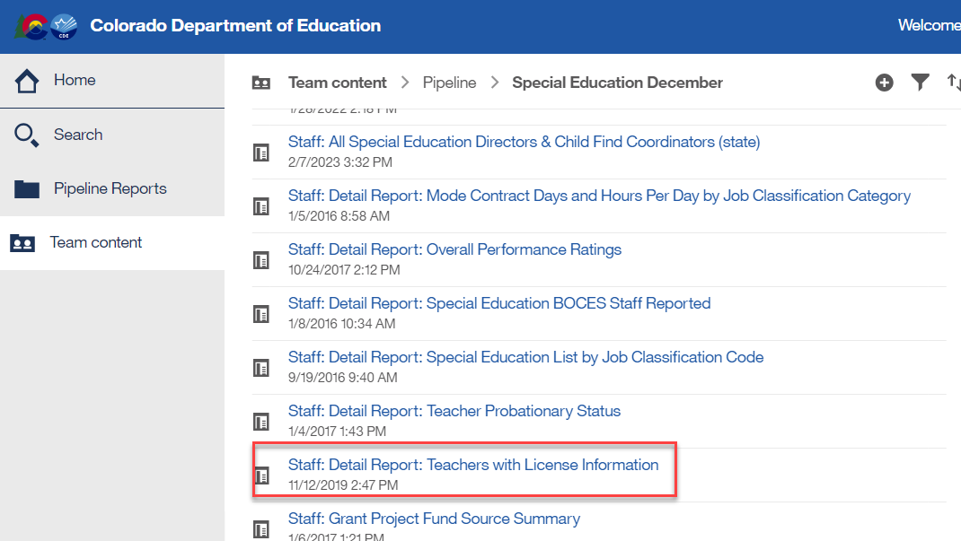
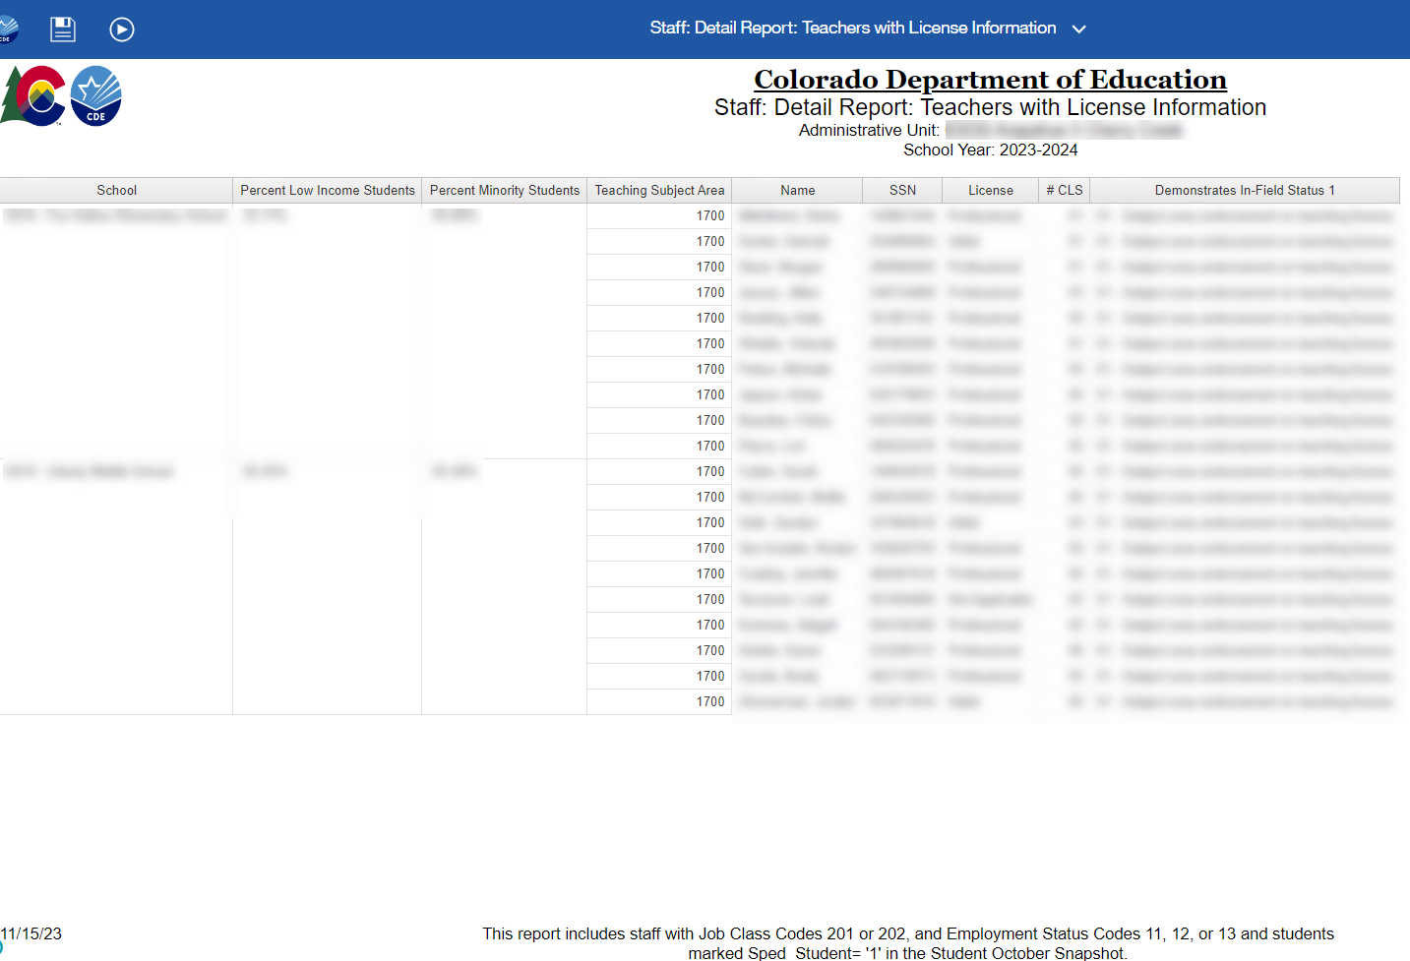
Special Ed December Count:
Staff: Detail Report: Teachers with License Information
Feedback needed – please email me if you have a preference!
Do you (AU respondents) use this report?
If so, which columns do you reference and why?
Would you object to changing this to shows all of your Sped staff licensing details – license type, endorsement types, date issued, date expired, in-field status
SpedDecCount@cde.state.co.us
Special Education December Count

Slide 13
Social Security Number (SSN) Validation
Social security number (SSN) is:
required for all staff
used to validate staff’s license and endorsement
validated against staff’s SSN in educator licensing records and in EDIS (Educator Identification System)
If staff SSN differs in any of the three validation check points (December Count, licensing records, EDIS), SAM Warning DC211 (staff does not hold a valid license) will generate.
To clear DC211 (if staff is licensed), the SSN must be corrected to be an exact match in all three validation check points.

Slide 14
SAM 50% Caseload Match
Special Education Teacher
A special education teacher’s 50% caseload match is satisfied if:
Staff is reported as the Primary Provider (EDID reported in Primary Provider field) to a majority of students identified in the same area of need as the teacher’s special education endorsement and grade range of students served.
Note: The 50% caseload match does not compile on EDIDs placed in any of the four Secondary Provider fields.

Slide 15
SAM 50% Caseload Match
Speech-Language Pathologist
A speech-language pathologist’s 50% caseload match is satisfied if:
Staff is reported as the Primary Provider (EDID reported in Primary Provider field) to a majority of students identified:
disability 08-Speech or Language Impairment (SLI)
disability 11-Developmental Delay (DD)
Staff is reported as a Secondary Service Provider (EDID reported in one of the Secondary Provider fields) to students identified in other disabilities who receive supplemental speech-language services, but SLI (08) or DD (11) is not the primary disability.
Note: The 50% caseload match does not compile on EDIDs placed in any of the four Secondary Provider fields.

Slide 16
Licensing and Caseload
Reference Documents
Guidance documents to assist in proper job coding, allowable license types and appropriate special education endorsements are posted at: https://www.cde.state.co.us/datapipeline/snap_sped-december
Staff Approval Matrix (SAM) and Licensing References:
Special Education Licensing Requirements by Job Classification and Fully Qualified Status
Special Education Endorsement Qualifications by Assignment, Disability, and Age of Student
(50% caseload match criteria by student disability)
Staff Approval Matrix (SAM: 1.5) Report Fact Sheet

Slide 17
Staff Reporting Reminders and Cognos Reports

Slide 18
Long Term Substitute Teacher
Long Term Sub Requirements (serving in job role for 90 days or more) in December Count:
Job code 204 (substitute teacher) does not pull into the December Count snapshot
If they are the primary provider for a Sped student, they should be reported with a job code of 202 or 238
A long-term sub for sped purposes is held to the same licensing requirements as a regular sped teacher or SLP. If the Special Ed license has expired or is not renewed by 12/01 and they are reported with job code 202 or 238, they will trigger a SAM (Staff Approval Matrix) warning.

Slide 19
Purchased Service (contracted) Staff
Purchased service staff are:
employed on a contractual basis, typically an annual contract for services
reported in the December Count, regardless of the amount of time, days or hours of the contract
not exempt from state licensing requirements
required to hold a valid and appropriate special education license and endorsement for the assignment and grade range of students served
reported with Employment Status Code = 23 Purchased Services
Note: If the contractual agreement is valid for the period including December 1st, the position is reported regardless of whether the contracted staff is actually “working” on December 1st.
For information on what data fields are required for contracted staff, download this document: https://www.cde.state.co.us/datapipeline/inter-staff-purchase-service-info

Slide 20
Common Miscoding
Special Service Providers
234 Occupational Therapist
235 Physical Therapist
211 Counselor
236 Psychologist
237 Social Worker
Positions often classified as “motor services” with job codes miscoded in data reporting.
Positions often classified as “mental health services” with job codes miscoded in data reporting.
Job code miscoding results in generated SAM Warning (DC209).
Verify staff license and endorsement prior to data reporting.
Ensure that staff positions are coded correctly in Human Resources systems and are in alignment with job codes/definitions in the Chart of Accounts/staff data reporting documents.

Slide 21
New Job Code for School
Mental Health Professionals licensed by DORA
New Job Code added in November 2023 for Senate Bill 23-004 Employment of School Mental Health Professionals
313 – School Based Therapist
School-Based Therapist (licensed outside of CDE). Individuals licensed by various state boards in the Colorado Department of Regulatory Agencies to provide supplemental and supportive services in the following areas: Licensed Addiction Counselor, Licensed Professional Counselor, Licensed Marriage and Family Therapist, Licensed Psychologist or Licensed Clinical Social Worker.
Eligible school-based therapists may be hired to supplement and support the services provided by CDE-licensed school mental health professionals and should not replace or supplant the work of special service providers. Eligible School-Based Therapists should limit their practice within their specific formal training area.
Questions about this new role? Email ESSU team members Hannah Prokop Prokop_h@cde.state.co.us and Krista Klabo Klabo_k@cde.state.co.us

Slide 22
Staff Assignment File and
Admin Instructional Area Codes
Separate assignment records are required in these cases:
  Pre-K grade - AIA 0035 Early Childhood/Prekindergarten
    Must break out a separate assignment record for Sped staff job codes serving Pre-k except 211
  Grade K only - AIA 0036 Kindergarten
    AIA code 0036 should be reported for a staff that is only serving grade K
  Grades K, 1, 2 - AIA 0041 Early Childhood/Elementary) (see below)
    AIA code 0041 should only be reported for staff with early childhood Sped endorsement
  Grades 3-12 or K-12 (depending on the staff’s endorsement type) - 0002 Special Education
EDIDs reported in both the Primary Provider and Secondary Provider fields (student IEP Participation data) compile into the grade caseload match for 202 and 238 staff records.
Note: Early Childhood Special Education (age level 0-8) endorsement is appropriate for services to students in grades PreK through 2 only. For SAM to determine qualified status, a separate assignment record for elementary grades K, 1, 2 (any combination of these grades) is reported with AIA 0041.

Slide 23
Cognos Reports
Cognos reports are available to assist with both staff and student December Count data.
Examples:
Errors: Staff Detail Report of Errors to Correct (displays SAM Warnings by individual staff)
SAM: 1.5 Non-Qualified Personnel Status (displays staff by job code with each generated SAM Warning type)
SAM: ALL Certified Staff Report (displays staff in assignments that require a CDE license)
SAM: Caseload Student Detail (DC210 Detail) (displays special education teachers and SLPs with individual primary and secondary students)
SAM: Caseload Summary (DC210 Summary) (displays special education teachers and SLPs with the number of primary students in each disability category)

Slide 24
Cognos Report
SAM: Caseload Summary or Detail Report (DC210)
Displays the number of primary students in each disability category for special education teachers (202) and SLPs (238).
Displays the total number of primary students in approved and non-approved disability categories per the staff’s special education endorsement.
Displays the caseload percentage of approved disability categories per the staff’s special education endorsement. (percentage must = at least 50% to satisfy the caseload match requirement)
If no license is found with a validity date of December 1st, the staff approval matrix (SAM) cannot calculate caseload summary data. These records display with zero number of approved/non-approved students and disability percentage totals.

Slide 25
Cognos Report
SAM: 1.5 Non-Qualified Personnel Status Status
The SAM 1.5: Non-Qualified Personnel Status report is a summary of staff who have not satisfied SAM approval criteria.
Staff who are not appropriately licensed and endorsed are listed per the generated SAM Warning(s).
Staff often generate multiple SAM Warnings and display in the report multiple times.
Staff displayed in this report are non-qualified for the position assignment.
Signature of the special education director required. Report is signed and uploaded in the Data Management System (DMS).

Slide 26
Avoid SAM Warnings
Verify all special education staff hold a valid and appropriate CDE license prior to the December 1st count date. (DC208/DC211)
Licenses “in process” must be submitted, complete and issued prior to December 1st.
Staff must hold an appropriate license and endorsement for the assignment. (DC209)
Staff caseloads are appropriate for the 50% caseload match per the staff’s special education endorsement and student disability categories. (DC210)

Slide 27
Post December Count
SAM Warnings will not prevent you from finalizing your December Count staff data.
If SAM Warnings remain unresolved at collection close, staff will display in the final SAM: 1.5 Non-Qualified Personnel Status report.
All non-qualified staff are included in the post December Count Correction Tracker accountability process.
AU Responsibility:
Upon review of the SAM: 1.5 Non-Qualified Personnel Status report, the AU Special Education Director signs the report verifying the contained data is valid and accurate.
The report is uploaded in the Documents tab in the ESSU Data Management System (DMS).
CDE Responsibility:
SAM: 1.5 report data for each administrative unit is reviewed to validate SAM results.
A Personnel Status Correction Tracker form is completed for each administrative unit listing all staff contained in the SAM: 1.5 report.

Slide 28

Questions, concerns, or hot topics you want to discuss?

