Slide 1
AEC Collections Webinar:
Collection Window 2 Overview
2/2/2024
Accountability Analytics Unit

Slide 2
Agenda
Collection Window 2 Overview
  Collections & Timeline
  Update on Accountability Pause
  About the Collections
  Collections Checklist
  Pipeline Basics
Actual Measures & Data for 2024 AEC SPF Collection
  Collection Basics
  Resources
  Submitting Your Data
  Error Logic
  Status Dashboards
  Collection Opt Out
  Sign Off Sheets
Planned Measures For 2025 AEC SPF Collection
  Collection Basics
  Comparison to Actual Measures
  Reasons to Participate
  Submitting New Measures
Resources, Trainings & Contacts

Slide 3
Collection Window 2 Overview
Collections & Timeline
Update on Accountability Pause
Collection Checklist
Pipeline Basics

Slide 4
Collection Window 2 Overview
Collections and Timeline
Timeline:
Month | Renewal/Application Designation Collection | Selection of Measures Collection (Planned and Actual)
January | Notify B Sanders/April Thompson of new schools seeking AEC designation by 1/31/2023 | Training - office hours
February | Training – office hours | Training – office hours
March | Renewal/Application collection opens 3/13/2024 Office hours for Renewal/Application collection will be available | Planned measures for 2024 AEC SPF collection opens 3/13/2024 Office hours for Selection of Measures available
April | Renewal/Application collection closes 4/26/2024 | Planned measures for 2024 AEC SPF closes 6/28/2024
May |  | Planned measures for 2025 AEC SPF collection opens 5/8/2024 Actual measures for 2023 AEC SPF collection opens 5/8/2024 Office hours for Selection of Measures
June |  | Planned measures for 2024 AEC SPF collection closes 6/30/2024 Actual measures for 2023 AEC SPF collection closes 6/30/2024 Office hours for Selection of Measures

Slide 5
Collection Window 2 Overview
About the Collections
Actual Measures and Data
Voluntary
2024 AEC SPF
Submitting measures and data
Cannot propose new measures through this collection window
Requires a sign off form
Planned Measures – 2025
Voluntary
2025 AEC SPF
Submitting measures only (no data)
Use this collection to propose a new measure to CDE and begin measure negotiations
Does not require a sign off form

Slide 6
Collection Window 2 Overview
Collections Checklist
Collections Checklist
Review the file layout and definitions document and other resource documents
Decide how you will submit your data OR decide if you will opt out of data collection
Download your submission sign off form
Complete your data submission OR opt out of data collection
Gather necessary signatures
If data is submitted check submission for errors
Finalize data submission using the Status Dashboard in Pipeline
Email completed sign off form(s) to B Sanders

Slide 7
Collection Window 2 Overview
Pipeline Basics
Accessing Data Pipeline
  If you are managing the AEC Collections for your district/BOCES – in part or in whole – then you will need to work with your local area manager (LAM) to receive data pipeline permissions
Role for collections: AEC~LEAAPPROVER
  Grants ability to sign into Alternative Education tab in Data Pipeline and the ability to submit data to CDE for these collections
  Ability to download/upload extracts to AEC collections
  Ability to add and edit records for 2024 Actual Measures Collection
  Ability to add and edit records for Planned Measures for 2025 AEC SPF Collection
  Ability to opt out of AEC collections
You cannot participate in the AEC Collections unless your LAM has assigned you to the AEC~LEAAPPROVER role!

Slide 8
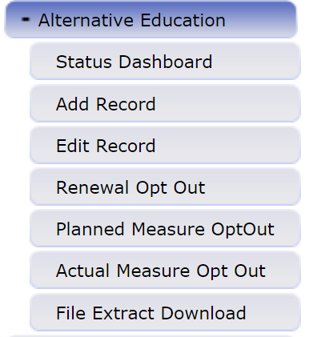
Collection Window 2 Overview
Pipeline Basics
This is where you will start for all AEC Collections.
Use this to formally submit your completed data submission to CDE. You can also use this to check errors in your data submission before finalizing it.
Add records for the both collections in this window.
Edit records for both collections in this window.
Opt a school, or schools, out of either collection.
Download file extracts for each collection.

Slide 9
Actual Measures and Data for 2024 AEC SPF Collection

Slide 10
Actual Measures and Data for 2024 Collection
Collection Basics
Actual Measures: Measures submitted with the intent of inclusion in the next AEC SPF cycle (2024 AEC SPF)
  VOLUNTARY for any school that has received or is planning to receive AEC designation
  Collection data is aggregated; not student level
  Data is included here, otherwise the measures are unable to be incorporated into the AEC SPF
  Can only choose from previously approved measures, or new measures which were negotiated during the Planned Measures – 2024 collection (ends April 26th)
  May opt out of collection, but must do so formally using the opt out feature

Slide 11
Actual Measures and Data for 2024 Collection
Resources
What do you need? | Why do you need it? | Where do you get it?
File Layout and Definitions (Actual) | Understand fields needed for data submission, able to see what measures are associated with which indicators and metrics | http://www.cde.state.co.us/datapipeline/per-aec
Confirmation that you have access to the AEC Collections in Pipeline | Cannot submit data without access to Data Pipeline | Local Area Manager grants AEC~LEAAPPROVER role permission
Optional Measures Cut Point Lookup Document | Can look up optional measure cut points and measure rating bands for previously approved measures | http://www.cde.state.co.us/datapipeline/per-aec

Slide 12
Actual Measures and Data for 2024 Collection
Submitting Your Data – Add/Edit Records
Use Add/Edit Records to complete if:
  You do not want to map numeric codes to indicator, subindicator, category, and metric names
  You do not want to reference a separate document to track which subindicators match which categories and which subindicators match which indicators
  One person will be doing the majority of the data entry and submission for all of the measure records
  You will be entering data measure by measure

Slide 13
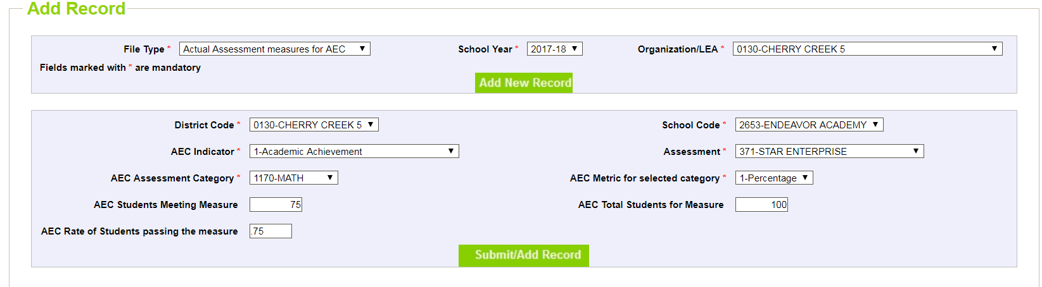
Actual Measures and Data for 2024 Collection
Submitting Your Data – Add/Edit Records
2023-24
Select
File Type: Actual Assessment Measure for AEC
School Year: 2023-24
Organization/LEA: Your District/BOCES
Hit Add New Record
Select
School Code
Choose Measure Details from dropdowns
  AEC Indicator
  Assessment
  Category
  Metric
Enter data
  Students meeting measure (numerator)
  Total students (denominator)
  Rate (final value)
Hit Submit/Add Record
13

Slide 14
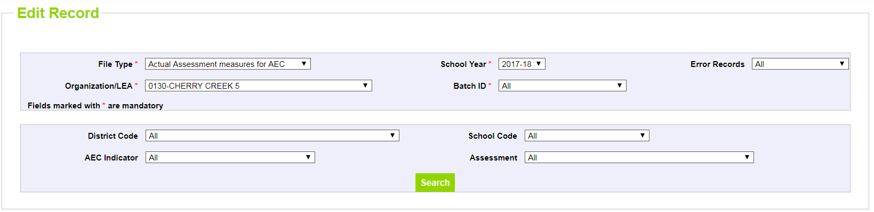
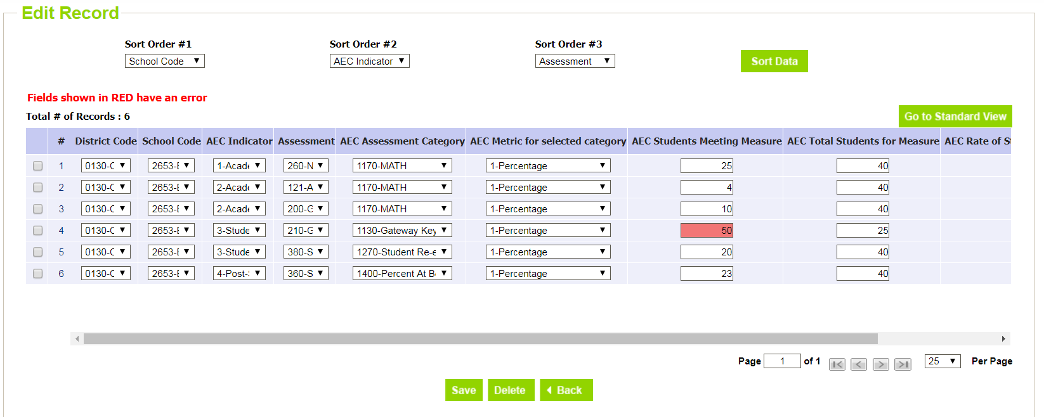
Actual Measures and Data for 2024 Collection
Submitting Your Data – Add/Edit Records
2023-24
Select
Actual Assessment Measures for AEC
2023-24
Your LEA
Hit Search
You can delete or modify any of these records in this screen. You can edit multiple records at once, then SAVE.
14

Slide 15
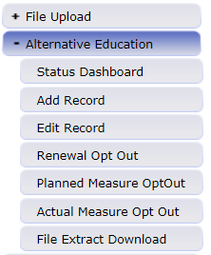
Actual Measures and Data for 2024 Collection
Submitting Your Data – File Upload
Use File Download/Upload to complete if:
  You have several AECs in your district/BOCES, and you are planning to submit several optional measures for each
  The staff completing the Actual Measures Collection are comfortable using and working with excel spreadsheets
  You have reviewed and have on hand all the additional resources you need for working with the file extracts
    http://www.cde.state.co.us/datapipeline/per-aec
Upload completed files to Data Pipeline for CDE review
Download blank files from Data Pipeline to submit

Slide 16
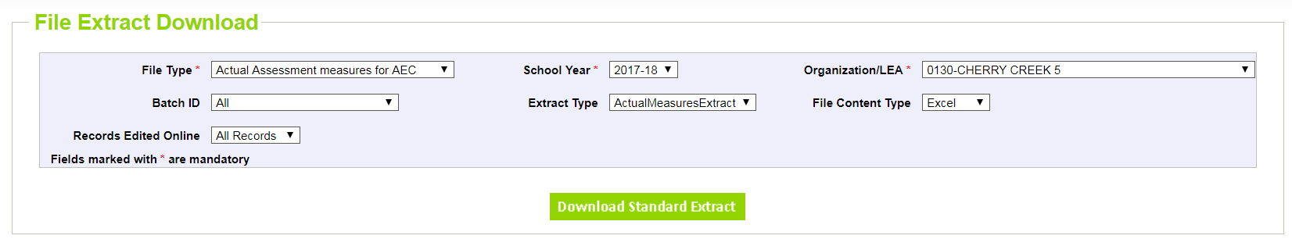
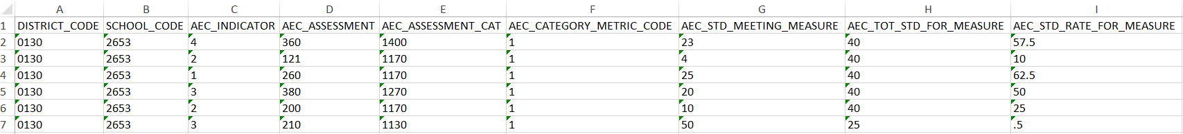
Actual Measures and Data for 2024 Collection
Submitting Your Data – File Upload
2023-24
Select
Actual Assessment Measures for AEC
2023-24
Preferred File Content Type (rec: Excel)
Hit Download Standard Extract
Add in the codes for:
AEC Indicator
AEC Subindicator
AEC Subindicator Category
AEC Subindicator Category Metric
Add in the data for:
Students meeting measure (numerator)
Total students for measure (denominator)
Rate/final value
16

Slide 17
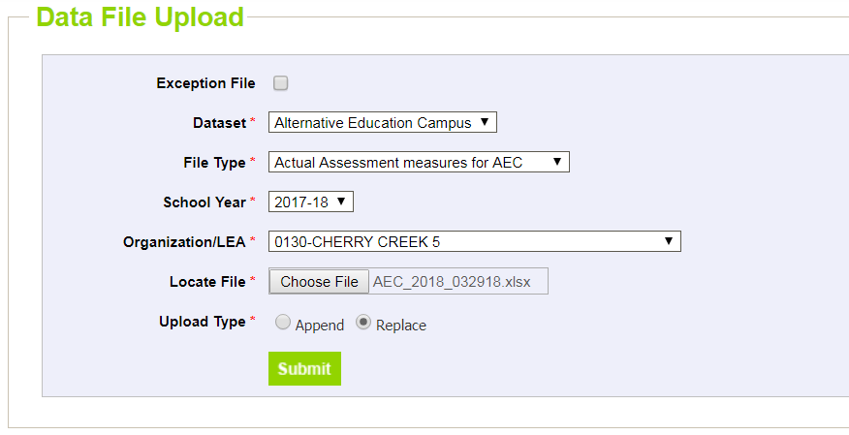
Actual Measures and Data for 2024 Collection
Submitting Your Data – File Upload
2023-24
Select
Alternative Education Campus in Dataset
Actual Assessment Measures for AEC in File Type
2023-24 in School Year
Your LEA
Choose your file
Replace/Append in Upload Type depends on data you’re submitting

Slide 18
Actual Measures and Data for 2024 Collection
Error Logic – Fields to Complete
Field | Code or Data? | Null Values Permitted?
AEC Indicator | Code | No
AEC Subindicator | Code | No
AEC Subindicator Category | Code | No
AEC Subindicator Category Metric | Code | No
AEC Students Meeting Subindicator | Data | Yes, if metric is not percentage or growth score
AEC Total Students for Subindicator | Data | No
AEC Final Subindicator Value | Data | No

Slide 19
Actual Measures and Data for 2024 Collection
Error Logic – Embedded Field Logic
Error Logic | Reason
If AEC Indicator is Academic Achievement, Postsecondary and Workforce Readiness, or Student Engagement, then AEC Total Students for Subindicator cannot be less than 16 | N of 16 is minimum for these indicators
If AEC Indicator is Academic Growth, then AEC Total Students for Subindicator cannot be less than 20 | N of 20 is minimum for this indicator
If AEC Subindicator Category Metric is Percentage or Growth Score, then the AEC Final Subindicator Value cannot be greater than 1 | Rate-based metrics must be entered as a decimal (ex: .50)
If AEC Subindicator Category Metric is Percentage or Growth Score, then AEC Student Meeting Subindicator cannot be null | Rate-based metrics must include both denominator and numerator
If AEC Subindicator Category Metric is MGP or Percentile Rank, then AEC Final Subindicator Value must be between 1 and 99 | MGP and Percentile Rank valid values are only between 1 and 99
If AEC Students Meeting Subindicator is not null, then this value cannot be greater than AEC Total Students for Subindicator | Likely an error; cannot have more students in numerator than denominator

Slide 20
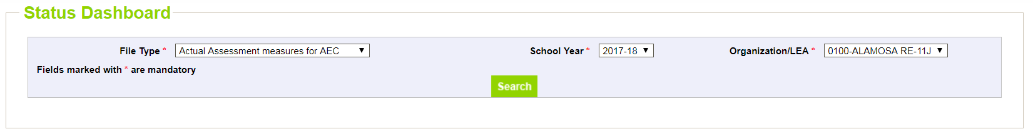
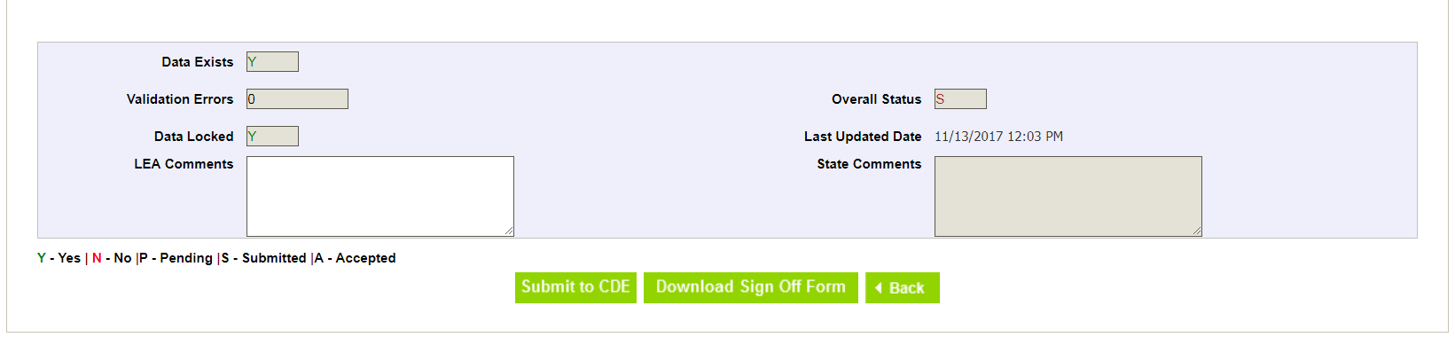
Actual Measures and Data for 2024 Collection
Status Dashboard
2023-24
Check your Validation Errors. When Validation Errors are 0, and you have no changes left to make on your data, hit Submit to CDE.
When you hit Submit to CDE, you have submitted your collection data!
Select
Actual Assessment Measures for AEC
2023-24
Your Organization/LEA
Hit Search
20

Slide 21
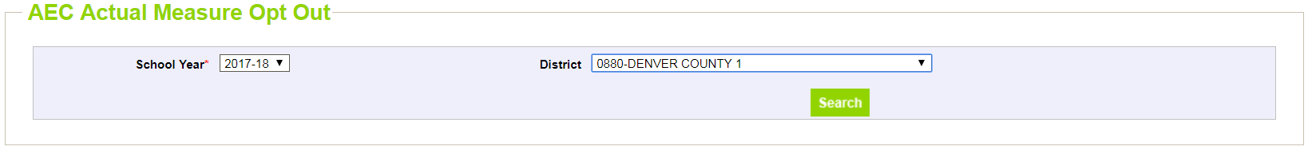
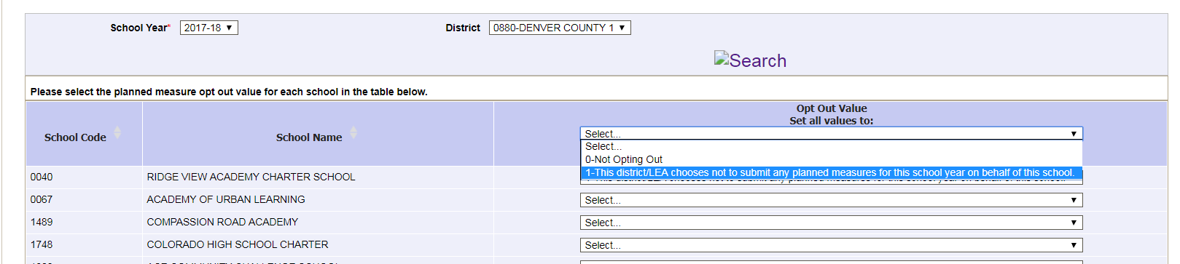
Actual Measures and Data for 2024 Collection
Collection Opt Out
2023-24
2023-24
Mark option 1 for any school not submitting actual measures and data.
Remember to hit SAVE when you are done!

Slide 22
Actual Measures and Data for 2024 Collection
Sign Off Sheet – Send to CDE
District submits data
District completes sign off form
Email signed form by 6/28/2024
One form is required for each AEC
Gather needed signatures
Scan completed form(s)
Email signed form to April Thompson (Thompson_april@cde.state.co.us)
Your AEC Collection data is not considered complete and final until we receive your sign off form!

Slide 23
Planned Measures for the 2025 SPF

Slide 24
Planned Measures for the 2025 AEC SPF
Collection Basics
Planned Measures: Measures that you are expecting to use for an upcoming AEC SPF cycle (2025 AEC SPF)
  VOLUNTARY for any school that has received or is planning to receive AEC designation
  No data is included, only the measure names
  Information submitted in this collection is to tell CDE the measures that the school intends to include on the 2025 AEC SPF
    This collection allows districts to indicate they plan on using a new-to-CDE measure
    New measures submitted through this collection will only be considered for the 2025 AEC SPF not for the 2024 AEC SPF
  May opt out of collection, but must do so formally using the opt out feature
  Districts will not be held accountable to measures submitted through this collection

Slide 25
Planned Measures for the 2025 AEC SPF
Collection Basics
What do you need? | Why do you need it? | Where do you get it?
File Layout and Definitions (Planned) | Understand fields needed for data submission | http://www.cde.state.co.us/datapipeline/per-aec
Confirmation that you have access to the AEC Collections in Pipeline | Cannot submit data without access to Data Pipeline | Local Area Manager grants AEC~LEAAPPROVER role permission
Previous year’s AEC SPF if available | Historical context for optional measures the AEC has submitted and had approved | https://www.cde.state.co.us/schoolview/performance

Slide 26
Planned Measures for the 2025 AEC SPF
Similarities and Differences in the Actual and Planned Measures Collections
Similarities to Actual Measures
Same pre-approved measures for use
Use the same features to upload data into Pipeline (but make sure to choose the Planned Measures for AEC collection)
Same process for opting out of this collection as for the Actual Measures collection, but use Planned Measure Opt Out button
Differences from Actual Measures
Planned Measures Collection does not require a sign off form
Planned Measures Collection only requires assessment information, not assessment data
Actual Measures collection impacts the 2024 AEC SPF; Planned Measures for 2025 AEC SPF looks forward to the AEC SPF after that (2025)

Slide 27
Planned Measures for the 2025 AEC SPF
Reasons to Participate in the Planned Measures Collection
Participate if:
You have a new-to-CDE measure to propose
You would like to get CDE’s perspective on the measures you’re planning to use
You want a standing record of what measures have been in consideration
Opt Out if:
You are planning to use the same measures as previously submitted
None of the measures you are planning to submit are new-to-CDE
New-to-CDE measures are those which have not been previously approved. If you cannot find your measure in the drop-down menus, then it should be considered new-to-CDE.

Slide 28
Planned Measures for the 2025 AEC SPF
Submitting New-To-CDE Measures
How to submit a new measure for consideration:
Field | Code | Label
AEC Indicator | 1 | Academic Achievement
 | 2 | Academic Growth
 | 3 | Student Engagement
 | 4 | Post-Secondary and Workforce Readiness
AEC Subindicator | 999 | New Subindicator
AEC Subindicator Category | 9999 | New Category
AEC Subindicator Category Metric | 1 | Percentage
 | 2 | Percentile Rank
 | 3 | Growth Score
 | 4 | MGP
 | 6 | Mean Score
To propose a measure that has not been previously approved, choose the indicator you believe it should fall into, New Subindicator and New Category, and whichever metric seems most appropriate.
B Sanders will reach out for specifics about the Subindicator and Category once submitted; negotiations will open between the district/BOCES and CDE
28

Slide 29
Resources, Trainings, and Contact Information

Slide 30
Resources and Trainings
AEC Collections Website:
http://www.cde.state.co.us/datapipeline/per-aec
  AEC Collections materials posted on website; last year’s training materials also posted
AEC Accountability Resource Page
https://www.cde.state.co.us/Accountability/StateAccountabilityAECs
AEC Collections Office Hours:
  Weekly office hours are available. You can sign up for a half hour slot to chat with B Sanders/April Thompson about any questions you may have about the AEC collections here: https://www.signupgenius.com/go/10C084DAEAA28A4F9C61-46489917-aecoffice

Slide 31
Contacts
AEC Collection Questions
B Sanders, AEC and Accountability Principal Consultant
  Sanders_b@cde.state.co.us
April Thompson, AEC Consultant &ACI Program Coordinator
  Thompson_April@cde.state.co.us
  303-358-7363
Identity Management Questions
Rich Morris, Systems Administrator
  Morris_r@cde.state.co.us
  303.866.6713

