Slide 1
Introduction to Special Education Data Reporting
Special Education IEP Interchange
Data Pipeline Training
Lindsey Heitman
Data Services Unit
Fall 2024

Slide 2
Agenda
General Overview – slides 4-7
Accessing the Data Pipeline/Identity Management- slides 8-11
Collection resources – slides 12-14
Data Pipeline IEP Interchange and Snapshots Overview – slides 15-17
IEP Interchange Timeline – slide 18
IEP Interchange Data Collected – slides 19-24
Snapshots that pull IEP Interchange Data – slides 25-29
Data Pipeline IEP Interchange Process – slides 31- 44

Slide 3
General Overview

Slide 4
Glossary of Terms
Term | Definition
LEA | Local Education Agencies – includes the AU and their member district(s) and BOCES
BOCES | Board of Cooperative Educational Services - exist to supply educational services to two or more school districts that alone cannot afford the service or find it advantageous and cost-effective to cooperate with other districts.
AU | Administrative Unit - a school district(s), a board of cooperative services, a charter school network, a charter school collaborative, or the state charter school institute, that is providing educational services to exceptional children.
IdM | Identity Management. A single sign on system, allowing the user to navigate between the applications without entering user ID information a second time.
LAM | Local Access Manager responsible for assigning the appropriate access to CDE applications
Data Pipeline | A streamlined approach to efficiently move required education information from school districts to the CDE
Interchange | The data holding place in the Data Pipeline. A method of providing data to CDE in which LEA’s may choose from multiple file formats to submit data throughout the year.
Snapshot | A date in time when data is pulled from the appropriate interchanges, validated by additional business rules, and approval given that signifies it was accurately reported for a specific point in time by an LEA
Cognos Reports/CEDAR | A type of report in which the user can view applicable reports that are formatted in a user-friendly environment. Colorado education data analysis and reporting system.
DMS | ESSU Data Management System (DMS) is another CDE single sign on system that assists AUs in meeting accountability requirements for Special Education and Gifted Education.

Slide 5

Town Hall Webinars
Weekly Data Pipeline Town Halls
Every Thursday from 9-10 am
Updates and reminders on open and upcoming data collections (agenda email sent on Wednesdays)
Email to subscribe: DATASERVICES-subscribe-request@cdelist.cde.state.co.us
If you can’t make it, you’ll find the slides and recordings posted here: http://www.cde.state.co.us/datapipeline/datapipelinetownhallpresentations
  Please be sure to review the slides for any collections you’re responsible for, so you don’t miss anything!

Slide 6
Syncplicity – CDE method for sharing student and staff personally identifiable information
IMPORTANT NOTE
  Personally Identifiable information (PII) for students or staff should not be shared through email.
  This includes information that when combined is identifiable:
    Student and staff names, full SASIDs or EDIDs, SSNs
Syncplicity – platform CDE uses for secure file/information sharing
Syncplicity Help
Used for exception requests, questions that include PII, spreadsheets that contain student or staff information
New respondents:
Email collection lead for access to your AU Syncplicity folder
Be sure to email CDE to notify us you’ve placed something in the folder for us to review. We aren’t automatically notified when you’ve saved something in your Syncplicity folder.

Slide 7


Collection Process Overview
Schools and Districts
Schools track data throughout school year
Admin Unit/SOP
Combines data from districts. Determines the appropriate coding for each record.
CDE via Data Pipeline
Districts provide data to Admin Unit/SOP
Verifies accuracy, corrects and approves data.
Checks data for accuracy
Collects data from Admin Unit/SOP
Edits data, all errors must be corrected
Federal Government
CDE Reviews and validates data and submits to U.S. Department of Education
Allows approval once passed all edit validations
Reports data to CDE
Notes:
Admin Unit/SOPs collect data from schools and/or member districts. Data is compiled at the AU level and submitted to the CDE via the Data Pipeline.

Slide 8
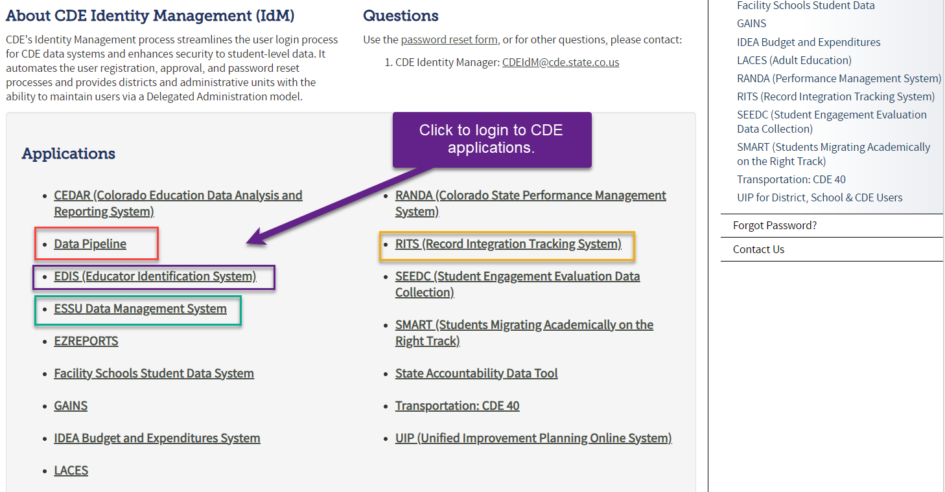
Accessing the Data Pipeline
IdM home page
Bookmark this link to access the CDE systems
Single sign-on used for all CDE applications
Access is based on the roles assigned to your user account

Slide 9
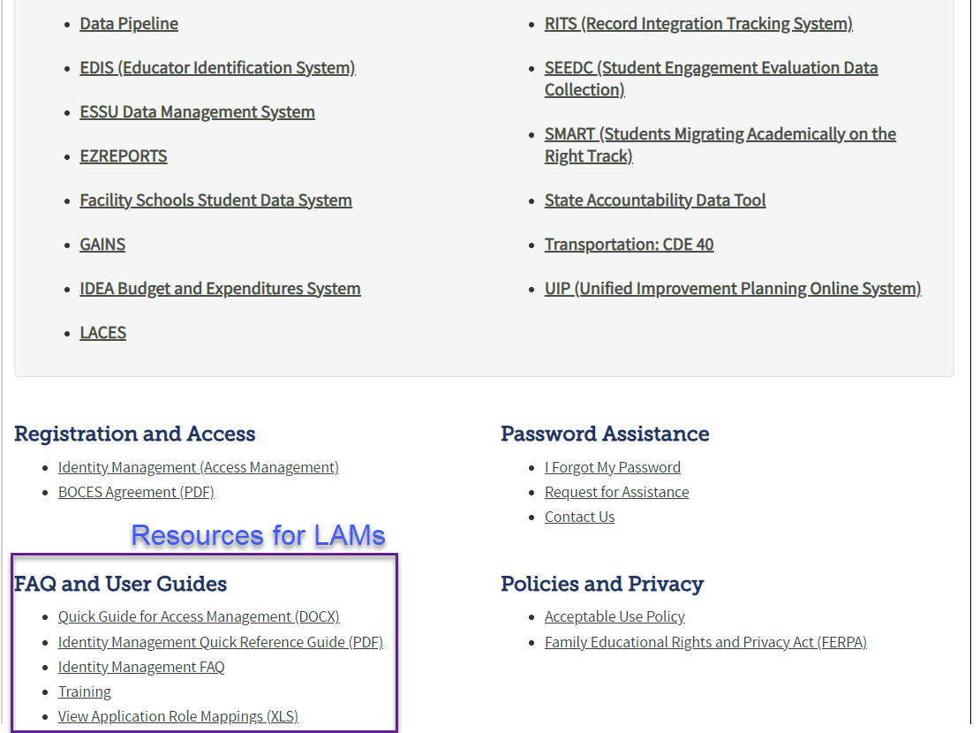
Bookmark the IDM home page. This is where you’ll find the Registration and Access section (IdM)
Local Access Manager (LAM)
Responsible for approving and administering access to CDE systems for all users within their organization.
District and AU LAMs (access to assign 4-digit or 5-digit group roles)
LAMS: Click Identity Management to add or modify user accounts

Slide 10
Data Pipeline IdM Roles - Special Education Collections
IMPORTANT NOTES
Only 1 role per group/per person
AU level roles are associated with the 5-digit AU #
Data Pipeline collection contact lists are generated from IdM roles. We do not keep manual email lists.
Please ask your LAM to update as necessary.
District Respondent (AU STF role optional)
District Respondent (NO AU role option)
Staff Interchange Role Options: STF
STF-LEAUSER – upload Staff Profile, Assignment Files
  OR
STF-LEAVIEWER – view only role for Staff Profile, Assignment Files
Discipline Interchange Role Options: DIS
DIS-LEAUSER – upload and modify Discipline Action File
  OR
DIS-LEAVIEWER – view only role for Discipline Action File
AU Respondent – Snapshot Roles
Special Ed December Count Snapshot Role Options: DEC
  DEC-LEAAPPROVER – approves, creates snapshots OR
  DEC-LEAUSER - creates snapshots OR
  DEC-LEAVIEWER- views snapshots
AU Respondent – Interchange Role
Special Ed IEP Interchange Role Options: SPE
SPE-LEAUSER – upload Special Ed Child, Participation, CEIS Files
  OR
SPE-LEAVIEWER – view only role for Special Ed Child, Participation, CEIS Files
Special Ed End of Year Snapshot Role Options: EOY
  EOY-LEAAPPROVER – approves, creates snapshots OR
  EOY-LEAUSER - creates snapshots OR
  EOY-LEAVIEWER- views snapshots
Special Ed Discipline Snapshot Role Options: SPI
  SPI-LEAAPPROVER – approves, creates snapshots OR
  SPI-LEAUSER - creates snapshots OR
  SPI-LEAVIEWER- views snapshots

Slide 11
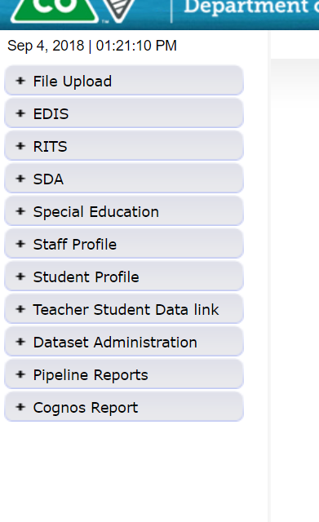
Data Pipeline Access
Data File Upload, Batch Maintenance, Format Checker
These tabs will vary depending on your LEA and level of access.
An AU respondent should always see a Special Education tab.
You will only see the Staff Profile tab if you have an STF role.
Status Dashboard/Snapshot tabs based on your IdM Roles
Error reports and other validation reports

Slide 12
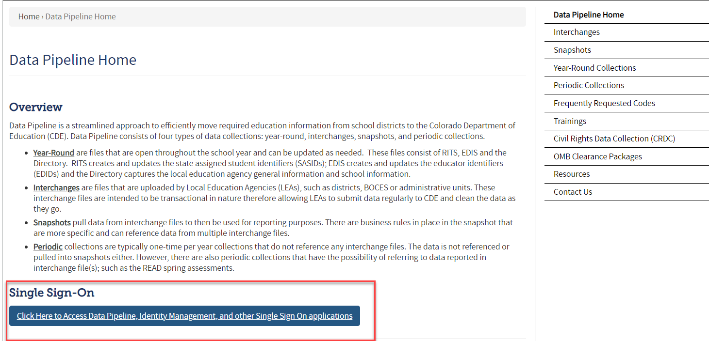
Data Pipeline Collection Resources
IEP Interchange Resources
Please bookmark this link for accessing the Data Pipeline Resources for all collections:
https://www.cde.state.co.us/datapipeline
Special Education December Count and EOY Resources
Codes – frequently used codes found here (AU codes, school codes, special education program codes, Allowed Eligible Facility codes)
All Pipeline collection dates, Mandatory Collections- legislation and uses, converting csv files to excel, and more

Slide 13
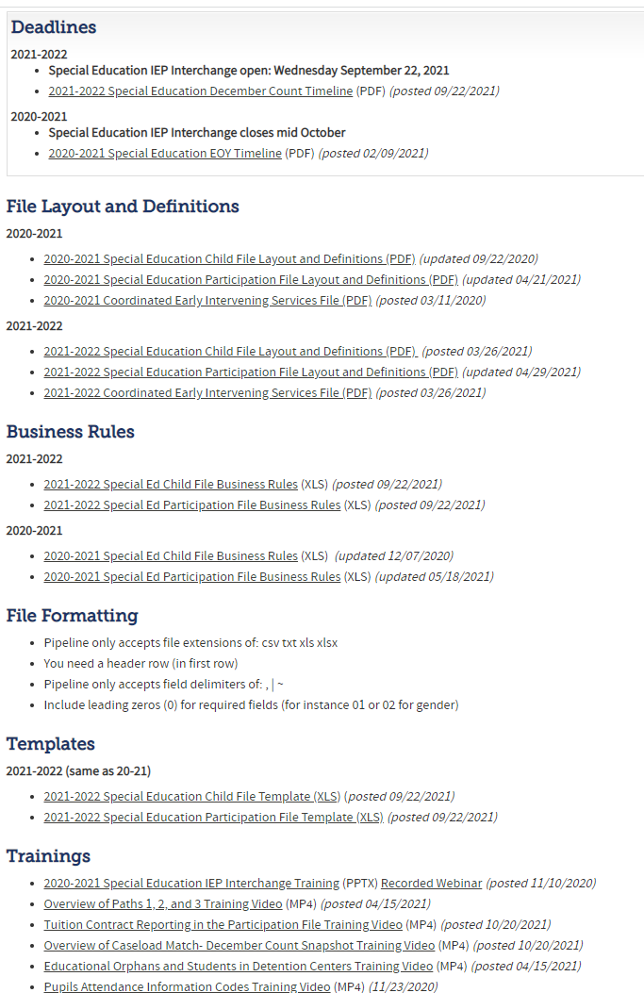
Special Education IEP Interchange Resources
Special Education IEP Interchange Webpage
At this link you will find:
Timelines
File Layouts
Business Rules
Templates
Training Slides/ Webinars
Additional Resources

Slide 14
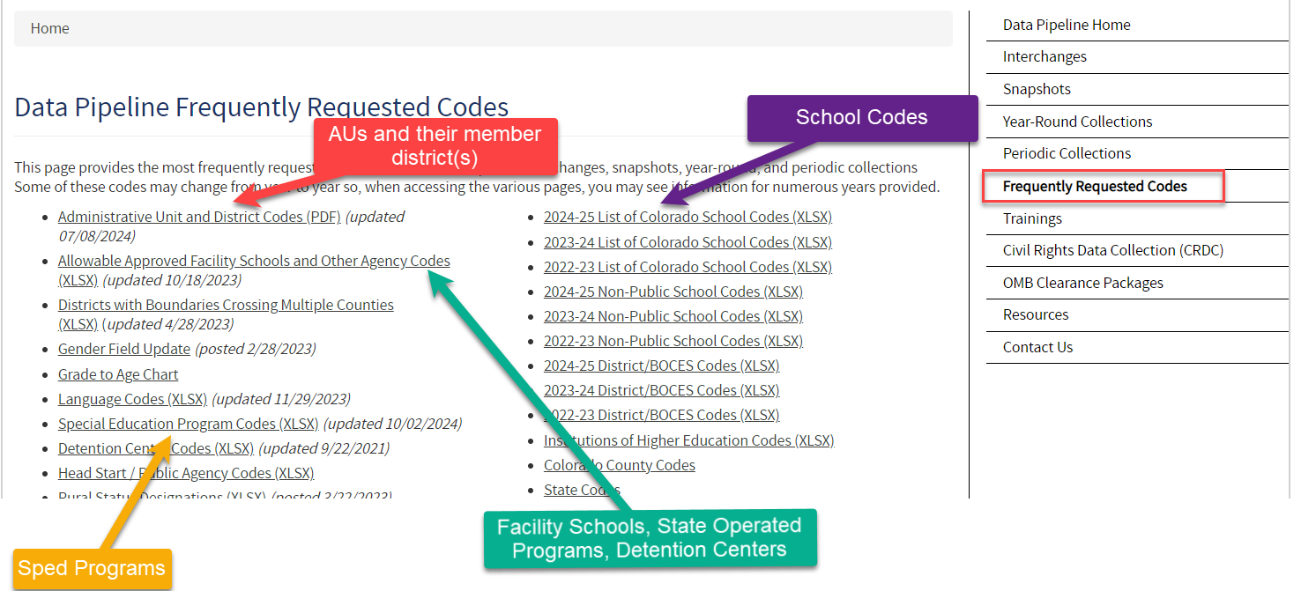
Frequently Requested Codes Webpage
https://www.cde.state.co.us/datapipeline/org_orgcodes
School Codes, AU Codes, Facility School Codes, Sped Program Codes, and more

Slide 15
Interchanges
Data Pipeline
Interchanges webpage
An interchange is a holding place for your data in which you may continually upload and validate your data files throughout the year. The interchange data is not your finalized dataset. See next slide for snapshot details.
There are 7 Interchanges:
At-Risk
Discipline
Special Education IEP
Staff
Student
Teacher/Student Data Link
Title 1
Data from the Interchanges in orange are included in the Special Education December Count Collection.
Interchanges house your data throughout the school year!

Slide 16
Snapshots
Data Pipeline
Snapshots webpage
A snapshot is a point in time “picture” of specific data fields extracted from the Interchange files.
There are 11 snapshots:
Attendance
Human Resources
READ
Special Education December Count
Special Education Discipline
Special Education End of Year
Staff Evaluation
Student Discipline
Student End of year
Student October
Teacher Student Data Link
The snapshots in orange are the three snapshots (collections) required by Administrative Units.

Slide 17

Special Education December Count Snapshot
1. Student Snapshot
2. Staff Snapshot
Data is pulled from these Data Pipeline Interchange files:
Special Education Child
Special Education Participation
Staff Profile
Staff Assignment
Student School Association
Student Demographic
District Responsibility:
Student Interchange
Staff (include Sped staff if AU is not uploading staff data)
AU Responsibility:
Special Education IEP Interchange
Sped Staff (ONLY if district is not uploading Sped staff)
IEP
IEP
STUDENT
STUDENT
STAFF
STAFF

Slide 18
Special Education IEP Interchange
Collection Year Timeline
2024-2025 Special Education IEP Interchange
Open from 10/01/2024 – 09/30/2025
Collects data for reporting period of 07/01/2024 – 06/30/2025
10/01/24 – Sped IEP Interchange opens
December Count Snapshot Due 2/21/25
11/01/24 – Sped December Count Snapshot opens
5/01/25 – Sped Discipline and Sped EOY Snapshots open
Sped Discipline Snapshot Due 7/31/25
Sped EOY Snapshot Due 9/30/25
2024-2025 Special Education Snapshots
December Count contains active SPED students and staff as of 12/01
Sped Discipline contains SPED students who had a discipline action during the school year
SPED End of Year contains all students in which your AU conducted an initial evaluation for special education and those you provided services to throughout the school year

Slide 19
Special Education IEP Interchange
Files and Data Collected

Slide 20
Special Education IEP Interchange Data
Special Education Child File
  Required by all AUs
  Student demographic information
Special Education Participation File
  Required by all AUs
  Special Education services and referral information
Medically Necessary Services Screen
  Required by all AUs
  AUs must report to CDE the number of requests for access to a student by a private healthcare specialist and whether the access was authorized or denied. Should include all students and all districts within AU.
  Input screen in Data Pipeline to manually add counts related to medically necessary services
Coordinated Early Intervening Services File
  As needed - only required if your AU funded CEIS or CCEIS using federal dollars
  You will be contacted by CDE if you need to upload this file

Slide 21
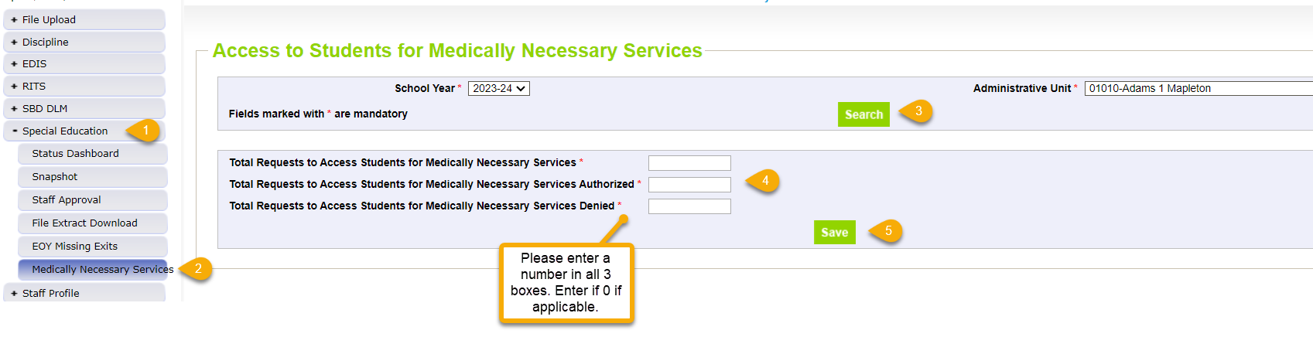
Medically Necessary Services:
Steps to Submit Counts to Data Pipeline
Steps
1. Click Special Education tab
2. Click Medically Necessary Services tab
3. Select School Year/AU and click Search button
4. Enter a number in all 3 boxes
5. Click Save button
Notes:
Counts must reflect all requests within all districts in the AU from 7/01/2024 – 6/30/2025
Counts include all students, not just Sped students
Must be completed by the time Sped EOY is approved fall 2025
# Requests Authorized
# Requests Denied
Total # of Requests

Slide 22
Special Education IEP Interchange –
Child and Participation File Details
Child File
Demographic information
1 record per student
The primary source of this information is the Student Interchange Student Demographic File – as long as the LASIDs match between Student Interchange files and IEP Interchange files
If student is not required to be submitted in the Student Interchange (private school, or facility students) the demographic data is pulled from this file into the snapshot
Participation File
Special Education services information
1 record per student
Record should reflect a student’s latest Sped status in the AU within the reporting period
The primary source of the Entry Grade Level field is the Student Interchange Student School Association File
If student is not required to be submitted in the Student Interchange (private school, or facility students) the Grade Level is pulled from this file
Each record must have a valid SASID and/or a LASID
Each record must have a matching record SASID/LASID combo on each file
LASIDs should match district uploaded Student Interchange files for the demographics to pull from the district files

Slide 23
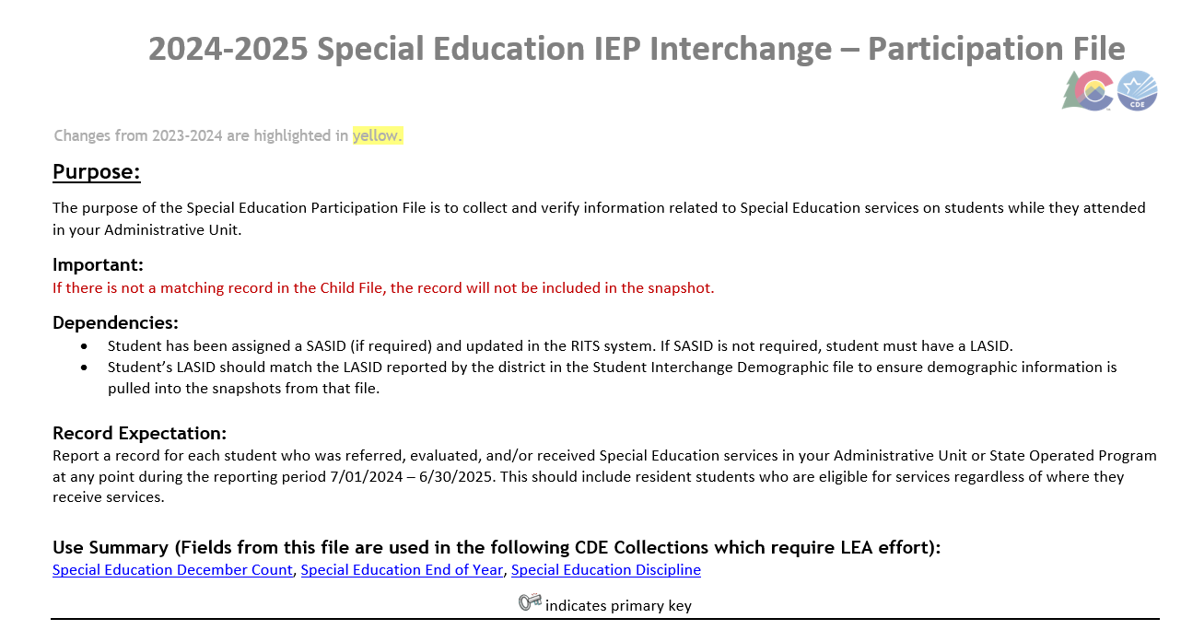
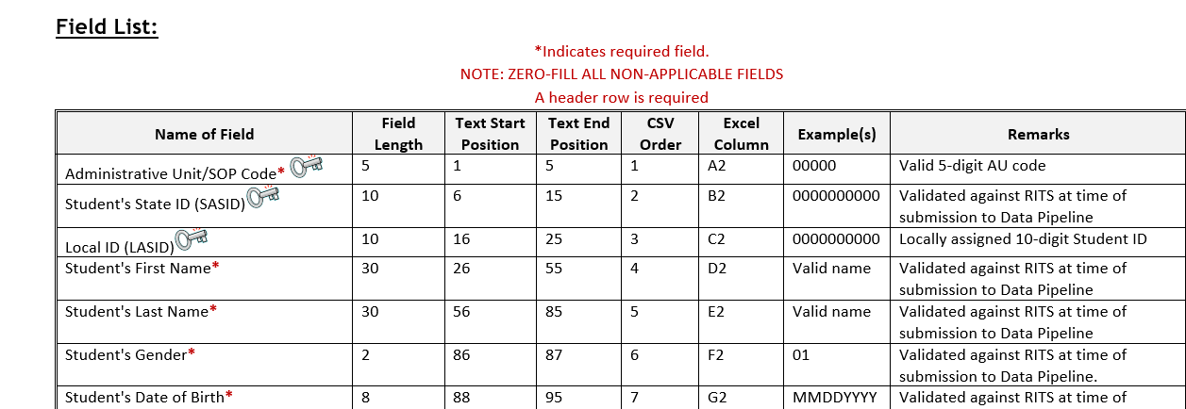
Screen Shot of the Participation File Layout
What’s included in the file layout?
Data field name, definition, and applicable codes for each field provided below the ordered format
Name and Order (format) of the fields
Number of characters in each field
Examples and remarks that help clarify
Changes listed at bottom of layout and highlighted yellow or strikethrough in red

Slide 24
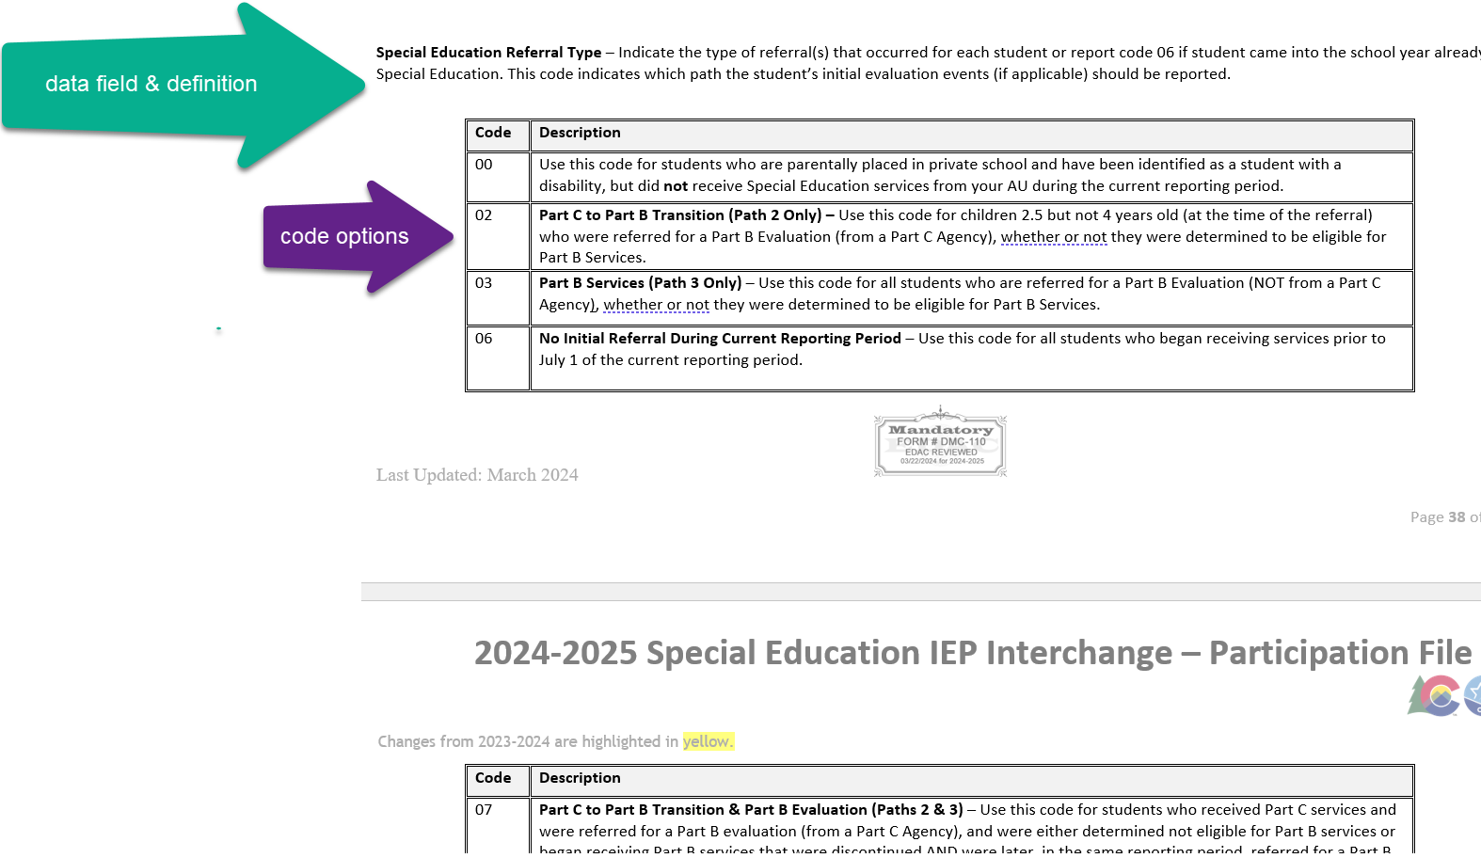
Special Education Participation File Layout
Data Field Definitions
All applicable codes and their definitions for the field

Slide 25
IEP Interchange and Snapshot Uses
Special Education IEP Interchange data is used in the following snapshots:
Notes on the Snapshot Process:
  Each snapshot pull records from the Child and Participation files based on the criteria set for that snapshot
  Keep in mind you may need to “manually” modify your interchange files’ data based on which snapshot is open to get the right records in your snapshots
  Snapshots are not automatically updated when interchange files are uploaded- a new snapshot must be created within the system to pull in the updated records
  Check the snapshot file layouts to see which data fields pull into each snapshot
  *Note: Error-free interchange files are not required to take a Snapshot but recommended. Get your interchange files as close to error free as possible before taking a snapshot!
Special Education December Count
Special Education End of Year
Special Education Discipline

Slide 26
Who to Report:
December Count Snapshot Purposes
Students in Special Ed who were receiving services per an IEP as of 12/01/2024
Parentally Placed Private School Students with a disability (all ages 3-21)– those receiving services per an ISP, IEP, and those not receiving services from the AU
Please Include:
all AU residents, regardless of where they attend
all students who attend your AU, regardless of where they live
residents in approved facility schools
any possible educational orphans in a residential facility within your AU

Slide 27
Who to Report:
Sped EOY Snapshot Purposes
Received services in your Administrative Unit (or a detention center within your AU) at any point during this reporting period (July 1-June 30)
Had an initial evaluation for Part B services:
  were 2.5 but not 4 years old when they were referred from Part C (early intervention services) to Part B Special Education services (path 2)
  were referred for a Part B special education Initial Evaluation (path 3)
Were placed in an approved CDE Facility School and you are the Administrative Unit of residence
Were detained at a Detention Center located within your AU boundaries
Were on an IEP and received services at a private school on a tuition basis or parentally placed in a private school, have an ISP and receive Sped services from the AU
received services outside the State of Colorado and are the responsibility of your Administrative Unit (these students are placed out of state per their IEP and should be reported by the Administrative Unit of Residence).
were evaluated, even if they were found not eligible. Check your data extracts to make sure students found not eligible are being reported too
*more specific details on who should be reported can be found on the Special Education EOY Data Content Guide pages 1 and 2. Posted here under Additional Resources:

Slide 28
Participation File Data Fields and
Which Snapshot They Pull Into
Fields in BLACK pull into both snapshots
Fields in RED only pull into December Count Snapshot
Fields in GREEN only pull into Sped EOY Snapshot
Special Ed December Count Student Snapshot - status as of 12/01
Special Ed EOY Snapshot - latest status in the school year in your AU
Primary Disability
School Code/Eligible Facility/Detention Code
Special Education Program Code
District of Attendance
Student’s District of Residence
State of Parent's Residence for Non-Residence Students
State of Attendance
Grade Level
SPED Pupil’s Attendance Information
Educational Orphan
Parentally Placed in a Private School
Special Education Funding Status
Educational Environment
Primary Service Provider’s EDID
Secondary Service Provider EDID fields 1, 2, 3, 4
Primary Disability
School Code/Eligible Facility/Detention Code
Special Education Program Code
District of Attendance
Student’s District of Residence
State of Parent’s Residence for Non-Residence Students
State of Attendance
Grade Level
Date of Entry to Special Education
Date of Exit from Special Education
Hours of Special Education Services per Week
Total School Hours per Week
Extended School Year Services
Basis of Exit
Special Education Referral Type
Current Eligibility and Services

Slide 29
Participation File Data Fields and Which Snapshot They Pull Into:
Path 2 and 3 Data Fields – Sped EOY only
Special Education EOY Snapshot Path 2 Data Fields
Special Education EOY Snapshot Path 3 Data Fields
Date Child is Found Eligible for Part C Services
Date of Referral to Administrative Unit from the Local Community Centered Board
Date of Parental Consent to Evaluate C to B
Date Evaluation Completed C to B
Reason for Delay in Completing the Evaluation C to B
Date of Initial Eligibility Meeting
Reason for Delay in Initial Eligibility Meeting C to B
Date IEP was Implemented C to B
Reason for Delay in IEP Implementation C to B
Eligibility and Services Path 2
Date of Parental Consent to Evaluate Part B
Date Evaluation Completed Part B
Reason for Delay in Completing the Evaluation Part B
Date of Initial Eligibility Meeting Part B
Date Initial IEP was Finalized Part B
Reason for Delay in Finalizing the Initial IEP Part B
Date IEP was Implemented Part B
Reason the IEP was Never Implemented Part B
Eligibility and Services Path 3
The edits for these data fields are switched to warnings during the December Count timeframe!

Slide 30
Data Pipeline IEP Interchange Process

Slide 31
File Upload
Tips
Refer to the File Layout and Definitions document for details on each file
Excel, CSV, or Text formats are accepted
Excel templates for Child and Participation Files posted on the IEP Interchange page under Templates (if needed)
No blank fields (file likely won’t upload if there are blanks)
Be sure the file is not open when uploading it
Be sure each field has the correct number of bytes
PLEASE BE AWARE OF THIS ISSUE WITH CSV Files
  CSV files lose leading zeros within a data field after opening. A file will not upload/process successfully unless the field has the correct number of bytes so any field that could start with a zero will not have the correct number of bytes unless you format it to text to retain those leading zeros. Find steps for retaining leading zeros posted here.
  Create a folder to save your files in as you work on each snapshot.
  Use a versioning process that makes sense to you to keep track of the file revisions.
  Create an email folder for handling the Data Pipeline system generated emails as you will need to refer to them throughout the Data Pipeline process.
  Be sure to save your final set of files for each snapshot.

Slide 32
Data Pipeline Process Overview – IEP Interchange
Steps can take place throughout the school year
1. Extract Child File and Participation File from SIS and upload files to Data Pipeline
  Enrich system uses web transfer to send both files at once to Data Pipeline (no manual upload necessary in Pipeline)
    Enrich users select ‘Child Count 24-25’ option when working on December Count Snapshot
    Enrich users select ‘EOY 24-25’ option when working on Sped EOY Snapshot
2. Check Batch Maintenance for file upload status and wait for a confirmation email from Data Pipeline system
  The email will show you the number of errors in your upload
    NOTE: If the file didn’t process, the email should show you which row of data contains a formatting “error”
3. Check and resolve interchange errors in each file
  Many of the same IEP Interchange file errors are found in both the Enrich system and the Data Pipeline system
    NOTE: Data Pipeline system is the official error source!
  Ideally data field corrections are made in SIS (Enrich, IC, PowerSchool, or other IEP systems used)
    Extract revised files and upload revised files to Data Pipeline. Repeat steps 1-3 until interchange errors are resolved.

Slide 33
Data Pipeline Process Overview – Snapshot, Report Review, Final Approval
Steps 4 and 5 can take place once snapshot opens
4. Create Snapshot
  It is not required to have ALL interchange errors resolved when you start taking snapshots, but it is recommended. Any records with interchange errors will not be pulled into your snapshot.
5. Check and resolve snapshot errors (review warnings too)
  Changes made in SIS (Enrich or other IEP systems) and files reloaded to interchange
  Go back to steps 1 and 3 – check for new interchange errors before taking a new snapshot
6. Review reports and make any changes necessary
  Go back and redo steps 1 – 4 until all errors are resolved and data is accurate
7. Print reports, sign, and upload signed reports to the Data Management System
8. Approve and finalize snapshot in Data Pipeline

Slide 34
Data Pipeline Process Overview
Extract files from SIS/update data files
Upload files under Data File Upload
Check Batch Maintenance screen/wait for confirmation email
Review error reports
Correct data in source system
Create Snapshot – pulls in error free interchange records

Slide 35
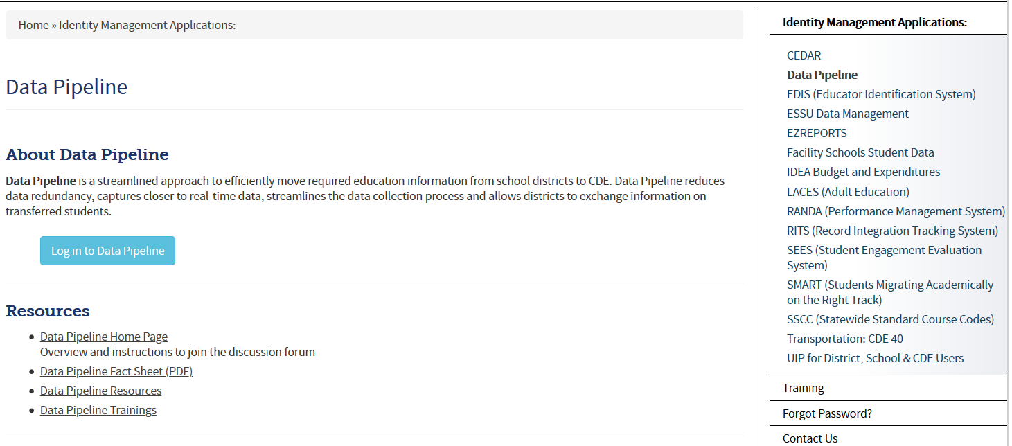
Where to Access the Data Pipeline
From bookmarked IdM homepage link, click the Data Pipeline bullet point to get to this screen. Next click
the blue login button shown below.

Slide 36
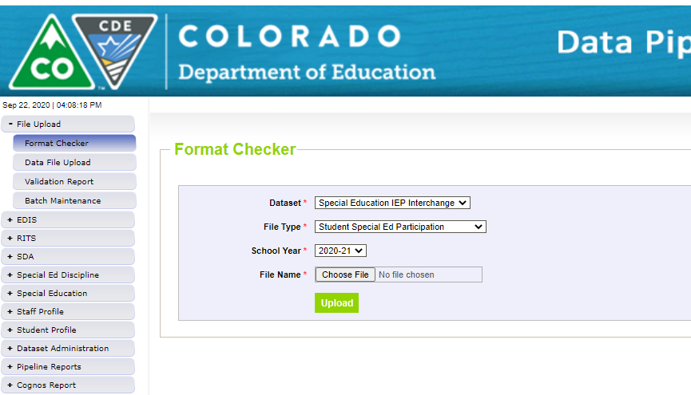
Format Checker Optional Check
Once the file is created, you have the option to run it through the Format Checker to help confirm the format is correct.
Format Checker ONLY checks the first row of data (2nd row on the file because you must have a header).
A field will only fail if there are too many characters in the field (too few will pass the format checker but file won’t successfully process).
All fields PASS = Ready to upload but doesn’t mean it’s completely correct. You must have the correct number of characters in each field and it will only fail if there’s too many vs too few.
Find the IEP Interchange file templates on the Special Education IEP webpage under the Templates section.

Slide 37
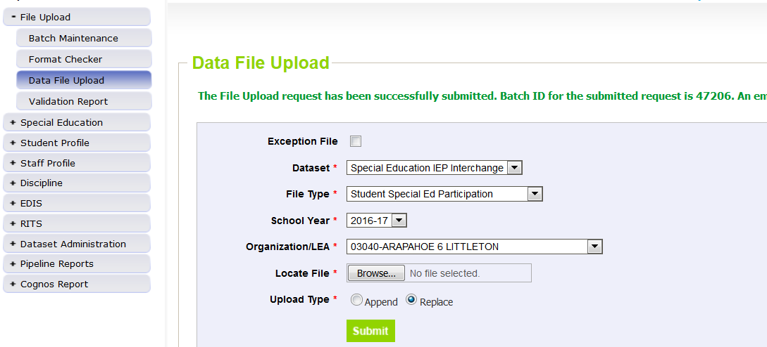
Step 1: Data File Upload
Click on File Upload -> Data File Upload
Select Dataset: Special Education IEP Interchange
Select File Type: Participation, Child, or CEIS
Select School Year and Organization/LEA (AU)
Click on Browse to locate File
Choose Replace or Append
  Most AUs use Replace
Click Submit
  message in green flashes across the top. A Batch ID will be created.
  This message does not mean the file has uploaded successfully!
REPLACE – deletes any prior uploaded data and replaces it with new file. *Recommended
APPEND – adds to existing data. Allows for multiple files to be uploaded at one time. Records on all files uploaded that meet the criteria will pull into snapshot.

Slide 38
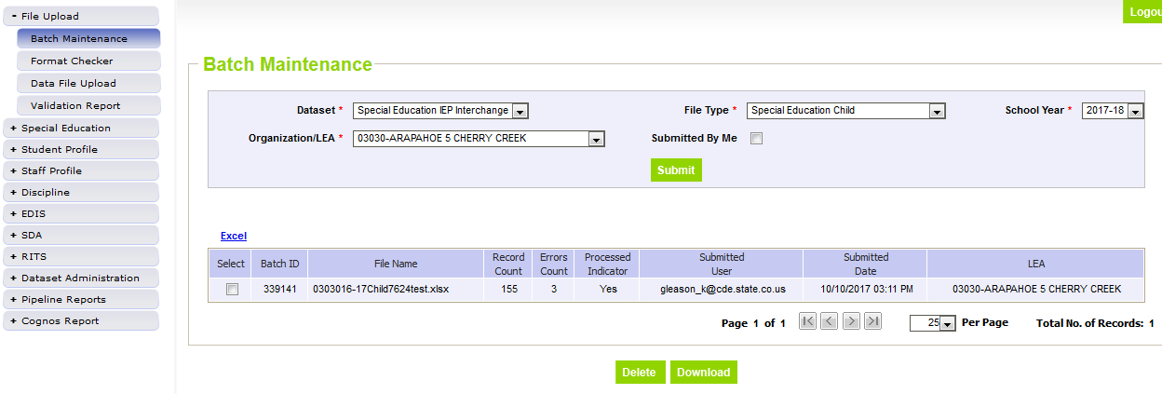
Step 2: Wait for email confirmation and check Batch Maintenance – Important Step
After every file upload, check Batch Maintenance to ensure files have processed successfully
Processed Indicator will say “YES”. If blank or “No”, file did not upload
Check Record Count, Error Count, and make sure submitted date and time look accurate
Check this screen once email is received or check here if email was not received at all.

Slide 39
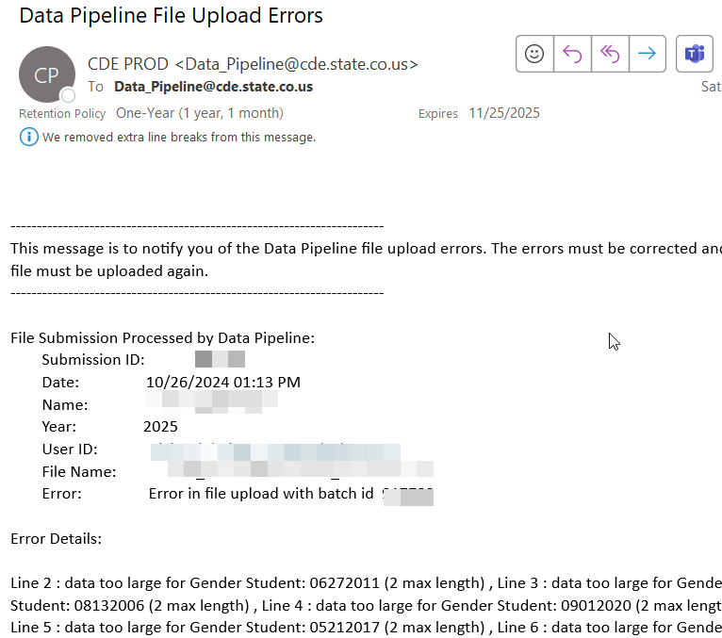
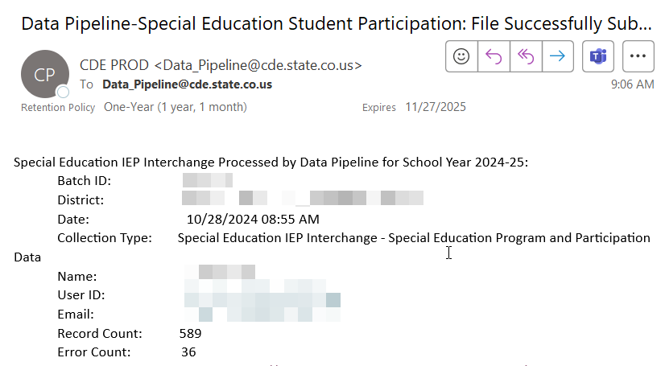
File Upload: Email Confirmation
Check email to ensure file was successfully uploaded – you should receive a confirmation email for each file uploaded or snapshot taken.
Email when file does NOT upload successfully
Email when file uploads successfully

Slide 40
File Did Not Process
Things to check:
Are you losing leading zeros? CSV formatted files lose leading zeros and columns must be formatted to retain them: https://www.cde.state.co.us/datapipeline/resources
Be sure there are no spaces in the name of the file
Be sure the file isn’t open when you upload it
Run the file through Format Checker to be sure you aren’t missing a field or need to remove a field
Check file for blank fields
  In Excel, add filters and check the filters box in each column for blank fields
Verify # of characters in each field are correct – use right and left justify
If none of these help, try copy/paste special values the cells with data into a new spreadsheet/template

Slide 41
Step 3: Check and Resolve IEP Interchange Errors
Two options for reviewing errors-both have a summary report and a detail report:
  Pipeline Reports - Error Reports/Special Education IEP Interchange
    Faster access and more user friendly
    Only exports the first 1000 errors to Excel
  Cognos Reports – Special Education IEP
    Will show all errors
    Can produce strange error screens - requires you to clear your browser cache periodically
The list of all Special Education Child File and Participation File Business rules (also known as edits, errors and warnings) can be found on the Special Education IEP Interchange webpage under the ‘Business Rules’ section.

Slide 42
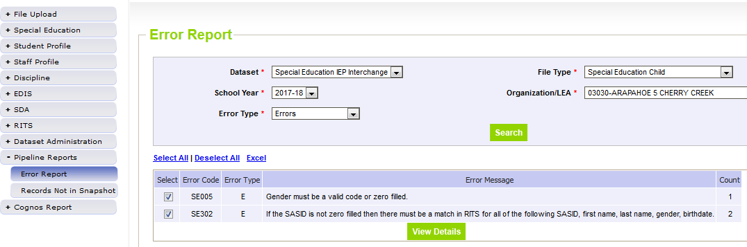
Checking IEP Interchange Errors under Pipeline Error Reports
Option for reviewing Interchange and Snapshot level error reports under Pipeline Reports. First click ‘Error Report’ and then filter on the following:
Dataset: Special Education IEP Interchange
File Type: select which file errors you want to view
Choose Error Type: Errors and Warnings, or just Errors, or just Warnings
Click Search
To see student level details, click View Details. To view in Excel, click Excel button.

Slide 43
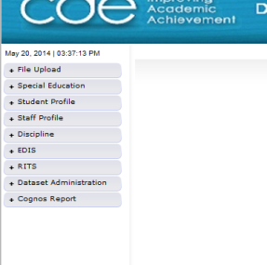
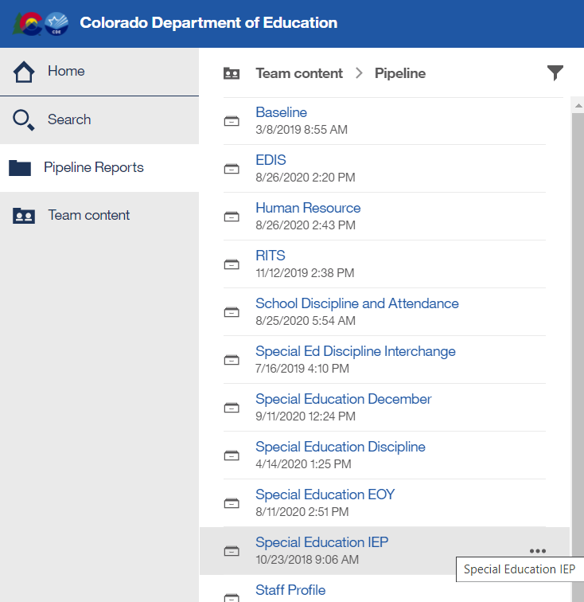
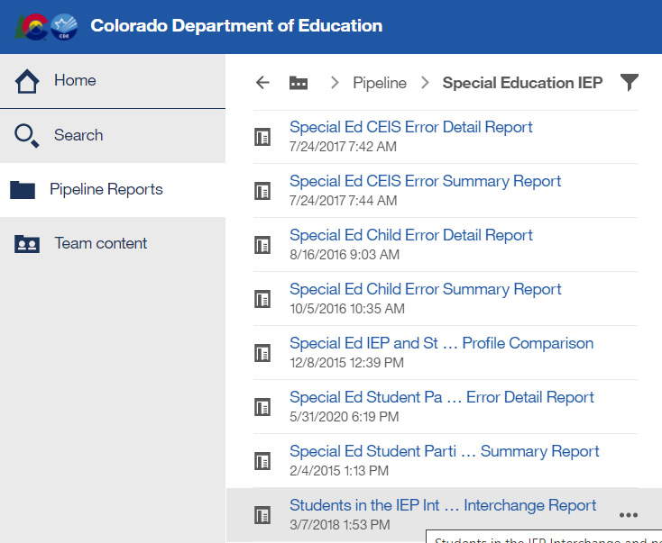
Checking IEP Interchange Errors under Cognos Reports
  In Data Pipeline click Cognos Reports tab and a new application will open with a list of folders.
  Next double click on the Special Education IEP folder which should bring up a list of reports.
  There is a Detail and Summary Error Report for each File. Double click on the name of the report to open it.

Slide 44
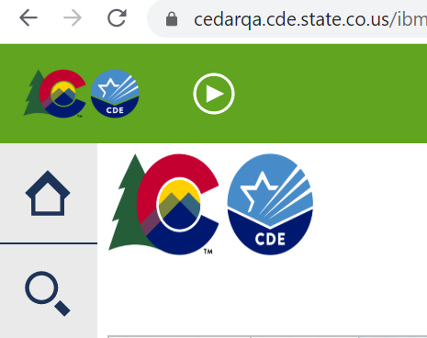
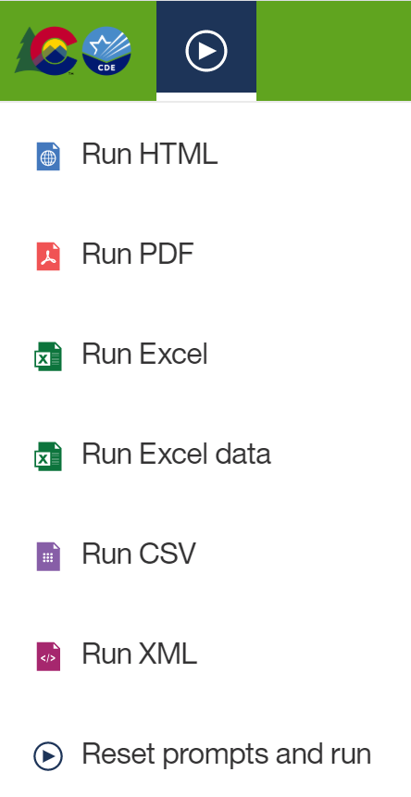
Exporting Cognos Report to Excel
Click on ‘Play’ Button
(available when a report is showing)

Slide 45
Special Education IEP Interchange: Contact Info
If you have any questions about the Special Education IEP Interchange, please use the snapshot email address that you’re working on. If it’s a general question, feel free to send to me directly.
December Count Snapshot email address SpedDecCount@cde.state.co.us
Special Ed EOY Snapshot email address SpedEndofYear@cde.state.co.us
Special Ed Discipline Snapshot email address SpedDiscipline@cde.state.co.us
Lindsey Heitman (720) 456-2033 heitman_l@cde.state.co.us
Email protocol – please include:
Administrative Unit #
error code # or school code # if applicable
Phone number
THANK YOU!

