Slide 1
Attendance Snapshot Training
2023-2024
Stick around for a live demonstration of Data Pipeline and the website after the presentation!

Slide 2
Attendance Snapshot Purpose
Districts are required to report to CDE the following data:
  Attendance for all students
  Students who are habitually truant
  Students who are chronically absent
CDE must report the above to the public and to the US Department of Education (EdFacts)

Slide 3
Attendance Snapshot Training Overview
The goal of this training is to help Districts/Local Education Agencies (LEAs) provide CDE the attendance data more efficiently and accurately
This training will include
  File information
  Creating the Attendance Snapshot
  Reviewing Errors/Warnings and Reports
  Finalizing the data (submitting to CDE)

Slide 4
Attendance Timeline
Date | Event | Event Description
04/17/2024 | Open | Districts may begin creating snapshots. Attendance Snapshot dependencies are the Student Demographic File and Student School Association File.
05/08/2024 10:30-12:00 p.m. | Training Event | Collection Overview Training
05/09/2024 | Interim Deadline | Upload Student Demographic and Student School Association Files
05/28/2024 | Interim Deadline | Create an initial Attendance Snapshot
06/12/2024 | Interim Deadline | Error free Student Interchange file uploads
06/26/2024 | Interim Deadline | Error free Attendance Snapshot
07/05/2024 | Report Review | Review Attendance Cognos Reports for data validation. Submit Attendance Snapshot data as soon as review is complete.
07/12/2024 | Deadline | Submit Attendance Snapshot data.
07/26/2024 | Deadline | Collection closes Superintendent Verification (sign-off) form due. Data remains embargoed until the official release in August.
08/16/2024 | Data Release | Official data release
See the Attendance website for collection timeline

Slide 5
Understanding the Attendance Snapshot

Slide 6
District or Board Policy-Attendance/Data Uses
Legislation Website
Local board adoption of written policy setting forth districts’ or BOCES’ attendance requirements
Based on your district or BOCES policies for attendance
Data Uses
  US Department of Education reporting
  Public Reports – Statistics Website
  Media and Research Requests
Topics of Interest:
  Attendance and Truancy Rates
  Chronic Absenteeism – counts and rates
  Habitually Truant Statistics

Slide 7
Personally Identifiable Information (PII)
Personally Identifiable Information (PII) is defined by state and federal laws as information that alone, or in combination, personally identifies an individual
  Includes direct identifiers (i.e. SASID, student names)
  Includes information when combined is identifiable
Colorado’s Student Data Transparency and Security Act outlines requirements for how Student PII is collected, used and shared
See CDE’s data security and privacy site for more information

Slide 8


Communicating PII – Syncplicity
At times data respondents may need to communicate PII with the ATS collection lead, this must be done through secure methods. DO NOT EMAIL PII
  Phone call is secure method; 720-441-7963
  Please do not leave PII in voicemail but rather request a return call to discuss PII
Syncplicity
  Secure file transfer site used to communicate PII with CDE collection leads
  Each collection lead maintains their own Syncplicity folder and can assign rights to that folder
    Student End of Year, Student October, and Attendance all utilize the same primary folder with subfolders to organize the collections
      Primary Syncplicity Folder: District Code – DISTRICT NAME – Student
      Subfolder: ATS 2023-24
  Email CDE collection lead when a file
  has been uploaded to syncplicity for review
    Attendance@cde.state.co.us

Slide 9
Quick Guide for Attendance Reporting
All attendance student-level data will be reported in the Student Interchange: Student School Association File
  You need the STD~LEA User role to make any updates to the Student files OR
  You will need to work with the Student Interchange respondent to make updates during the Attendance snapshot process
IDM Roles – Can be assigned by your LAM (Local Access Manager)
You will need at least 1 person in your district assigned to LEAPPROVER
Application | Collection | Role | Internal Name
Pipeline | Student Interchange | LEA USER | -STD~LEAUSER
Pipeline | Attendance | LEA USER or APPROVER | -ATS~LEAUSER -ATS~LEAAPPROVER

Slide 10





Student Interchange Files
Student Demographic File
  One record per student
  Upload this file first
Student School Association File
  May include multiple records per student
  Only records meeting the snapshot criteria will pull into ATS
Student Interchange
Graduation Guidelines File*
  Secondary students only
  Expect multiple records per student
Adjustment File*
  As needed for SEY Collection
*Not needed for Attendance Snapshot

Slide 11
Snapshot (collection): Source Files
A data snapshot begins with uploading the corresponding interchange files. These interchange files become the source of information, or source file for specific data fields on a snapshot.
Source File A
Contains multiple columns of data/information as outlined on the file layout for this source file.
Source File B
Contains multiple columns of data/information as outlined on the file layout for this source file.
File A: Element 1
File A: Element 2
File B: Element 1
File B: Element 2
File A: Element 4
File A: Element 3
File A: Element 5
File B: Element 3
File B: Element 4

Slide 12
Snapshot (collection): Creation
When a snapshot is triggered, it pulls needed information from the source (interchange) files into a new file called the snapshot.
Source File A
Source File B
File A: Element 1
File A: Element 4
File B: Element 1
File B: Element 4
File A: Element 2
File A: Element 3
File A: Element 5
File B: Element 2
File B: Element 3
Snapshot

Slide 13
Snapshot (collection): Internal Flags
Snapshots typically won’t use every data element on a source file.
Snapshots often pull in information called “internal flags.” These are calculated pieces of data from information provided on the interchange files or from other internal data in data pipeline.
Source File A
Source File B
Internal Flags
File A: Element 2
File A: Element 5
File B: Element 3
Internal Flag: 1
Internal Flag: 2
Internal Flag: 3
Snapshot
File A: Element 1
File B: Element 1
File A: Element 3
File A: Element 4
File B: Element 2
File B: Element 4

Slide 14
Attendance Data Fields – Reported in Student Interchange
A data snapshot begins with uploading the corresponding interchange files. These interchange files become the source of information, or source file for specific data fields on a snapshot.
Student Demographic/Student School Association data fields
  District Code
  Name (Last, First, Middle)
  School Code
  Total Days Attended
  Total Days Excused
  Total Days Unexcused
  Total Possible Attendance Days
  Habitually Truant
  Etc…
File Type | Student | Data Elements in File
Student Demographic - DEM | Johnny Smith | Race, FRL Status, English Language Learner Information
Student School Association -SSA | Johnny Smith | School Code, Entry Date, Exit Date, Total Days Attended, Total Days Excused, Total Days Unexcused, Total Possible Attendance Days

Slide 15
Attendance Data Flags – Calculated in Pipeline
When a snapshot is triggered, it pulls needed information from the source (interchange) files into a new file called the snapshot.
Snapshots typically won’t use every data element on a source file.
Snapshots often pull in information called “internal flags.” These are calculated pieces of data from information provided on the interchange files or from other internal data in data pipeline.
Internal Flags:
  Federal Race
  Special Education
  Migrant
  ELL
  Foster
  Chronically Absent Status
  Gifted and Talented
File Type | Student | Data Elements in File
Attendance Snapshot | Johnny Smith | Race, FRL Status, ELL, School Code, Entry Date, Exit Date, Total Days Attended, Total Days Excused, Total Days Unexcused, Total Possible Attendance Days, Chronically Absent Status

Slide 16
Attendance Snapshot Records Criteria
Pulls all error-free records from the Student School Association file (that have a matching error-free Demographic record) that match the following criteria:
  School Code is a valid public school AND
  Pupil Attendance Information between 01 and 08 (students attending an educational program operated by the reporting district) AND
  Total Possible Attendance Days is greater than or equal to 10.0 AND
  Grade Level between 004 and 120 (PK-12th) AND
  Entry Date is not the same as the Exit Withdraw Date AND
  Primary School = 1

Slide 17
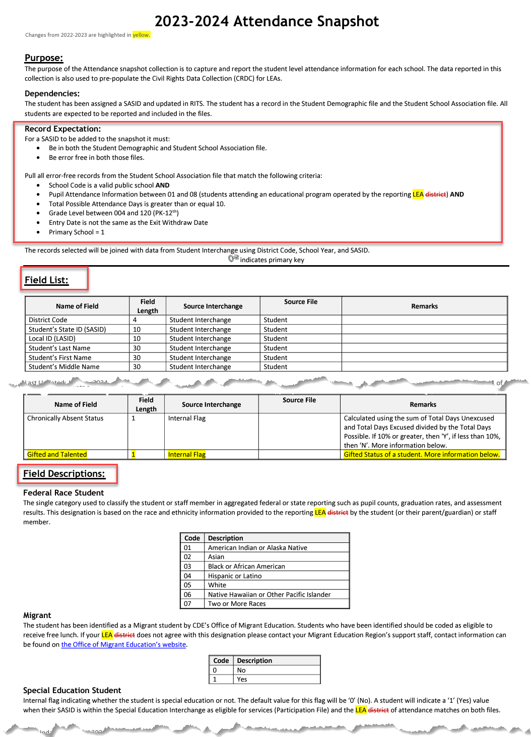
Attendance Snapshot Layout
Purpose: This is where the Overview, Dependencies and Record Expectations are. You can find the criteria in the previous slide here under Record Expectations.
Field List: This is the list of fields that are included in the Attendance Snapshot. Each field will have their Name, Field Length (how many characters are within the field), Source Interchange (what interchange does this information come from), Source File (which specific file is this information pulled from: Student or Student School Association) as well as Remarks. Please note that while we have many of the data elements come from the Student Interchange files, we also have our Internal Flags shown as well like Chronically Absent Status.
Field Descriptions: This is where our internal flag definitions are described. Each internal flag will have a description on how it is calculated.

Slide 18
Reporting Attendance Data
Each record in the Attendance Snapshot represents the attendance information for the student at each school of enrollment
Snapshot only includes students enrolled and in attendance for at least 10.0 days at the school
The student total days possible must equal the sum of their days attended, days excused absent and unexcused absent:
Student Total Days Attended
Student Total Days Unexcused Absent
Student Total Days Possible
Student Total Days Excused Absent

Slide 19
Attendance Data Fields
Total Days Attended
The aggregate number of days the student attended school. If the student attended for at least a half of a day, it should be counted as a full day of attendance
Total Days Excused
The aggregate number of days the student had excused absences (out of school). Absence due to a suspension is excused. (A student who is tardy is not considered to be absent). If the student missed more than a half of a day, it would be counted as a full day absent.
Total Days Unexcused
The aggregate number of days the student was absent (out of school), without being excused from a parent/guardian. (A student who is tardy is not considered to be absent). If the student missed more than a half of a day, it would be counted as a full day absent.
Total Possible Attendance Days
The aggregate number of days the student would have attended school if there had been no absences. Expelled students are included until date of expulsion. This number must equal the sum of Total Days Attended, Total Days Excused by Students and Total Days Unexcused by Students combined.
  *These fields must contain a decimal point when reporting them in the Student Interchange (10.0, 265.0)

Slide 20
Excused Absences
Excused Absences occur when the student is absent for an acceptable reason as identified within the attendance policy set by local school board of education as declared in 22-33-104 (4)(a) C.R.S. which may include, but is not limited to, the following reasons: funeral, illness, injury, legal obligation, medical procedure and religious observation.
Local schools may require appropriate documentation to verify excused absences.
Absences due to suspension or expulsion of a child shall be considered excused absences for purposes of calculating habitually truant students (22-33-107 (3)(a) C.R.S.)
Excused Absences are included in the Chronic Absenteeism Calculation

Slide 21
Unexcused Absences
Unexcused Absences occur when the student is absent without a reason or for an unacceptable reason as identified within the attendance rules set by local school board of education policy as declared in 22-33-104 (4)(a) C.R.S.
If authorized school officials determine that the parent’s excuse is not valid or verified, the absence shall be unexcused.
Unexcused Absences are used to calculate Truancy rates
Unexcused Absences are included in the Chronic Absenteeism Calculation

Slide 22
Habitually Truant Status – Reported in SSA File
Indicate if the student met any of the habitually truant criteria for the reported school record with the corresponding code
0 | Student was not habitually truant
1 | Truant Four or More Days in a Month – The student had four total days of Unexcused Absences from a public school in any one calendar month: calculated by the sum of unexcused absences converted to days and fractions of days.
2 | Truant Ten or More Days in a School Year – The student had ten or more total days of Unexcused Absences, but never accumulated four or more total days of unexcused absences from that public school in any one calendar month: calculated by the sum of unexcused absences converted to days and fractions of days.
3 | Truant for Both Conditions – The student had both four (or more) total days of Unexcused Absences from the reporting public school in any one calendar month and ten or more total days unexcused absences from the same public school during the reported school year; calculated by the sum of unexcused absences converted to days and fractions of days.

Slide 23
Chronically Absent Status – Calculated in Attendance Snapshot
Indicator if the student was absent 10% or more of the days enrolled in the public-school year during the school year.
  A student is absent if he or she is not physically on school grounds and is not participating in instruction or instruction –related activities at an approved off-grounds location for the school day.
  Chronically absent students include students who are absent for any reason (e.g., illness, suspension, the need to care for a family member), regardless of whether absences are excused or unexcused.
Calculated using the sum of Total Days Unexcused and Total Days Excused divided by the Total Days Possible per record. If 10% or greater, then ‘Yes’, if less than 10% then ‘No’.

Slide 24
Data Pipeline Process

Slide 25
Snapshot Process
0. Make sure Student Information System is updated
Extract Interchange Files from SIS and upload Interchange files to Pipeline (Student Demographic, Student School Association Files)
Check Business Rules Associated with Interchange files
Errors on Interchange files?
  Yes – Correct Errors in SIS and go back to step 0
  No – Move on to step 4*
Create Snapshot
Check Additional Business Rules Associated with Snapshot
Errors?
  Yes - Correct Errors in SIS and go back to step 0
  No – Move on to step 7
Review Reports and Finalize
  If you need to correct any data, you will need to go back to step 0
*Note: Error-free interchange files are not required to take an Attendance Snapshot but recommended. Get your interchange files as close to error free as possible before taking a snapshot!

Slide 26
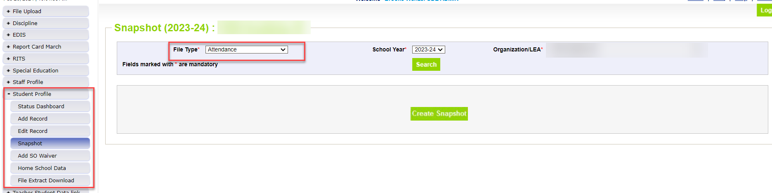
Creating Attendance Snapshot – New (skipped to step 4)
Attendance Snapshot is now located under Student Profile!
  Select Student Profile then Snapshot
  Fill out prompts for Attendance (File Type: Attendance, School Year: 2023-24, Organization/LEA should auto-fill)

Slide 27
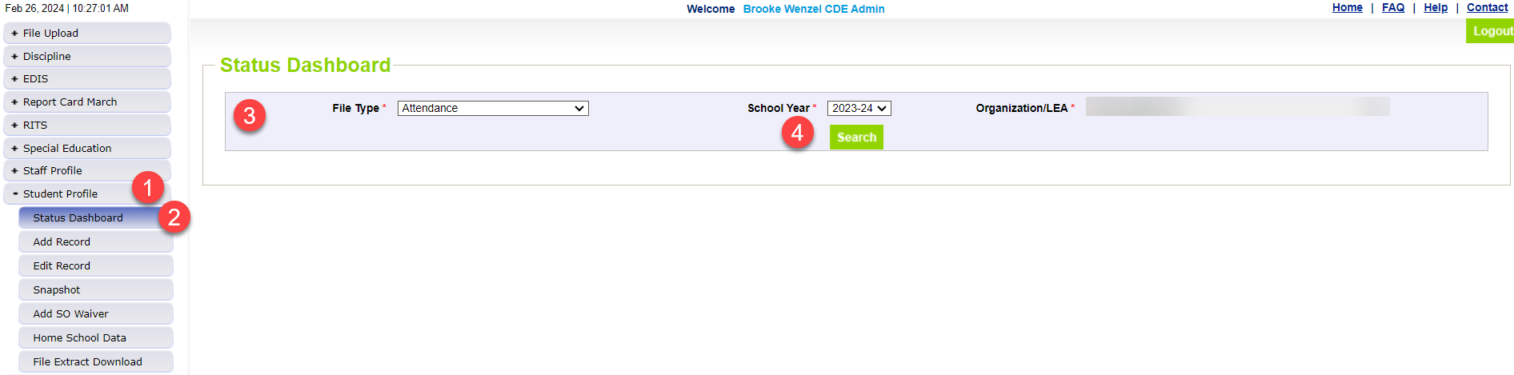
Status Dashboard Screen
To view Status of your Snapshot, you will now navigate under Student Profile
  Select Student Profile then Status Dashboard
  Fill out prompts for Attendance (File Type: Attendance, School Year: 2023-24, Organization/LEA should auto-fill) and click Search

Slide 28
Review Errors and Warnings (steps 5-6)
Two options:
  Using Pipeline Error Report
  Using Cognos/CEDAR
You may use either option exclusively or both throughout
Both options are listed at the bottom of the left tabs in Data Pipeline
Again: You will need to review errors/warnings at both the Student Interchange Level AND Attendance Snapshot Level (both error reports are accessed in a similar way)

Slide 29
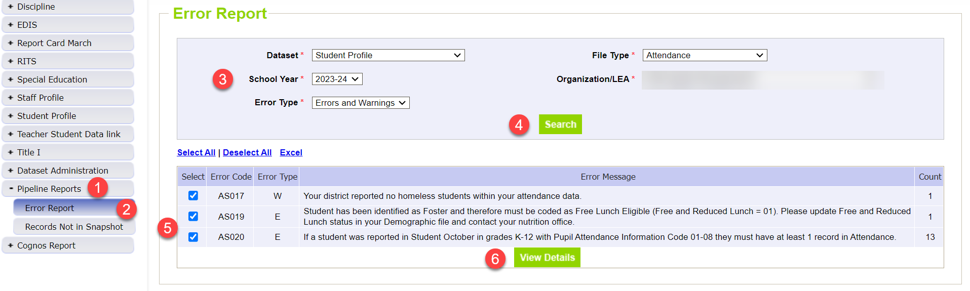
Using Data Pipeline Reports
(Errors and Warnings)
Select Pipeline Reports
Select Error Report
Fill out prompts for Attendance
Click Search
  The list of errors (and warnings should appear)
Use the check boxes on the left of each error/warning to select the ones you wish to view more details about
Click View Details to view more specifics on each error/warning

Slide 30
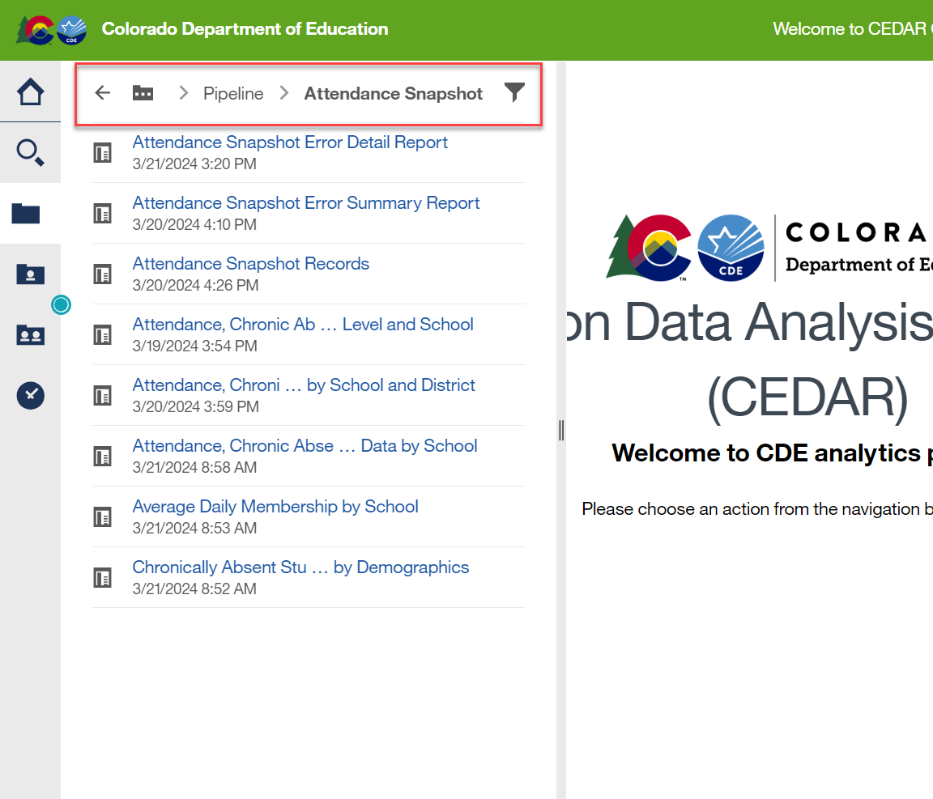
Using Cognos (Errors and Warnings)
Select Cognos Report
Select Solid folder on left-hand side of screen
Click Attendance Snapshot
  The list of reports should be shown.

Slide 31
Snapshot Process (Again)
0. Make sure Student Information System is updated
Extract Interchange Files from SIS and upload Interchange files to Pipeline (Student Demographic, Student School Association Files)
Check Business Rules Associated with Interchange files
Errors on Interchange files?
  Yes – Correct Errors in SIS and go back to step 0
  No – Move on to step 4*
Create Snapshot
Check Additional Business Rules Associated with Snapshot
Errors?
  Yes - Correct Errors in SIS and go back to step 0
  No – Move on to step 7
Review Reports and Finalize
  If you need to correct any data, you will need to go back to step 0
*Note: Error-free interchange files are not required to take an Attendance Snapshot but recommended. Get your interchange files as close to error free as possible before taking a snapshot!

Slide 32
Available Cognos Reports to Validate Data
(other than error reports)
Attendance Snapshot Records
Attendance, Chronic Absenteeism and Truancy Data by Grade Level and School
Attendance, Chronic Absenteeism and Truancy Data by Race/Ethnicity and Gender by School and District
Attendance, Chronic Absenteeism and Truancy Data by School
Average Daily Membership by School
Chronically Absent Students by Demographics
Attendance Cognos Report Guide

Slide 33
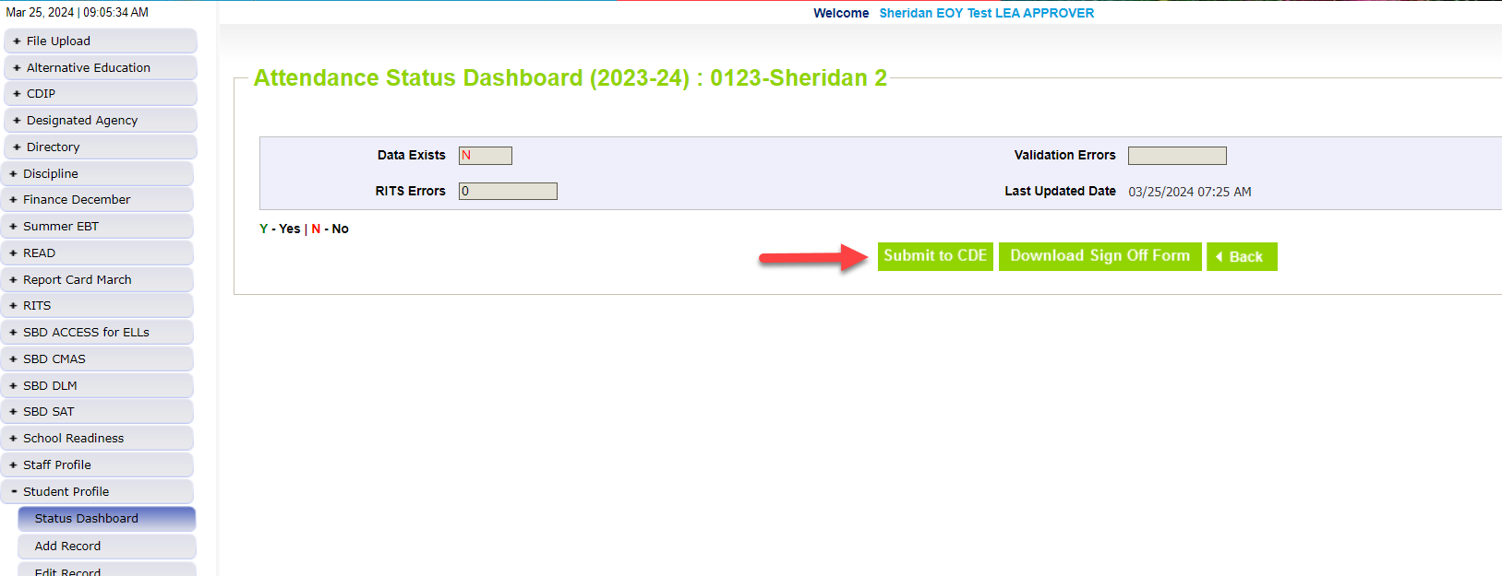
Finalizing Data
Once data is accurate-all reports reviewed and correct…
ATS~LEA APPROVER for district will need to ‘Submit to CDE’
ATS~LEA APPROVER will also need to Download Signoff Form, get it signed by superintendent and emailed back to Brooke Wenzel (Attendance Collection Lead)

Slide 34
Wrapping Up:
Regardless of internal methods, the following metrics must be calculated and reported for each student‘s record in the Student School Association file:
Total Days Attended
Total Days Excused
Total Days Unexcused
Total Days Possible Attendance
Habitually Truant Status

Slide 35
Thank You for Attending! – Stick Around for a live demo of Data Pipeline/Attendance Website
720-441-7963
Attendance@cde.state.co.us
Attendance Snapshot Website
Student Interchange Website

