Slide 1
2023-2024
Special Education December Count
Office Hours
^{December 5, 2023}

Slide 2
Special Education December Count:
Timeline and Trainings
Next Deadline
Friday, December 8^{th /}20th
  Special Education IEP Interchange - AU respondent
  Child File
  Participation File
  Staff Interchange
  Staff Profile File– District and/or AU respondent
  Staff Assignment File– District and/or AU respondent
NOTE: The CDE winter break is 12/22/23 – 01/01/24
Friday’s deadline is a soft deadline/target date and the hard deadline has been moved to 12/20!
SpedDecCount@cde.state.co.us
Lindsey Heitman (303) 866-5759

Slide 3
Special Education December Count:
Snapshot date criteria for record to be included in snapshot
KEY DATES for 02, 03, 07 initial referrals
These dates must be populated and as of 12/01 for funding
Date IEP Implemented = Start Date of Sped
  *This is the date the services started, not the date the IEP was finalized.
*OR you can report an 06 and zero-fill all path 2 and 3 date fields
Path 2 Data Fields (10):
Date Child is Found Eligible for Part C Services
Date of Referral to Administrative Unit from the Local Community Centered Board
Date of Parental Consent to Evaluate C to B
Date Evaluation Completed C to B
Reason for Delay in Completing the Evaluation C to B
Date of Initial Eligibility Meeting
Reason for Delay in Initial Eligibility Meeting C to B
Date IEP was Implemented C to B should = Start Date of Sped
Reason for Delay in IEP Implementation C to B
Eligibility and Services Path 2
Path 3 Data Fields (9):
Date of Parental Consent to Evaluate Part B
Date Evaluation Completed Part B
Reason for Delay in Completing the Evaluation Part B
Date of Initial Eligibility Meeting Part B
Date Initial IEP was Finalized Part B
Reason for Delay in Finalizing the Initial IEP Part B
Date IEP was Implemented Part B should= Start Date of Sped
Reason the IEP was Never Implemented Part B
Eligibility and Services Path 3

Slide 4
Staff Data Checks
Confirm within your LEA who will be uploading your Special Education staff data
Verify district has uploaded your LEA’s staff files
  District/AU Activity Report -->Cognos Reports/Special Education December
  This report will give you the staff and student file status – files have been uploaded, # of errors, date last uploaded, etc
Verify staff file errors are resolved or being worked on/errors are going down
  Your Sped staff data will not pull into your snapshot validations until it is error-free in the Staff files
Once staff data is error-free at the Staff Interchange level, verify it is pulling into your December Staff Snapshot using Included records report:
  Run ‘Included Snapshot Records: Staff Interchange’ report from --> Cognos Reports/Special Education December folder
  These are the records included in your Dec Staff Snapshot at any point in time
    Missing records from this report will trigger lots of snapshot errors

Slide 5
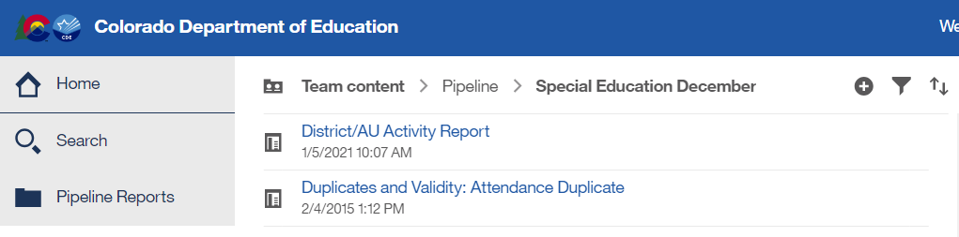
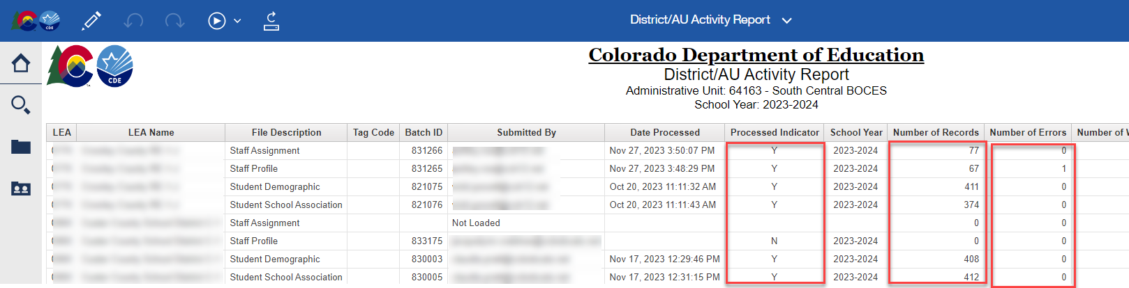
District/AU Activity Report

Slide 6
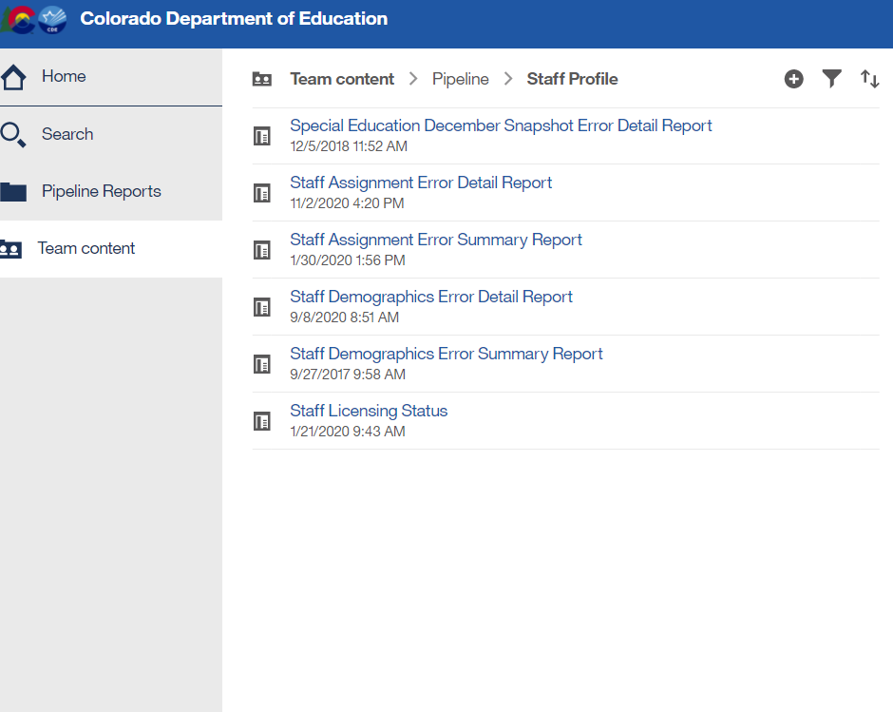

Special Education December Count – Report available for Staff Interchange User to see Dec Snapshot errors
Staff Interchange Users and Viewers are able to see their district’s December Count snapshot errors by downloading this report under:
  Cognos Reports- Staff Profile- Special Education December Snapshot Error Detail Report
Those with STF role have access to this error report

Slide 7
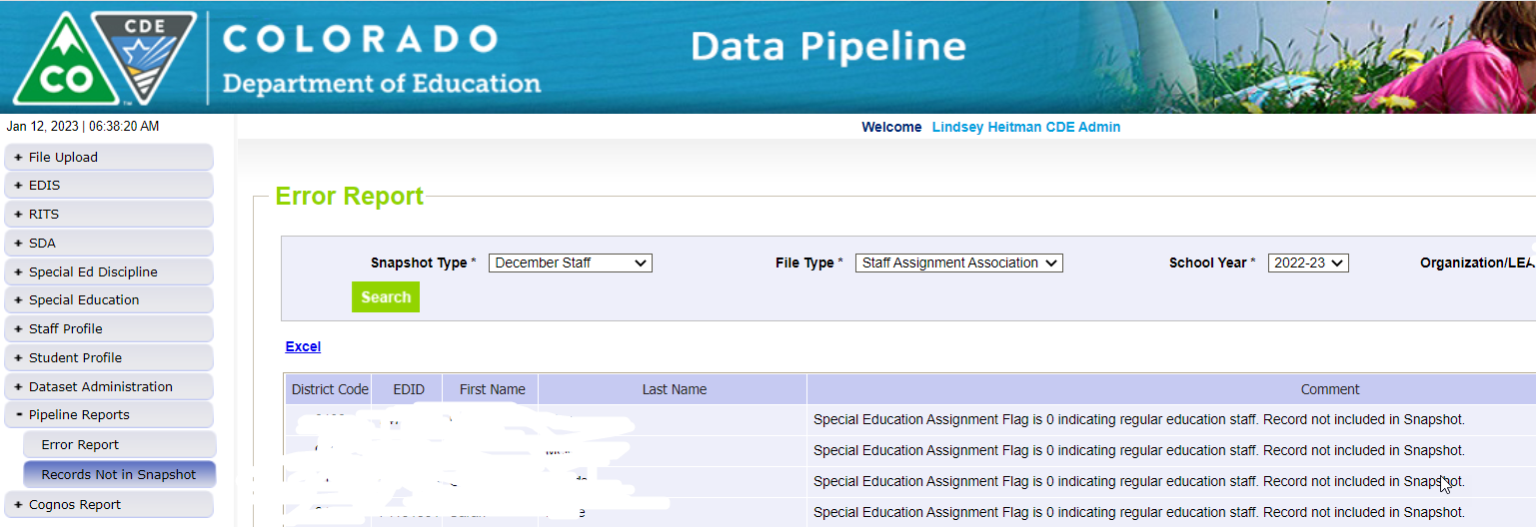
Records not found in Snapshot Report
Due to Criteria Issue
Records that are not in the Included Snapshot Records report may be located in the ‘Records Not in Snapshot’ report for December Staff or December Student
Missing records are broken out by
Student or Staff and file types for each
Pipeline Reports: Records Not in Snapshot

Slide 8
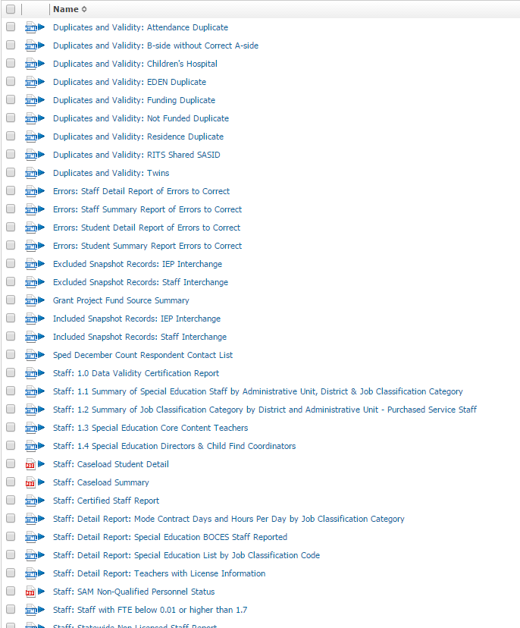
Special Education December Count Cognos Reports
-->Cognos Reports/Special Education December Count
Error Reports: Staff and Student have separate reports
Excluded Report: Includes excluded records – those w/ interchange errors
Included Report: Includes records that are included in the snapshot
*The included reports help to troubleshoot snapshot errors DC114, DC115, DC225, DC019, DC020, DC191-204
*Check for DC225 first and get it cleared before looking into snapshot errors

Slide 9


Slide 10
Special Education December Count
Contact Information
Lindsey Heitman – SpedDecCount@cde.state.co.us 303-866-5759
  Data Pipeline SPED Snapshot submission questions
  Includes Staff Interchange Sped staff questions
Orla Bolger – bolger_o@cde.state.co.us December Count Staff and Student Content Expert
Josh Fails – Fails_J@cde.state.co.us DMS Access questions
Dawna Gudka – Gudka_D@cde.state.co.us Human Resources Snapshot Submission
*Please include your AU #, District #, Error code # or cognos report name (if applicable) in emails
Resource Webpages
  Special Education IEP Interchange
  Staff Interchange
  Special Ed December Count Snapshot
  ESSU Data Management System

