Slide 1
SY 2024-25
Summer 2025
Indicator 14: Post-School Outcomes
Colorado Department of Education
Exceptional Student Services Unit
April 2025

Slide 2

Purpose
Indicator 14 data collection and reporting​
Prepare to conduct Post-School Outcomes (PSO) interviews with former students

Slide 3
Objectives
Understand the importance of gathering and using PSO data​
Understand data collection requirements​
Understand the data collection process​
Clarify how to record information and close interviews

Slide 4


What is the State Performance Plan (SPP) Annual Performance Report (APR)?
States submit various data/reports to the U.S. Dept of Education
Office of Special Education Programs (OSEP) at U.S. Dept of Education evaluates States’ special education programs
(SPP/APR) = State’s report to OSEP on how the State’s special education program is doing
  Due every February
Data (SPP/APR)
Evaluation
Notes:
All states and territories submit various data and reports to the U.S. Department of education.
We, in special education, submit data and reports to the Office of Special Education Programs (OSEP) at the U.S. Department of education.
SPP-APR is one of these reports that all states and territories must submit to OSEP. OSEP uses the SPP-APR submitted by the states to evaluate how special education programs are working in states.
The SPP-APR is due every February. The public input the CDE is collecting for the 2023-24 school year will be submitted to OSEP on Feb 1st, 2025.

Slide 5
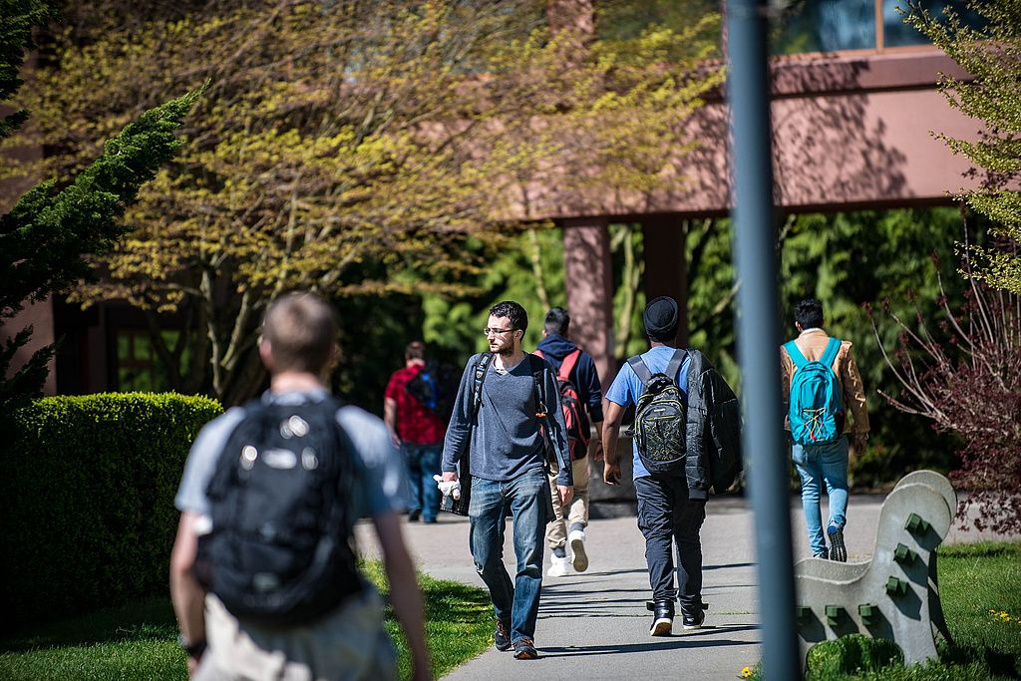

Indicator 14: Post School Outcomes
Percent of former students who are no longer in secondary school, had IEPs in effect at the time they left school, and were:
(A) Enrolled in higher education within one year of leaving high school
(B) Enrolled in higher education or competitively employed within one year of leaving high school.

Slide 6
Indicator 14: Post-School Outcomes (cont.)
Percent of former students who are no longer in secondary school, had IEPs in effect at the time they left school, and were:
(C) Enrolled in higher education or in some other postsecondary education or training program, or competitively employed or in some other employment within one year of leaving high school.
14(C) is total students engaged

Slide 7
Indicator 14 Determination and SPP/APR Measures
Measures for AU Determination and SPP/APR Targets
  Higher Education (A): Target is 24.60%
  Higher Education + Competitive Employment (B): Target is 72.15%
  Higher Education + Competitive Employment + Other Education + Other Employment (all engagement) (C): Target is 82.96%
  Contact Attempts: Goal is 100%
  AUs are expected to meet State targets and goals for full points on annual determination.

Slide 8
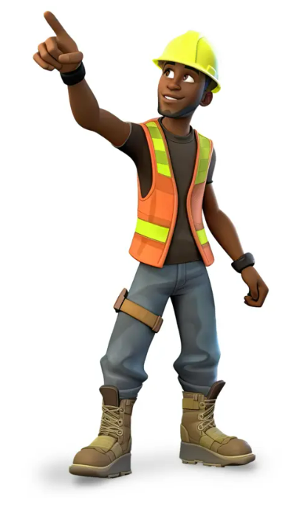
Importance of PSOs
One purpose of the Individuals with Disabilities Education Improvement Act (IDEA) 2004 is:​
“To ensure that all children with disabilities have available to them a free appropriate public education that emphasizes special education and related services designed to meet their unique needs and prepare them for further education, employment, and independent living.​”
​Youth’s post-school outcomes are one measure of how well states meet the purpose of IDEA.​

Slide 9

Importance of PSOs (Cont.)
Opportunity to evaluate whether students with disabilities who exit special education from high schools in your district had the knowledge, skills, and support for postsecondary education, training, employment, and community engagement to experience successful:​
  enrollment in postsecondary education​
  credential attainment​
  competitive integrated employment​
  community engagement

Slide 10

How is Each PSO Measure Defined?
Other Postsecondary
Education or Training
Higher Education
Competitive Employment
Other Employment
enrolled full or part-time
community college
(2-year program)
college/ university (4 or more-year program)
1 complete term
worked for pay at or above the minimum wage
setting with others who are nondisabled
20 hours a week
90 days at any time in the year since leaving high school
includes military
employment
enrolled full or
part-time
education or training program
(e.g., adult
education, vocational technical school that is less than a 2-year program)
1 complete term
worked for pay or
self-employed
90 days at any time since leaving high
school
includes working in a family business (e.g., farm, store, fishing, ranching,
catering services, etc.)

Slide 11
Student Statistics from Summer 2024
6,220 exited special education
4,003 selected for the interview sample
54 removed from sample: returned to high school, were incarcerated, or passed away
3949 adjusted sample
2,562 out of 3949 (64.88%) participated in the interview
2,562 out of 6,220 (41.19%) of ALL former students who had IEPs at the time of leaving secondary education were interviewed.

Slide 12
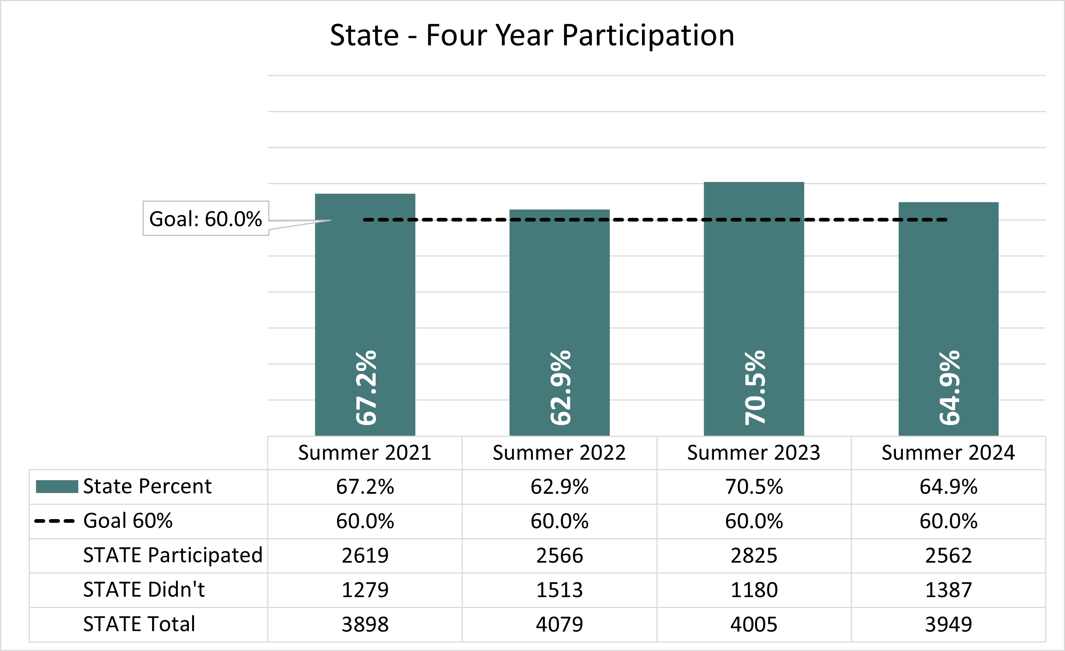
Participation Rate Trend

Slide 13
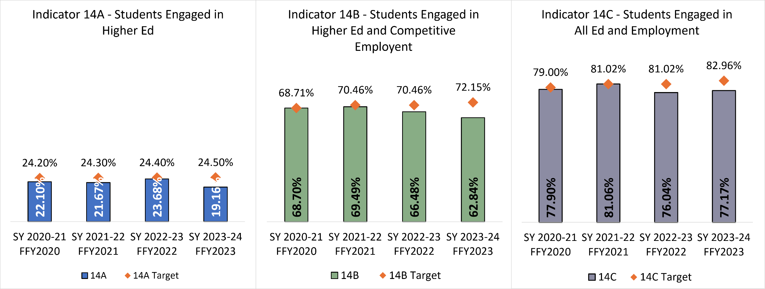
Indicator 14 Engagement Trend

Slide 14
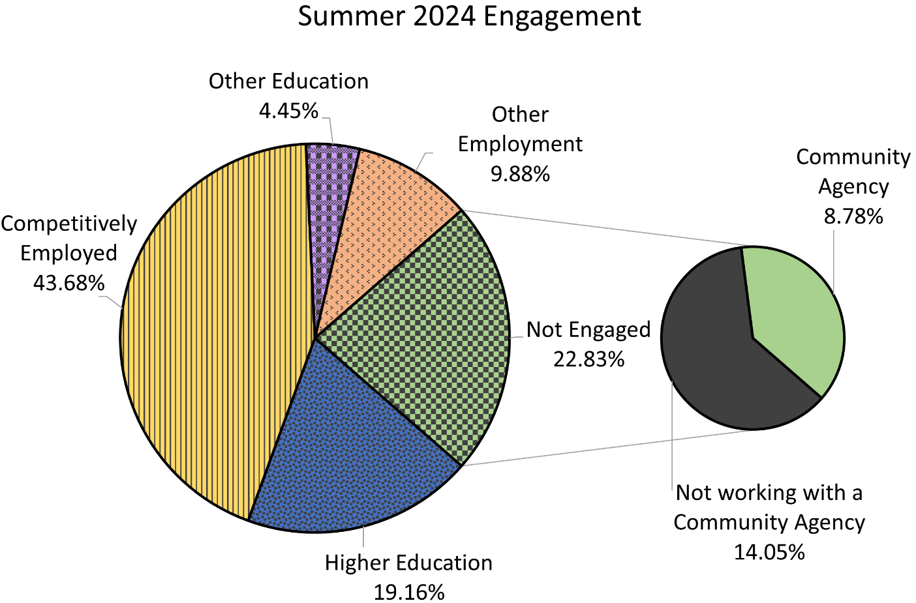
PSO Engagement from Summer 2024
Engagement Categories, Student Counts, and Percentages
Students who qualify for “working with a community agency” are considered “not engaged” according to OSEP’s definition.
Out of the 585 students reported as “Not Engaged”, 225 are “Working with a Community Agency.”

Slide 15

Source of Student Sample
Students with IEPs who left high school between during SY 23/24 (2024 SPED EOY report)​
Reached maximum age
Graduating with a regular diploma​
Discontinued School/Dropped Out
Completed non-diploma certificate
High School Equivalency Diploma

Slide 16
Student Sample Size
Student sample size is based on the number of students who were reported in the Special Education End of Year (SPED EOY) collection as exiting special education in each AU.
  Small AUs: 1 – 100 exiters (interview all students (census))
  Medium AUs: 101- 200 exiters (interview 100 students)
  Large AUs: 200 or more exiters (interview 200 students)

Slide 17

Data Collection Process
PSO data is collected in the ESSU Data Management System (DMS).
The AU director/designee will determine who has access to the DMS for conducting interviews.​
Interviews will be conducted after the student has been out of school/services (school year 2023-2024) for 12 months.

Slide 18
Data Collection Process (Cont.)
May 1, 2025: Student lists available in the DMS
June 1, 2025: Data window opens
September 30, 2025: Data Window Closes
Survey via telephone
Data is entered into the DMS
200, 100, or census of all exiters (based on # of exiters in prior year)
Interviews conducted no sooner than 12 months after exit date

Slide 19
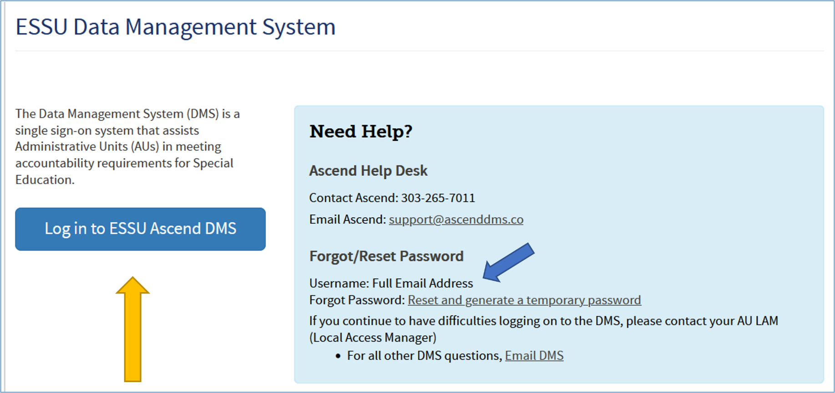
Logging in to the DMS
Sign in to DMS from https://www.cde.state.co.us/idm/essu-data using your single sign-on.
Notes:
AUs will sign in to the DMS to find the list of students whose parents were randomly selected for participation in the ESSU Data Management System.

Slide 20
Access to the Ascend DMS
If you do not have access to the DMS, contact your AU Local Access Manager (LAM).
If you forget your password, there is a “Forgot Password” reset option on the log in page.
If you get a security error message when logging in, have your IT person mark the page as safe, updates to Firewall security may block the page.

Slide 21
Access to the Ascend DMS (Cont.)
The CDE DMS application in Access Management is ASCDMS. There are 4 roles that grant access to PSO Interviews in the DMS:
  MD – For Monitoring Directors, all access.
  GDnMD – For Gifted and Monitoring Directors, all access.
  MRR – For Record Review access, includes I-14 PSO Interview access.
  MPSI – I-14 PSO Interview access
Only one role can be assigned per user. If more than one role is assigned, you may not be able to log in.
Questions about logging in or roles contact Josh Fails at
fails_j@cde.state.co.us

Slide 22
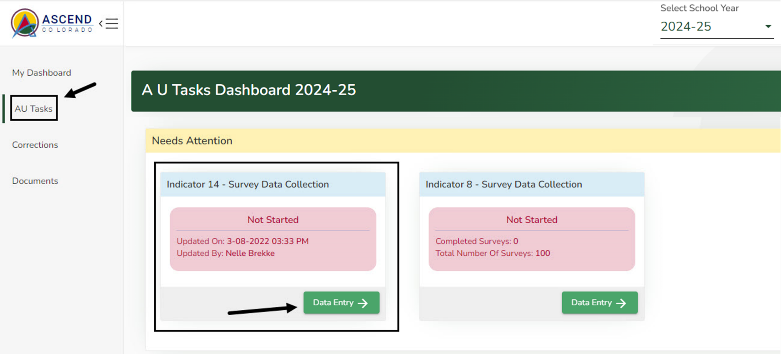
Locating the Interviews
Make sure school year shows 2024-25.
Click on “AU Tasks” on the left of the page
Click on “Data Entry” button in Indicator 14 tile

Slide 23
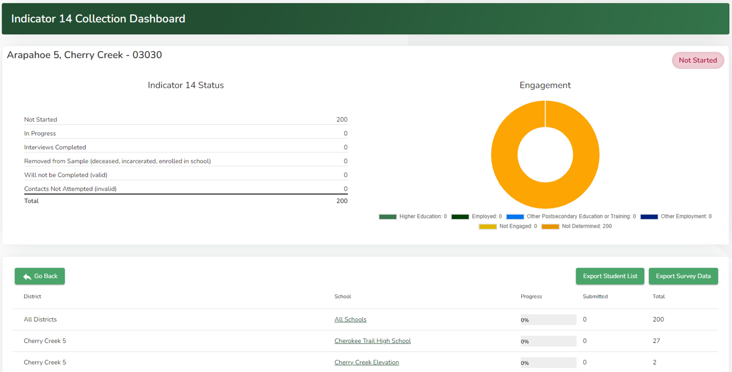
Indicator 14 Collection Dashboard
Export
Select “All Schools” or
Select by individual schools

Slide 24
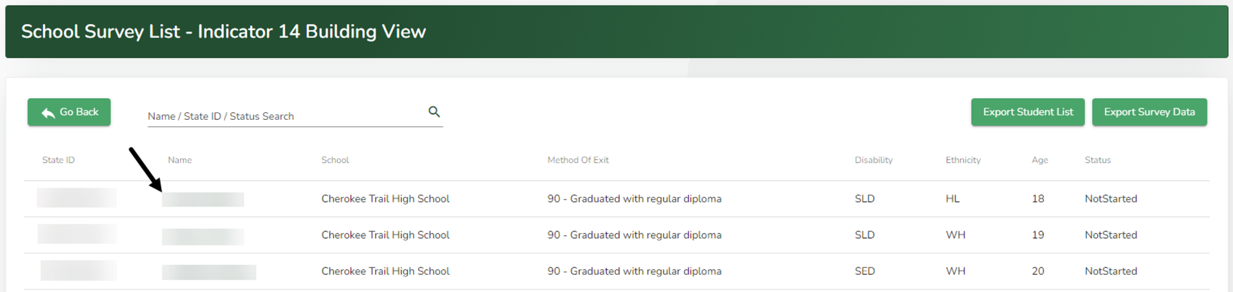
Starting your PSO Interview
After selecting “All Schools,” or an individual school, find the student you are interviewing and click their name.

Slide 25
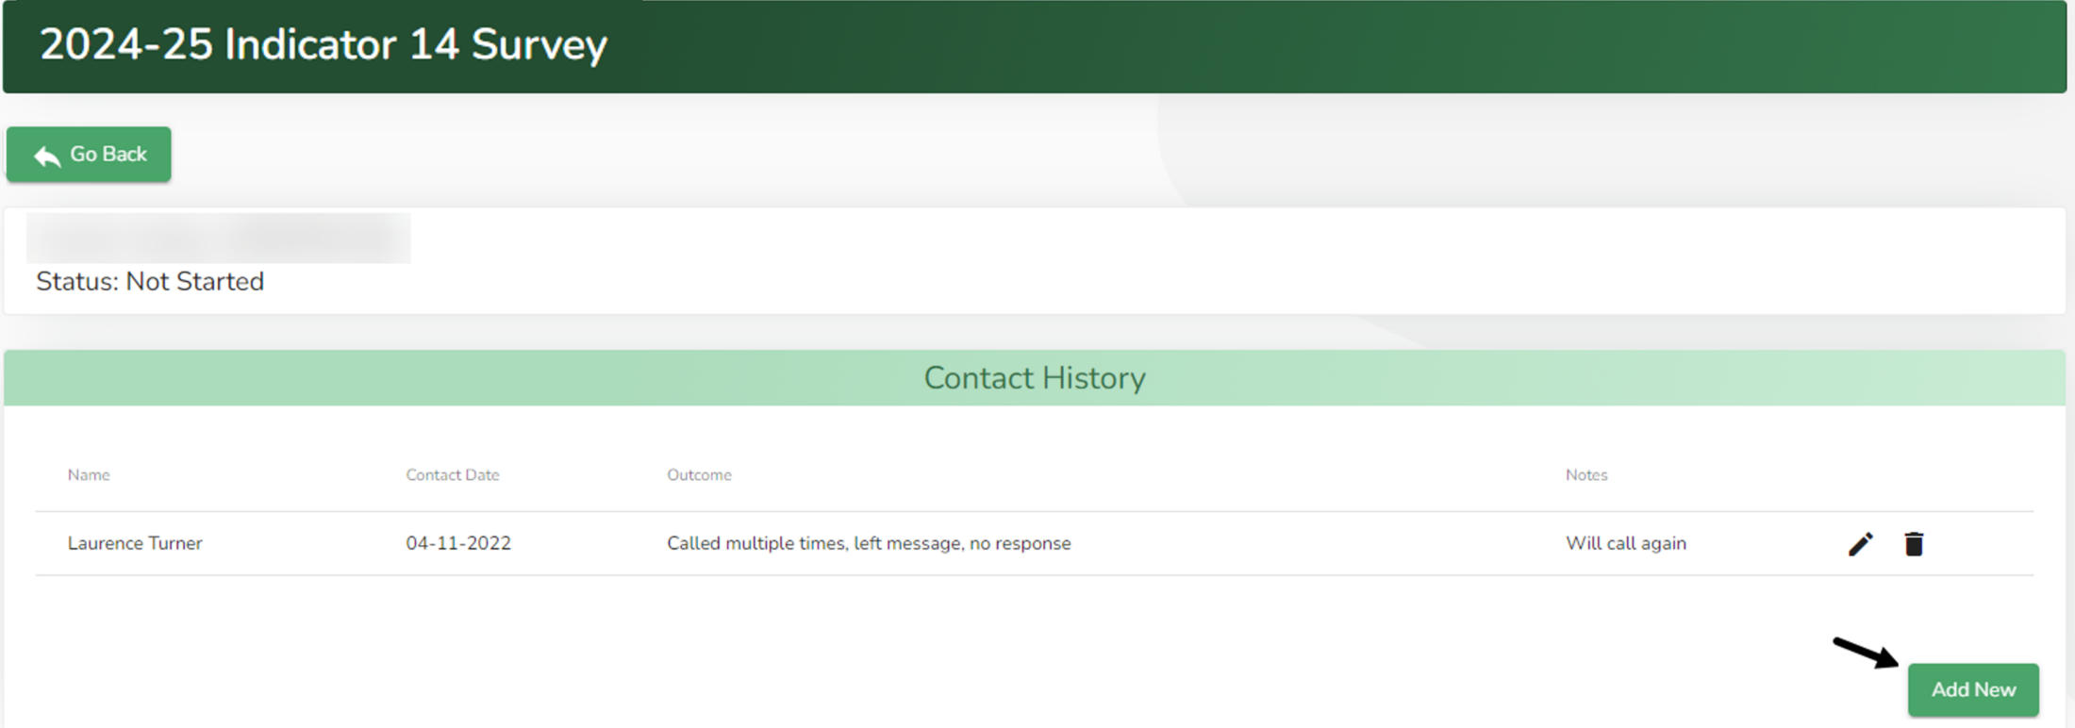
Logging Contact History
The system will automatically record a contact attempt once you select “Will Not Complete”, “Will Complete Later”, or “Submit.”
If you need to manually record a contact, select the green “Add New” button in Contact history section.

Slide 26
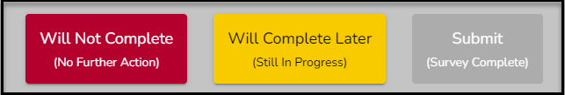
Interview Status
Reasons for “Will not Complete”
Student still enrolled in school (including 18-21 services)
Incarcerated
Deceased
Response recorded as “Removed From Sample”
Declined to be interviewed/hung up
Called multiple times but no answer/no response
Phone Disconnected – used multiple sources
Response recorded as “Will Not Complete (Valid)”
No contact information available
Contact not attempted
Response recorded as “Contacts Not Attempted (Invalid)”

Slide 27
Interview Status (Cont.)
Reasons for “Will Complete Later”
Person not available to talk (work, busy)
Wrong Contact information, obtaining new information
Left a Message
No Answer
Response Recorded as “In Progress”
Survey Complete
If the student participates and completes the interview, you will select the “Submit” button.
Response recorded as “Completed”

Slide 28
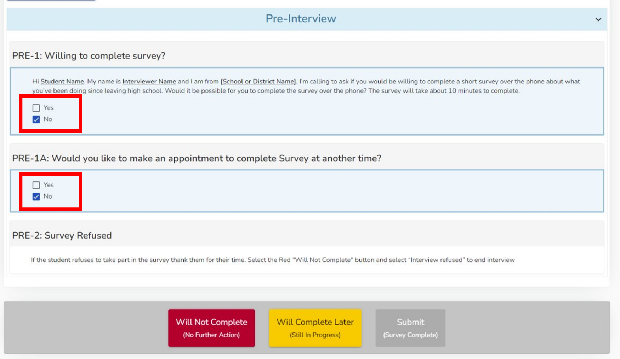
When Student Refuses the Interview
You will select “No” for your first 2 questions and you will receive a prompt.
Select the “Will Not Complete” button

Slide 29
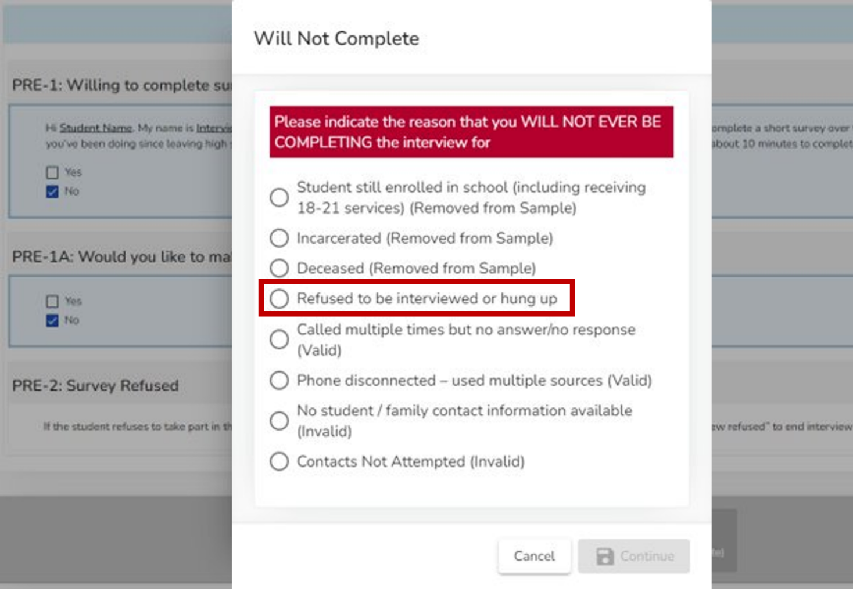
When Student Refuses the Interview (Cont.)
Select “Refused to be interviewed or hung up”
Once you hit continue, the system will return you to the school list of students. ​
This student’s status will now show as “Will Not Complete"

Slide 30
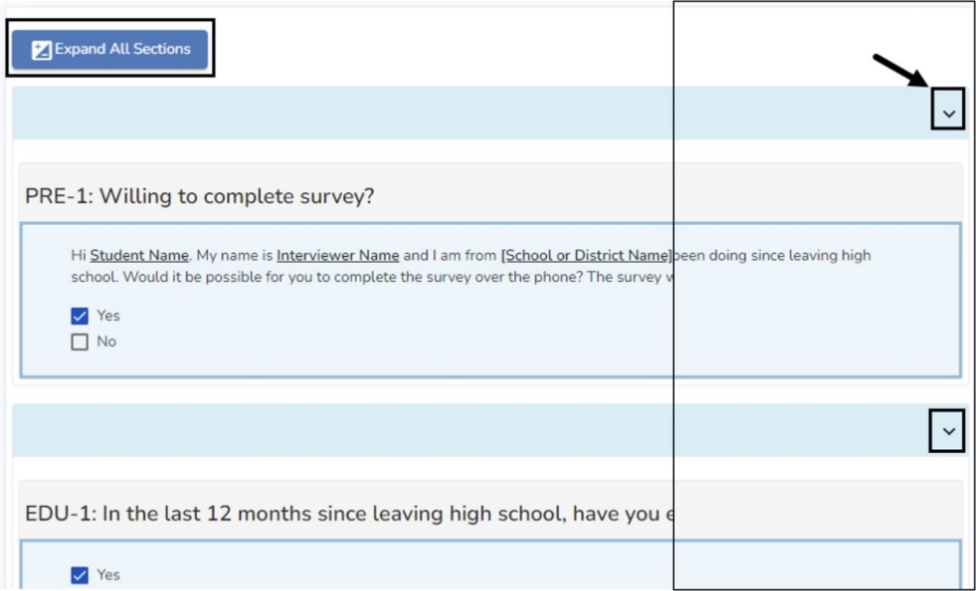
Conducting the Interview
Click Yes and the interview will open.
To expand a section and show interview questions, click the caret (down arrow) on the right side of the section, or click the “Expand All Sections” button.
Selecting certain answers will trigger additional questions when required.

Slide 31
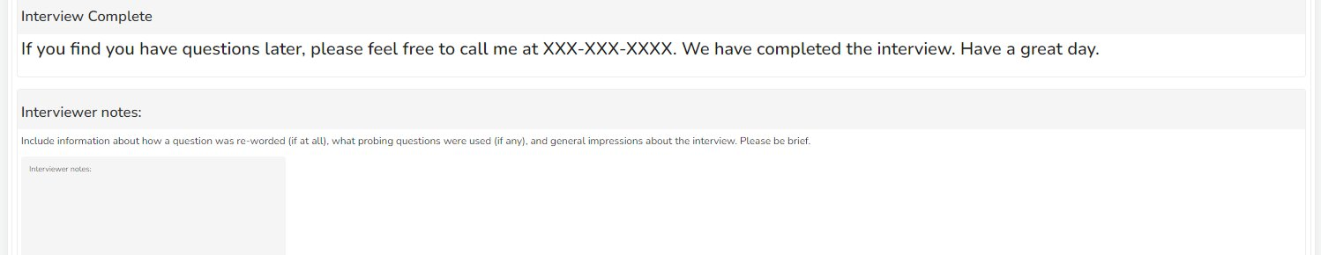
Post Interview Questions
Questions 1 through 3 require a written response prior to completing the survey​
Interviewer Notes – Answer "none" if there are no additional notes

Slide 32
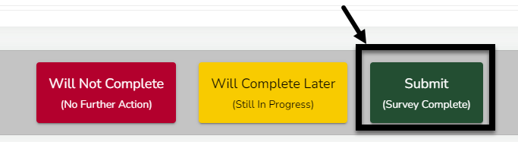
Completing an Interview
When all the interview questions have been completed, the green Submit button will become available at the bottom.
Click the green Submit button to complete and close the survey.

Slide 33
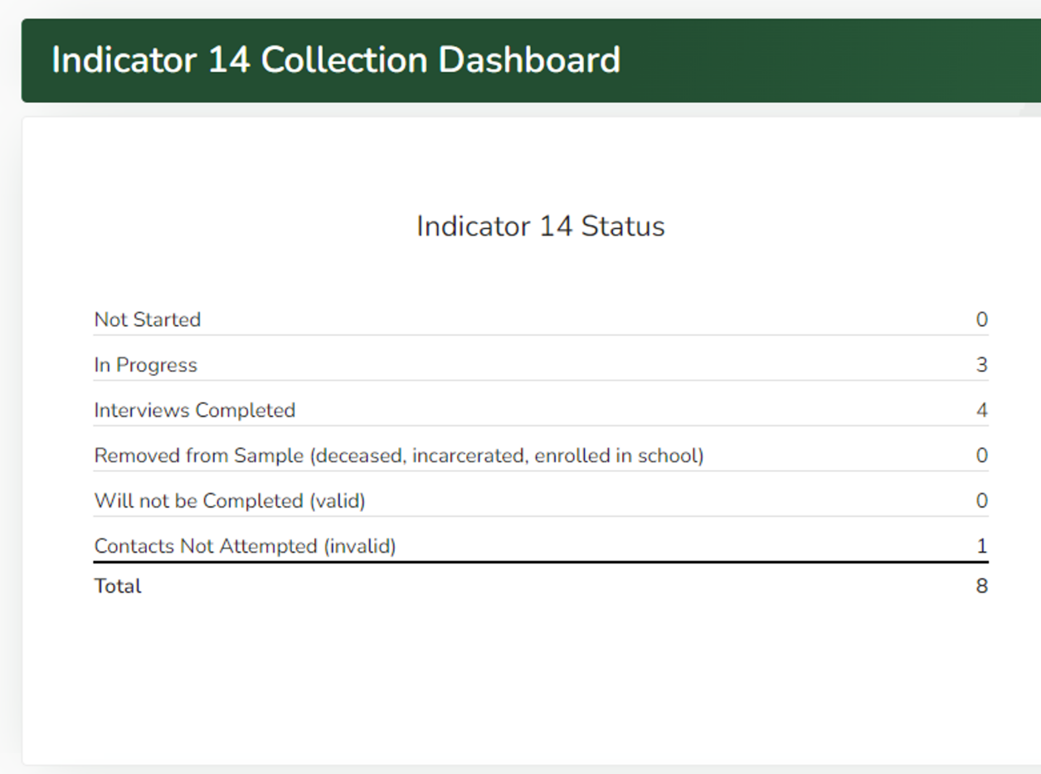
AU Tracking Mechanism
Status section on the Collection Dashboard updates in real time
Prior to submission, there should be no counts in
“Not Started” or “In Progress”

Slide 34
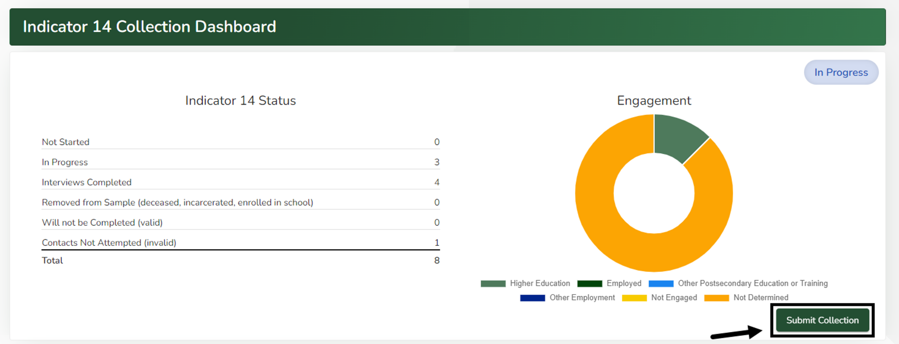
Submitting a Completed Collection
When all interviews have been completed, submit the collection to CDE for review by clicking the green “Submit Collection” button on the Indicator 14 Collection Dashboard page.

Slide 35
Unable to Submit
If you try to submit with incomplete interviews, a warning box will appear at the bottom of the page stating:
“Unable to submit collection. There are Surveys that have not been marked as Completed. Please submit all Surveys then try submitting the collection again.”

Slide 36
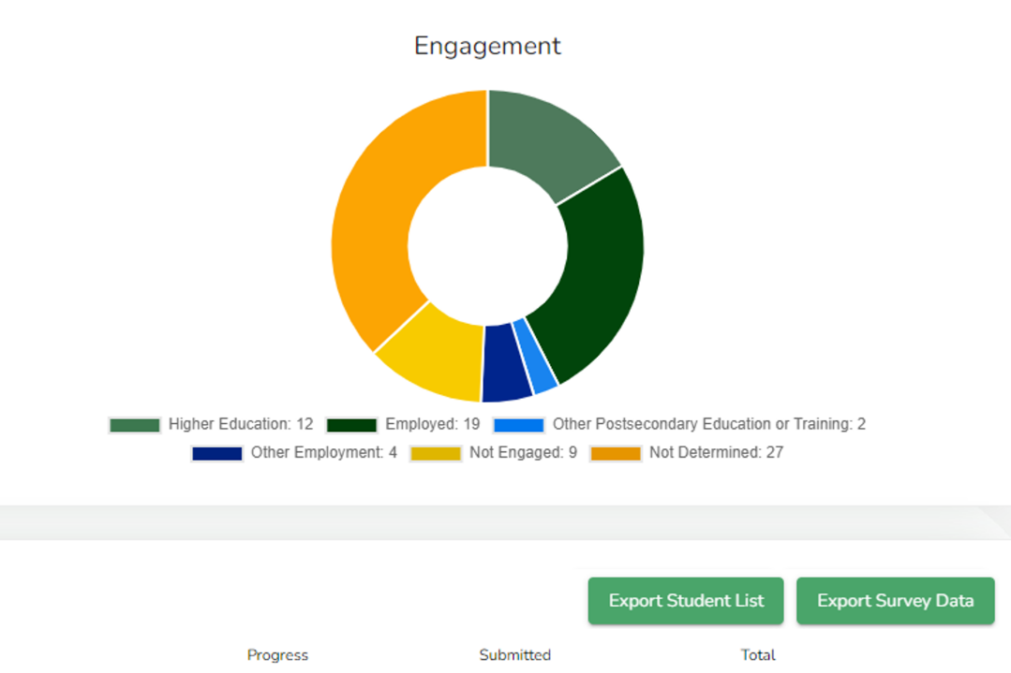
Exporting Raw Data
To export your complete survey data, click green “Export Survey Data” button on the right side of you I-14 dashboard.
Export

Slide 37

Questions?

Slide 38
Important Things to Remember…
May 1, 2025: Student lists available in the DMS
June 1, 2025: Data collection window opens (You will receive an email reminding you that the data collection window is open.)​
Data will be collected from students who exited SY 23/24, no earlier than one year ago.​
You are required to answer all questions​.
Call on different days of the week and at different times​
August 15, 2025: You will receive a progress update with a friendly reminder that the deadline is approaching.
September 30, 2025: Data collection window closes

Slide 39
Additional Resources
CDE Secondary Transition page
Timeline for PSO interview process
A link to request PSO interview postcards​
PSO sample letter in English and Spanish​
PSO sample contact form​
Current PSO survey protocol​
Glossary of terms​
National Post School Outcomes (NPSO) center “Contacting Hard-to-Find Youth​”
NPSO “Branding Your PSO Data Collection Process”
DMS Professional Learning System (PLS) Indicator 14 Help Page

Slide 40

Thank you for all you do for your students!
Thank you in advance for your time and effort in collecting accurate information during the Post-School Outcome interview process.
Your hard work is greatly appreciated!

Slide 41
Contact Information
For questions on Indicator 14 - Post School Outcomes interview process, please contact:
Kacy Little Owl
little_owl_k@cde.state.co.us
720-827-8283
For questions on the DMS, please contact:
Josh Fails
fails_j@cde.state.co.us
720-618-0538

