Slide 1
Adult Education and Workforce Development Convening Session
Monday, January 22, 2024
1:00 – 2 p.m.

Slide 2
Disclosure
The contents of this presentation were developed under grants from the U.S. Department of Education and the Colorado State Legislature. However, the contents do not necessarily represent the policies of the federal and state government, and you should not assume endorsement by either of the governmental offices.

Slide 3
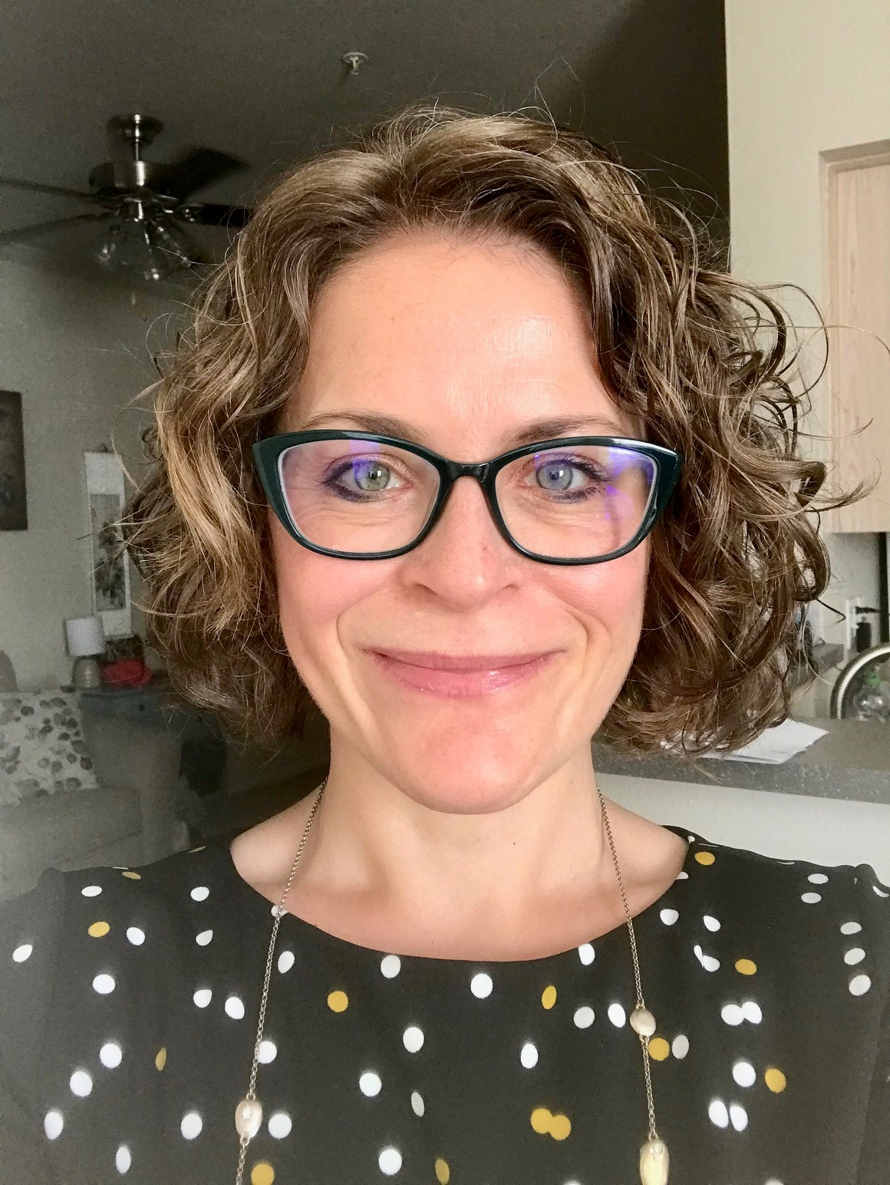
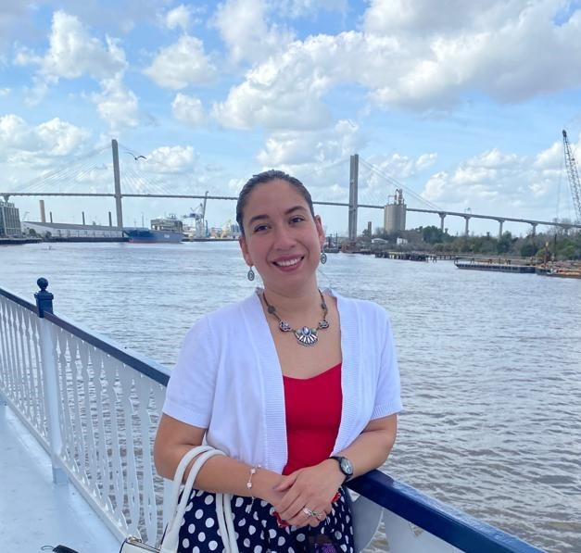
[Re] Introductions
Lacey Miller
Program Coordinator
miller_l@cde.state.co.us
Tell us about yourself!
Please turn on your mic (or comment in the chat) share your name, organization, and a project you are looking forward to this calendar year.
Glendy Calderon
Program Coordinator
calderon_g@cde.state.co.us

Slide 4
Agenda
Introductions
CRSP Overview with Dana Bustamente, Employment and Training Coordinator, CDHS
Professional Development Opportunity MPAEA/CAEPA
Next meeting dates

Slide 5

PD Opportunity
Notes:
The Mountain Plains Adult Education Association (MPAEA) and Colorado Adult Education Professional Association (CAEPA) conference is scheduled for May 6-7, 2024, at the Grand Hyatt Vail. Several Colorado adult educators will be presenting at the conference. As a courtesy, all Colorado adult educators may register for the conference at the Member Rate of $400 (early bird rate valid through February 29, 2024). Registration, a schedule and hotel information are available at the MPAEA website.

Slide 6
Preconference hosted by AEI on May 5
Full Preconference hosted that Sunday
Schedule:
  8 a.m. - 5:30 p.m. registration open
  9 a.m. - 12 p.m. morning preconference sessions
  12 p.m. - 1 p.m. lunch (included if registered for 2 half-day sessions)
  1 - 4 p.m. afternoon preconference sessions
If your organization is interested in presenting during AEI's morning or afternoon preconference sessions, please connect with any AEI staff on this call or Dr. Ally Garcia.

Slide 7
Next Convening Meetings
March 25, 2024, 1 - 2 p.m.
May meeting will be cancelled, and partners are encouraged to attend to MPAEA/CAEPA to connect live with AEI and Adult Education providers/educators from across Colorado and the surrounding states.

Slide 8
Contacts from this meeting
Amanda Brewer
Laura Anderson
Lacey Miller
Glendy Belle Calderon

Slide 9
Thank you!

