Slide 1
CDE Office Hours
February 29, 2024

Slide 2
ESSER Office Hours
Topics
Listening Segment
Title I, Part A District Level Set-Asides
Addressing Educator Shortages in Colorado: Available Opportunities

Slide 3
Listening Segment
Each Office Hours will have a listening segment, wherein we would like to hear from LEAs regarding:
Current hot topics/matters in your LEAs and in your roles
How CDE can support you with ESSA and/or ESSER implementation
What TA or guidance would be helpful for your roles
Any questions you may have

Slide 4
Updates and Reminders

Slide 5
February 29, 2024 Updates and Reminders
ARP ESSER III -
Please submit requests for funds at your earliest opportunity!
We need to assess what funds remain unspent.
All Post Award Revisions must be submitted prior to June 30, 2024.
Funds must be obligated prior to September 30, 2024…even if requesting a late liquidation.
Please email mohajeri-nelson_n@cde.state.co.us if you believe you may need a late liquidation.
ESSER Reporting -
Reminder that there will be a 2023-2024 data collection for school level allocation, re-engaging students, and participation in summer school, afterschool, ELO, tutoring, and educational technology if ESSER funds were used in 2023-2024 for these purposes. So, please track student participation.
Additionally, if ESSER funds are used for early childhood education or community schools, there is also a collection for that information.

Slide 6
Reporting Timeline
Reporting is based on the prior year! So, we have two more reporting periods after this year!!
ESSER Reporting | Spring 2024 | Spring 2025 | Spring 2026
ESSER I | 7/1/22 - 9/30/22
ESSER II | 7/1/22 - 6/30/23 | 7/1/23 - 9/30/23
ESSER III | 7/1/22 - 6/30/23 | 7/1/23 - 6/30/24 | 7/1/24 - 9/30/24

Slide 7
Title I, Part A District Level Set-Asides
Federal Programs and Supports Unit
February 29, 2024

Slide 8
Title I, Part A District Level Set-Asides Purpose
Ensure that LEAs are aware of allowable Title I, Part A set-asides
Ensure LEAs are using district level set-asides consistently and correctly
Ensure LEAs know what set-asides are required and which are optional
Consider how district level set-asides could be used to sustain activities currently funded by ESSER

Slide 9
Review Findings & Trends

Slide 10
2023-24 Consolidated Application Findings & Trends
During the 2023-24 Consolidated Application cycle, Title I specialists from the Federal Programs and Supports Unit reviewed all Title I budget lines coded to the district level or coded as a District Managed Activity. Some common trends were noted:
Inconsistent use of the Parent Involvement set-aside
Limited use of the Preschool set-aside and Family Literacy set-aside
Confusion around allowable District Managed Activities

Slide 11
Required Title I, Part A Set-Asides

Slide 12
Parent Involvement Set-Aside
Required for LEAs with a Title I, Part A allocation greater than $500,000. LEAs must budget a minimum of 1% of the LEA’s total Title I allocation to support parent involvement activities.
At least 90% of the set-aside must go to Title I schools
District may retain no more than 10% support district-level parental involvement activities
Parents must be involved in LEA’s decisions on how to use these funds
If the LEA received more than $500,000 in total Title I funds the set-aside applies to the equitable services for non-public schools as well
For more information on this use of funds visit the Elementary and Secondary Education Parent, Family and Community Engagement webpage.

Slide 13
Homeless Set-Aside
All districts must budget at least $50, and no more than 25% of their Title I, Part A allocation, for this set-aside.
Homeless set-aside should be sufficient to handle the educational needs of students identified as experiencing homelessness.
LEAs should use methods suggested by the National Center for Homeless Education to determine an appropriate amount.
Example uses for the Homeless Set-Aside (based on LEA need):
Transportation for homeless students
School supplies for homeless students
Homeless Set-Aside cannot be used for:
Cash or gift cards
Separate educational programs within school or off-site

Slide 14
Neglected Facilities Set-Aside
Allocations for districts with a neglected facility. Required set-aside amounts are published on the Office of Grants Fiscal webpage.
The use of funds must be developed in partnership with the facility school.

Slide 15
Non-Public School Set-Aside
Required set-aside if LEAs have participating non-public schools.
LEAs must conduct consultation with eligible non-public schools in a timely and meaningful manner.
A public agency (i.e. the LEA) must control funds. Private schools do not receive allocations from the SEA.
LEAs must determine the proportionate share of funds used to provide equitable services under Title I, Part A based on the entire Title I, Part A allocation prior to taking any other set-aside off the top. (Other Title Grants also have equitable services defined under Title VIII.)
LEAs must obligate the set-aside to provide equitable services to eligible students attending non-public schools in the first fiscal year in which funds are available.
Services must be secular, neutral, and non-ideological; supplemental; and costs must be allowable, necessary, and reasonable.
For information regarding carryover, visit the Equitable Services to Non-public schools webpage.

Slide 16
Optional District Level Set-Aside

Slide 17
Administration
Any activity required for administering the grant, but not working with students directly such as business services are included in this function.
Capped at 10% of Title I, Part A allocation in combination with indirect costs

Slide 18
Preschool Set-Aside
District support for school or district-based preschool activities
Support, coordinate, and integrate services provided under Title I with early childhood education programs
If supporting a district preschool program, ESEA funds may only serve children whom the LEA identifies as eligible because they are at risk of failing to meet the State’s academic achievement standards when they reach school age
Capped at 30% of Title, Part A allocation
Examples of allowable activities include:
Professional development for early childhood staff and preschool teachers
Direct intervention with students
Support for students transitioning to kindergarten
Additional guidance: Non-Regulatory Guidance Early Learning in the Every Student Succeeds Act

Slide 19
Family Literacy Set-Aside
Literacy program for families in Title I schools
capped at 30% of Title I, Part A allocation
Examples of allowable activities include:
Adult GED, EL, or parenting classes
Parent and child activities
Student activities involving literacy
Different than the Parental Involvement Set-Aside

Slide 20
Additional Support for Schools Identified for Targeted Support or Comprehensive Support and Improvement
District level set-asides can be used for financial incentives and awards for teachers who serve in Title I schools identified for Comprehensive Support and Improvement (CS) or implementing Targeted Support and Improvement (TS) plans.
Purpose must be to attract and retain qualified and effective teachers.
Capped at 5% of the LEA’s total Title I allocation.

Slide 21
Transportation for Eligible Students
Costs to provide transportation for students attending a public school identified for comprehensive support and improvement transfer to another higher-performing public school in the district.
Capped at 5% of the LEA’s total Title I, Part A allocation

Slide 22
District Managed Activities (DMA)

Slide 23
Pay Differential
The District Managed Activity (DMA) function code could be used for pay differential. Pay differential in Title I schools is used to equalize and account for the amount schools must spend on salaries and fixed charges.
Example: A Title I school is hiring several veteran teachers and several new teachers. The LEA may choose to pay an amount equal to the new teacher’s salary out of the school’s budget for each teacher and pay the difference using DMA.
If…
New teacher salary: $45,000
Veteran teacher salary: $65,000
Then…
Amount paid per teacher from school budget: $45,000
Amount paid for veteran teacher from DMA: $20,000

Slide 24
Additional Year of Title I Support
Supporting a previous Title I school for one additional year that is no longer eligible to receive Title I funds due to a change in poverty level. The LEA must allocate a per pupil amount that is the same as or lower than current Title I schools such that it falls within rank order even though the school will be marked as Not Served (NS) in the School Profile section of the Consolidated Application.
Note: If a school is eligible to be served under any method of serving, the Additional Year of Title I Support set aside is not applicable.

Slide 25
District Set-Aside for Operational Need
ESSA Section 200.77 allows for districts to support all or a subset of Title I schools by retaining funds at the district level to conduct other authorized Title I activities not referenced above. However, the district must consider the following guiding questions when determining if the funds should be allocated to the school or retained at the district level…
Guiding questions on next slide

Slide 26
Guiding Questions for District Set-Asides
Guiding Questions for Allowability: If the district can respond positively or has evidence to support responses to the following questions, the activity is likely allowable.
Is this an allowable activity under Title I, Part A?
Does this activity address the support needed for students most at risk of not meeting state standards?
Is this strategy or activity addressing a need identified in the LEA's Comprehensive Needs Assessment and what data does the LEA have to demonstrate that need?
Is there an operational need for maintaining the funds at the district level?
Consider and explain how the funds retained at the district level are addressing Title I schools equitably (i.e. whether all schools identified for CS, TS, and ATS are served comparably).
Has the LEA considered whether the remaining allocation for schools are sufficient to support student achievement in a meaningful way (i.e. the amount by which per pupil allocations (PPA) may be increased at the school level if the set-aside did not exceed the limitation, how rank order would be affected).
What is the justification, added benefit(s) of, or reason(s) for retaining funds at the district level?
Does retaining funds at the district level increase the cost effectiveness of an activity (i.e., pooling resources to serve multiple schools)?
Do the district level activities meet at a minimum level 4 criteria (i.e., promising practices) of the ESSA tiers for evidence-based interventions?

Slide 27
District Managed Activity Waiver
Colorado caps the District Managed Activity Set-Aside at 20% of the LEA’s Title I allocation. A waiver is required for DMA set-asides that exceed 20%
Complete the DMA waiver here

Slide 28
Rank Order Considerations
LEAs may not use district level set-asides as a means to avoid serving schools at the school level or as a means to circumvent rank order requirements.
Learn more about rank order requirements here.

Slide 29
Sustaining ESSER Activities
Things to consider:
Is the need currently being addressed through ESSER-funded activities an ongoing need? In other words, the LEA CNA data continues to demonstrate an ongoing need for the activity(ies).
What’s most important to preserve? What initiatives were most effective?
Are there any effective/successful district level activities that your district is currently funding with ESSER that could be sustained using a Title I set-aside?

Slide 30
Questions?

Slide 31
Addressing Educator Shortages in Colorado: Available Opportunities

Slide 32
Addressing Educator Shortages in Colorado: Available Opportunities
February 29, 2024
Travis Garoutte, Educator Workforce Development Manager, Educator Talent
Rachel Echsner, ESEA Title I & II Specialist
Sue Miller-Curley, ESEA Title II Monitoring Specialist
Nazie Mohajeri-Nelson, Executive Director, Federal Programs

Slide 33
Addressing Educator Shortages in Colorado: Available Opportunities Purpose
Share existing CDE supports, trainings, and other offerings to address educator recruitment and retention.
Consider how to use federal funds in order to meet LEA needs in educator recruitment and retention.

Slide 34
Why do teachers choose to stay in the profession?

Slide 35
“What actions support effective recruitment and retention?”
Podolsky, A., Kini, T., Bishop, J., & Darling-Hammond, L. (2016). Solving the Teacher Shortage: How to Attract and Retain Excellent Educators. Palo Alto, CA: Learning Policy Institute.
Recruitment and Retention
Improve teacher preparation and reduce costs to enter the profession.
Strengthen hiring practices and personnel management.
Provide quality mentoring and induction.
Improve teachers’ working conditions.
Increase teacher compensation.

Slide 36
Educator Recruitment and Retention Office

Slide 37
Educator Recruitment and Retention (ERR) Office
The Educator Recruitment and Retention office was formed in response to SB21-185, which directs CDE to provide support for school districts, BOCES, and charter schools around educator recruitment and retention.

Slide 38
ERR Team Tenets
Purposeful articulation of pathways to licensure
Thoughtful connection of people to resources
Meaningful relationships that value the unique circumstance of all stakeholders
Creative problem solving in the moment and system planning for the long term

Slide 39
Current Authorization Details
Credential Type | BA required | Experience required | Enrollment in an EPP req’d | Length of issuance | District-specific | Renewable | Grant money available | Available for special education
Adjunct authorization | BA or 5 years exp. | BA or 5 years exp. | NO | 3 years | YES | YES | NO | NO
1-year sub authorization | NO | NO | NO | 1 year | NO | YES | YES | N/A
3-year sub authorization | YES | NO | NO | 3 years | NO | YES | YES | N/A
Emergency authorization | YES | NO | YES *or fulfilling prep requirements | Up to one year | YES | Once | NO | NO
TEE authorization | YES | NO | YES | 1 year | YES | Up to twice | YES | YES
TOR license | NO | NO | YES | 2 years | YES | Once due to unforeseen circums. | NO | NO
Alternative teacher license | YES | NO | YES | 1, 2, or 3 years | YES | YES | YES | YES

Slide 40
Current Authorization Details (cont.)
Credential Type | BA required | Experience required | Enrollment in an EPP req’d | Length of issuance | District-specific | Renewable | Grant money available | Available for special education
CTE authorization | Depends | YES | NO | 3 years | NO | No, must be advanced | NO | NO
Interim authorization | YES | NO | YES | 1 year | NO | Once | NO | YES
Interim authorization/alt | YES | NO | YES | 1 year | YES | Once | YES | YES
Alternative principal authorization | YES | 3 years’ teaching experience | YES | 3 years | YES | NO | NO | NO
SSPs: RNs, OTs, PTs and O&M specialists must meet full licensure requirements
All other SSPs may qualify for a TEE to finish coursework or meet an exam requirement

Slide 41
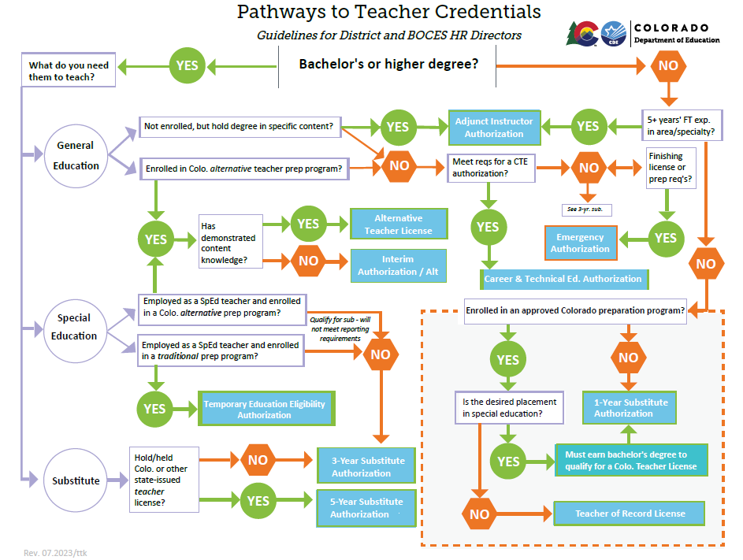
Pathways to Teacher Credentials

Slide 42
Educator Recruitment- Grow Your Own
Get kids/community excited about the teaching profession
Invitation to education
HS students/community assist in classrooms
Concurrent enrollment
Teacher Recruitment Education and Preparation (TREP)
Career Advance Colorado
Paraprofessional to teacher pipelines/funding
How does a person in Colorado pay for college to become a teacher?

Slide 43
Educator Licensing for Rural Educators
Alternative Licensure for candidates with bachelor’s degrees
Western Colorado University Adult Degree Completion
CU Denver Paraprofessional to Teacher Advancement Pathway
Coming Soon!: Teacher Apprenticeship Program

Slide 44
Educator Recruitment and Retention Program
The Educator Recruitment and Retention (ERR) program was created by SB21-185 to provide qualified program applicants with up to $10,000 in one-time financial assistance toward their educator preparation program costs. Recipients must commit to teaching in a shortage area for three years in a Colorado public school. Educators who are enrolled in a Colorado-approved educator preparation program (EPP) and employed as an alternative teacher, Temporary Educator Eligibility (TEE) authorization holder, paraprofessional, or CTE instructor are eligible to apply.

Slide 45
Financial Opportunities for Aspiring and In-service Educators
Financial Opportunities for Aspiring and In-service Educators

Slide 46
Educator Development - Principal Leadership Institute (PLI)
2022-2023
Distributive Leadership
20 Principal Coaches, 20 Principal Coachees
2023-2024
Distributive Leadership, Science of Reading, New Principal
20 Principal Coaches, 20 Principal Coachees
20 Additional Principal Coaches Trained
2024-2025
40 Principal Coaches and 40 Principal Coachees
Look for PLI registration March 2024!

Slide 47
Educator Development - Induction
Induction Handbook 2023
Induction Rubrics Revised 2023
Webinars: Induction Rubric Launch and Program Assessment
PLCs: Five Meetings Per Year Average Attendance of 30
Gatherings: Grown From 25 to 40 (Public, Private, Charter)
Individualized Coaching and Support

Slide 48
Educator Development - Mentoring
Colorado Teacher Mentor Grant
8 Mentoring PLCs Throughout the Year
Individualized Coaching and Support
Free Mentor Teacher Academy

Slide 49
Educator Recruitment: Tell Your Story
Video Newsletters, Podcasts, Blogs
Community
Staff
Social Media Campaign
Website
Teach In Colonial Website

Slide 50
Questions to Consider
Is your school/district telling its story or letting someone else tell it?
Is your school/district actively recruiting students and community members year round?
Does your school/district invest in all educators through comprehensive onboarding, induction and mentoring throughout the critical years?
Does your school/district invest in the development of principals and supervisors of principals?

Slide 51
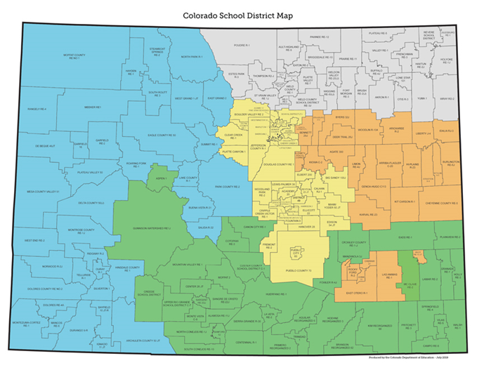
CDE’s Educator Recruitment & Retention Team
Region | Regional Specialist
West | Derrick Martin martin_d@cde.state.co.us 720-456-9199
South | Travis Garoutte garoutte_t@cde.state.co.us 303-905-2814
Eastern Central | Ella Padilla padilla_e@cde.state.co.us 720-470-4824
Northeast | Mary Miner miner_m@cde.state.co.us 303-656-3253
Central | Heather Grantham grantham_h@cde.state.co.us 720-387-0769
NORTHEAST
EASTERN
CENTRAL
WEST
CENTRAL
SOUTH

Slide 52
Educator Recruitment and Retention
Using Federal Funds

Slide 53
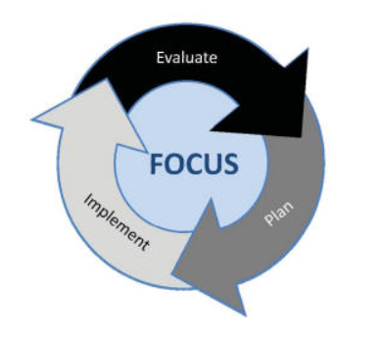
Planning Cycle for Federal Funds
Conduct CNA and identify local needs
Monitor implementation and effectiveness of programming
Consider potential evidence-based strategies to address needs
Presentation on the planning cycle for federal funds can be found here.
Adjust implementation based on actual data
Implement plan to address needs
Use guiding questions to determine allowability and appropriate funding source
Finalize Plan

Slide 54
Funding Educator Opportunities with ESSA
Considering your LEA’s needs, ESSA funds can be used to address the following:
Title I: Improving The Academic Achievement of The Disadvantaged
Title II: Preparing, Training, and Recruiting High-Quality Teacher, Principals, or Other School Leaders
Title III: Language Instruction For English Learners And Immigrant Students
Title IV: 21st Century Schools
Title V: Small Rural Districts

Slide 55
Title I, Part A District Set-Aside
Title I, Part A district level set-aside for financial incentives can be used for financial incentives and awards for teachers who serve in Title I schools identified for Comprehensive Support and Improvement (CS) or implementing Targeted Support and Improvement (TS) plans for the purpose of attracting and retaining qualified and effective teachers in an amount that does not exceed 5% of the LEA’s total Title I allocation.

Slide 56
Supplement, Not Supplant
Federal funds must be used to supplement, not supplant non-Federal funds that would otherwise be used for activities allowed under each ESEA subpart.
Examples:
Title I funds could be used to hire an additional teacher to meet class size reduction needs, but cannot be used for every teacher’s base salary.
Title II might be used for additional mentorship time for new teachers, but cannot be used for costs incurred by the district’s required induction activities.
Title III could be used to hire a new teaching assistant to provide additional support to English Learner/Multilingual Learners, but cannot pay for the the EL/ML teacher’s salary.
Title IV might be used to hire a new counselor, but cannot be used to pay a counselor’s salary that was previously paid by the general fund for the same duties.

Slide 57
Funding Considerations
ESSER Sustainability
Consider:
What are ongoing needs, as determined by the LEA Comprehensive Needs Assessment (CNA), that are currently or were previously ESSER funded?
What’s most important to preserve?
What funding sources can you use to continue some of the investments that you’ve made?
What other funding streams have you used in the past? Did you use state and local funds before ESSER?
Braiding funds allows LEAs to pool multiple funding streams for the purpose of supporting at-risk students.
Funding Matrix
See the January 24, 2024 BruMan Training on SNS and other ESEA provisions to consider when transitioning activities off of ESSER. For password, email Emily Owen from your LEA email address.

Slide 58
Breakout Session (10 minutes)
Break out groups
Recruitment and Retention Opportunities (Travis + Sue)
Planning Federal Funds for Recruitment and Retention (Rachel)
ESSER Sustainability (Nazie)
Feedback Survey: Please complete thanks!

Slide 59
Contacts
Educator Talent:
Travis Garoutte, Educator Workforce Development Manager garoutte_t@cde.state.co.us
Federal Programs and Supports:
Nazie Mohajeri-Nelson, Executive Director mohajeri-nelson_n@cde.state.co.us
Rachel Echsner, Title I & II Specialist echsner_r@cde.state.co.us
Sue Miller-Curley, Title II Specialist miller-curley_s@cde.state.co.us
Notes:
Sue

Slide 60
Thanks!

Slide 61
Upcoming Meetings
Notes:
Nazie

Slide 62
Looking Ahead…
Any requests for topics or questions?
Upcoming Office Hours:
March 14
Spring Work Session Opportunities
Title IV Allowable Uses
CCNetwork: The Grid
Targeted Assistance vs Schoolwide

Slide 63
CDE Contacts!
Emails: Lastname_Firstinitial@cde.state.co.us (e.g., Smith_a@cde.state.co.us)
Federal Programs & Supports (ESEA/ESSER Program Supports) | School Finance & Operations (Fiscal and Systems Supports)
Nazie Mohajeri-Nelson, Executive Director of Federal Programs & Supports Unit Program Specialists Program Implementation Supervisor: Laura Meushaw Program Implementation Coordinator: Christina Adeboye Sullivan Program Monitoring Supervisor: Tammy Giessinger ESEA/ESSER Monitoring Coordinator: Kristin Crumley Program Effectiveness Supervisor: Tina Negley Program Evaluation & Research Coordinator: Mary Shen ESEA Programs Specialists and ESEA Regional Contacts (assigned by district) Title I: Laura Meushaw, Evita Byrd, Rachel Echsner, Kim Boylan Title II: Rachel Echsner, Sue Miller-Curley Title III: Rachel Temple, Kim Boylan Title IV & Stronger Connections Grant: Nathan Hickman, Evita Byrd Title V: Christina Adeboye-Sullivan, Rachel Echsner ESSER Program Specialists Jonathan Schelke Kim Boylan Kriselda Craven Nadine Penn ESEA and ESSER Data and Reporting Specialists Mackenzie Owens (ESSER) Melissa Chaffin (ESEA) Jerry Ring (ESEA) | Amy Carman, Executive Director of School District Operations Unit Fiscal Specialists Jennifer Austin, Director of Grants Fiscal Management ESEA Robert Hawkins, Grants Fiscal Analyst Steven Kaleda, Grants Fiscal Analyst ESSER Fiscal Specialist Steven Kaleda Grants Fiscal Analyst ESSER Monitoring Hilery Morris, ESSER Fiscal Monitoring Kristina Jones, Federal Fiscal Monitoring and Reporting Specialist Werner Hagemann, ESSER Fiscal Monitoring Specialist Application Systems Specialists DeLilah Collins, Director of Grants Program Administration Online Applications Systems Technical Support Michelle Prael

